Slide 1

2 Detectron2 Model
Peter H. Chen

Slide 2
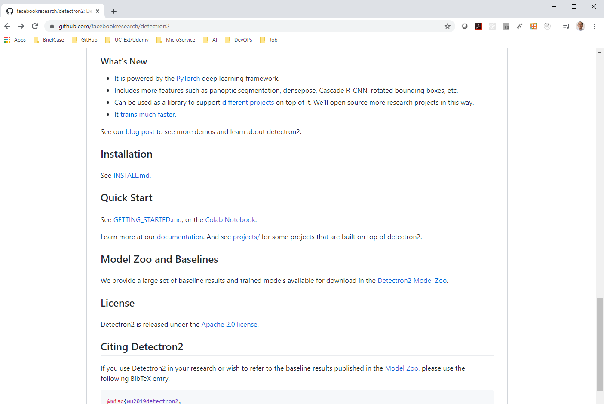
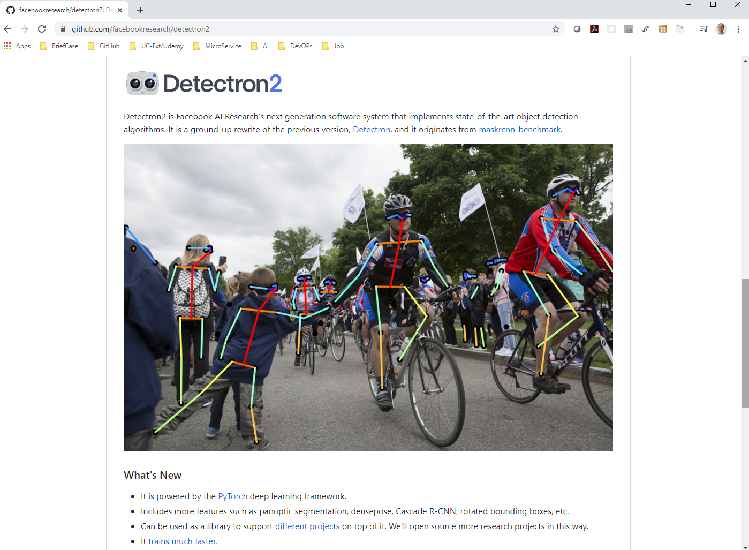
2 Detectron2 Model
https://github.com/facebookresearch/detectron2/blob/master/MODEL_ZOO.md
Detectron2 is powered by PyTorch Deep Learning Framework.
It includes features, object detection, segmentation, pose estimation of people, and etc.
It can be used as a library to support different objects on top of it.

Slide 3
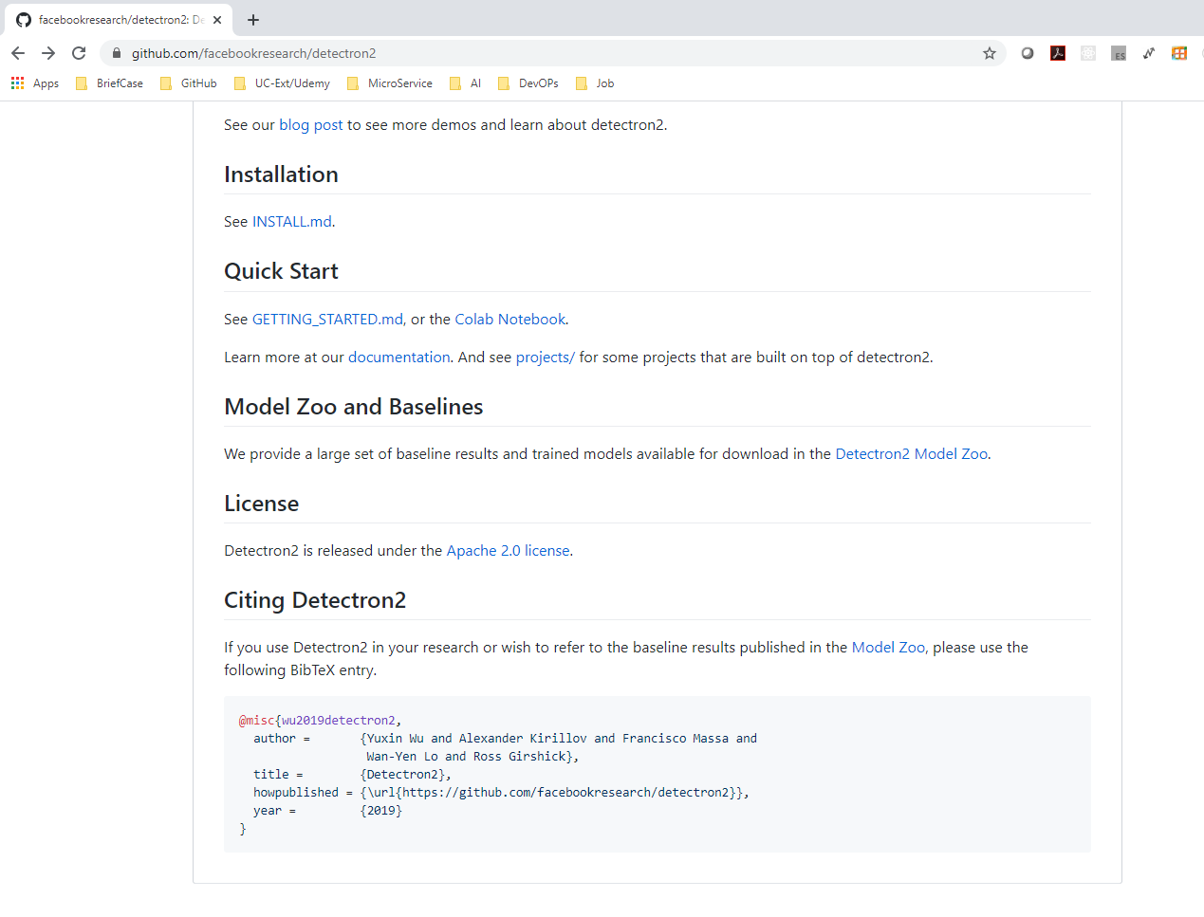
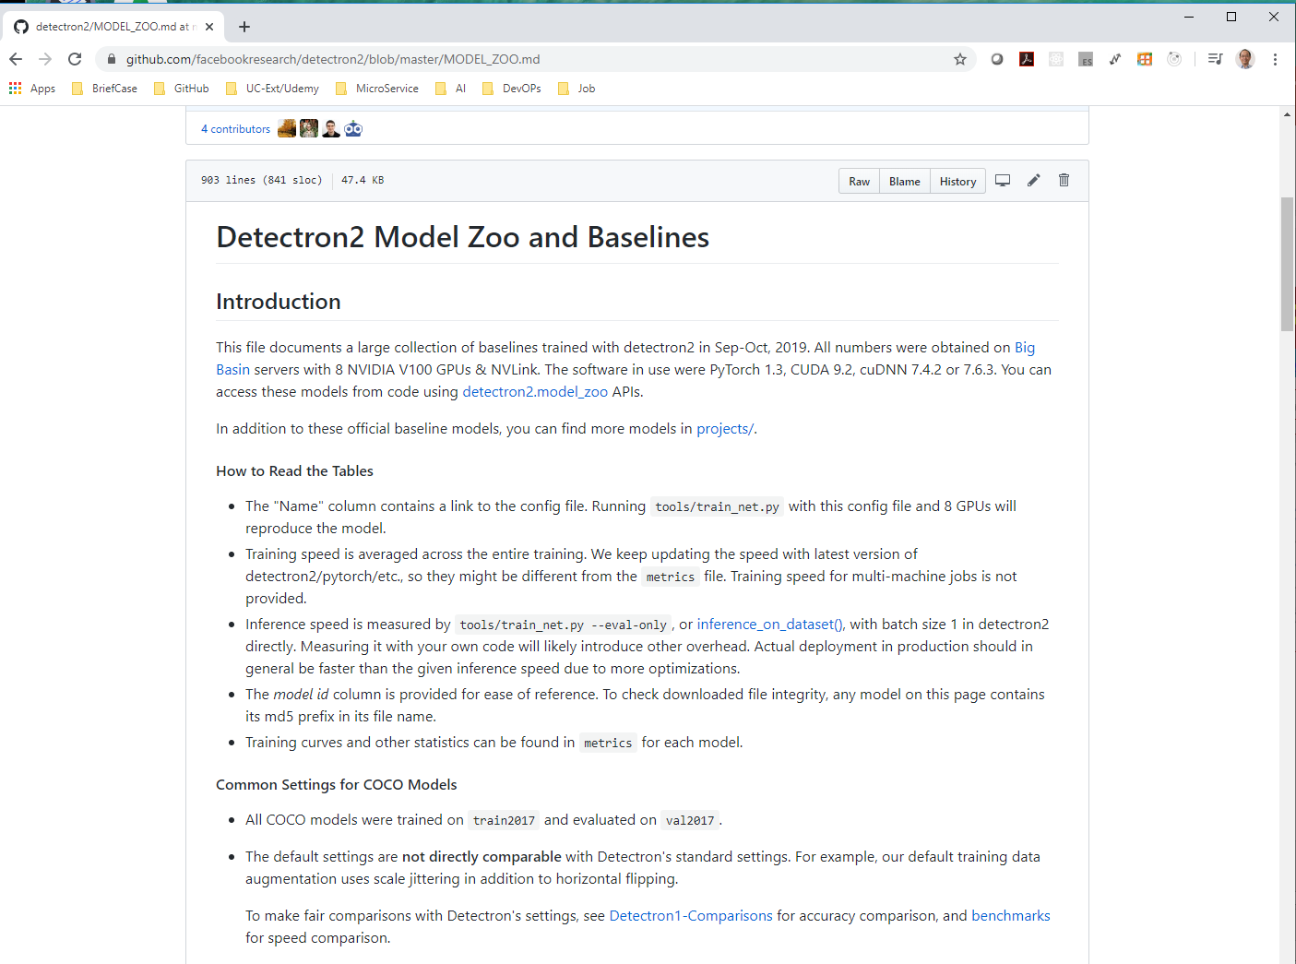
2 Detectron2 Model
https://github.com/facebookresearch/detectron2/blob/master/MODEL_ZOO.md
Detectron2 has a lot of pre-trained model called Model Zoo.

Slide 4
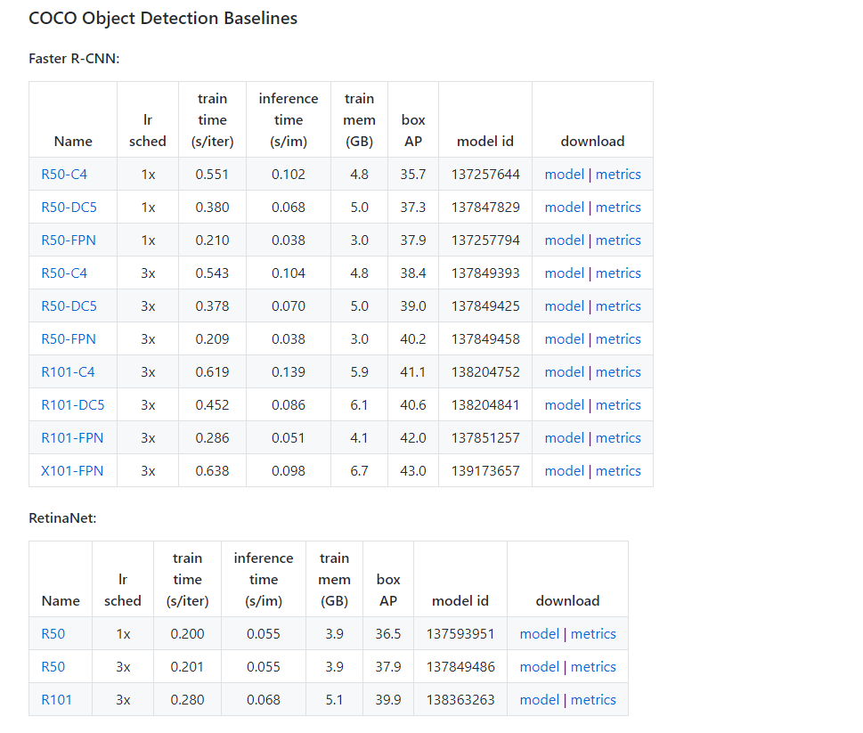
2 Detectron2 Model
https://github.com/facebookresearch/detectron2/blob/master/MODEL_ZOO.md
The baseline models and as you can they are models based on the COCO Object Detection.

Slide 5
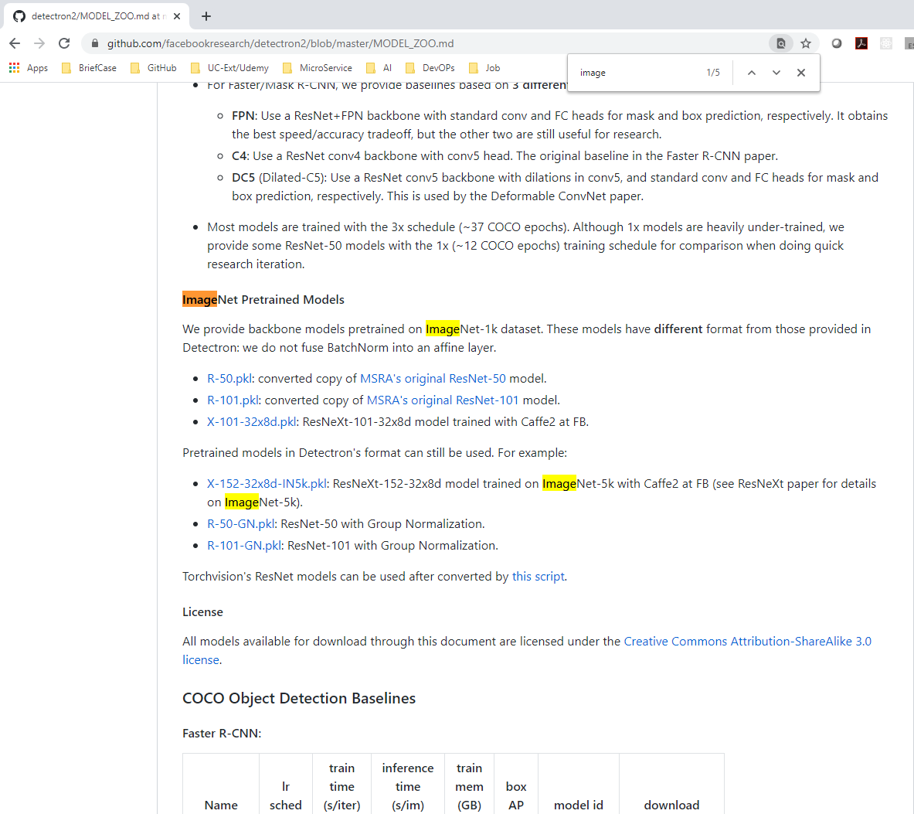
2 Detectron2 Model
https://github.com/facebookresearch/detectron2/blob/master/MODEL_ZOO.md
Dataset trained on ImageNet Pretrained Models.

Slide 6
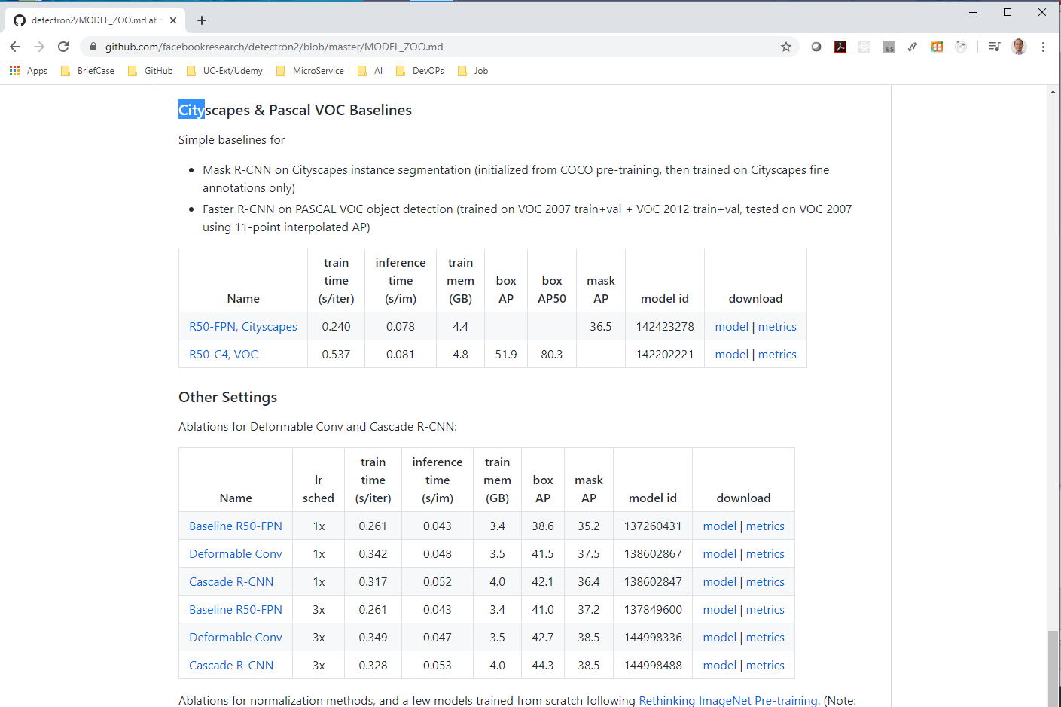
2 Detectron2 Model
https://github.com/facebookresearch/detectron2/blob/master/MODEL_ZOO.md
Some models are based on the CityScapes.

Slide 7
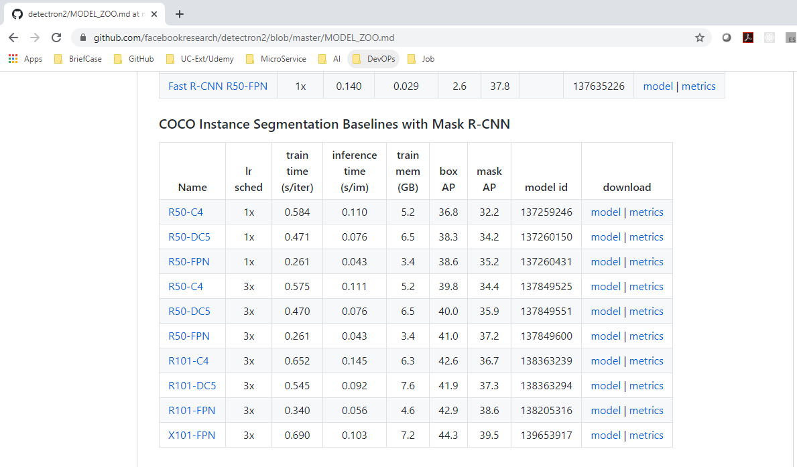
2 Detectron2 Model
https://github.com/facebookresearch/detectron2/blob/master/MODEL_ZOO.md
We will use COCO Instances Segmentation: X101-FPN.

Slide 8
End of Chapter

