Slide 1

3 Dataset
Peter H. Chen

Slide 2
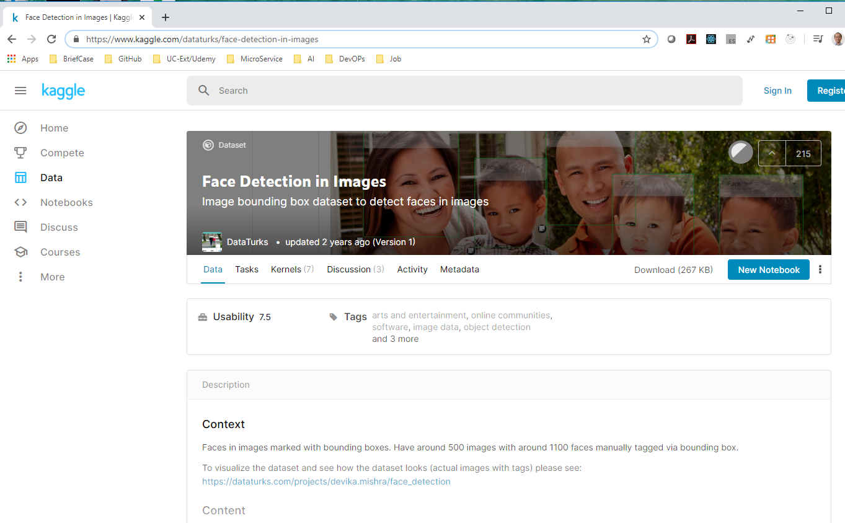
3 Dataset
https://www.kaggle.com/dataturks/face-detection-in-images
Dataset for Face Detection in Images:
Next, we look at dataset at kaggle.com/dataturks/face-detection-in-images.

Slide 3
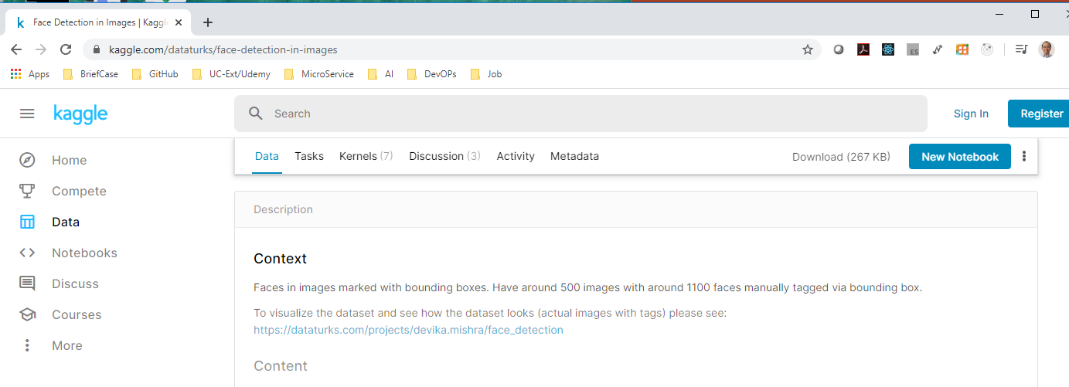
3 Dataset
https://www.kaggle.com/dataturks/face-detection-in-images
The kaggle.com/dataturks/face-detection-in-images dataset provides the dataset.
It is very old data set and has about 500 images. Very small dataset.
Those images we have around 1,100 faces.
We will have the bounding box around the human faces.

Slide 4
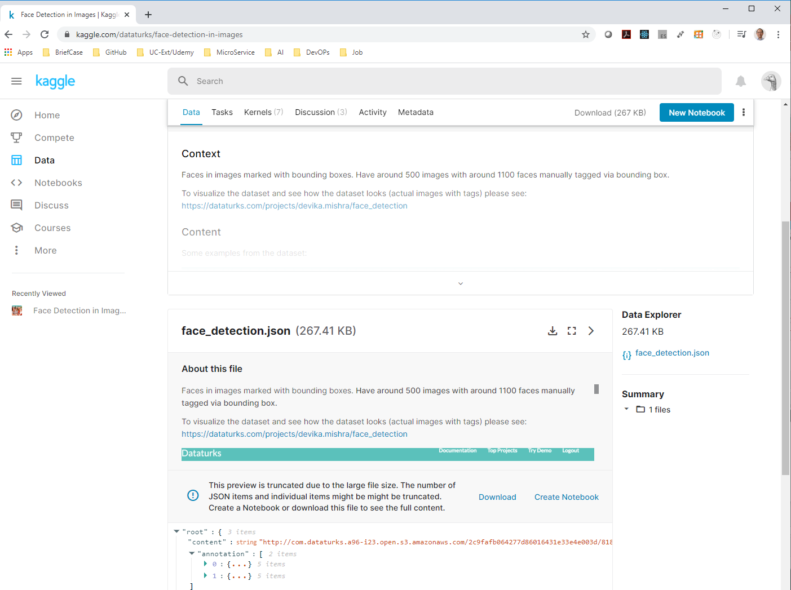
3 Dataset
https://www.kaggle.com/dataturks/face-detection-in-images
Click link to go inside the dataturks/face-detection-in-images

Slide 5
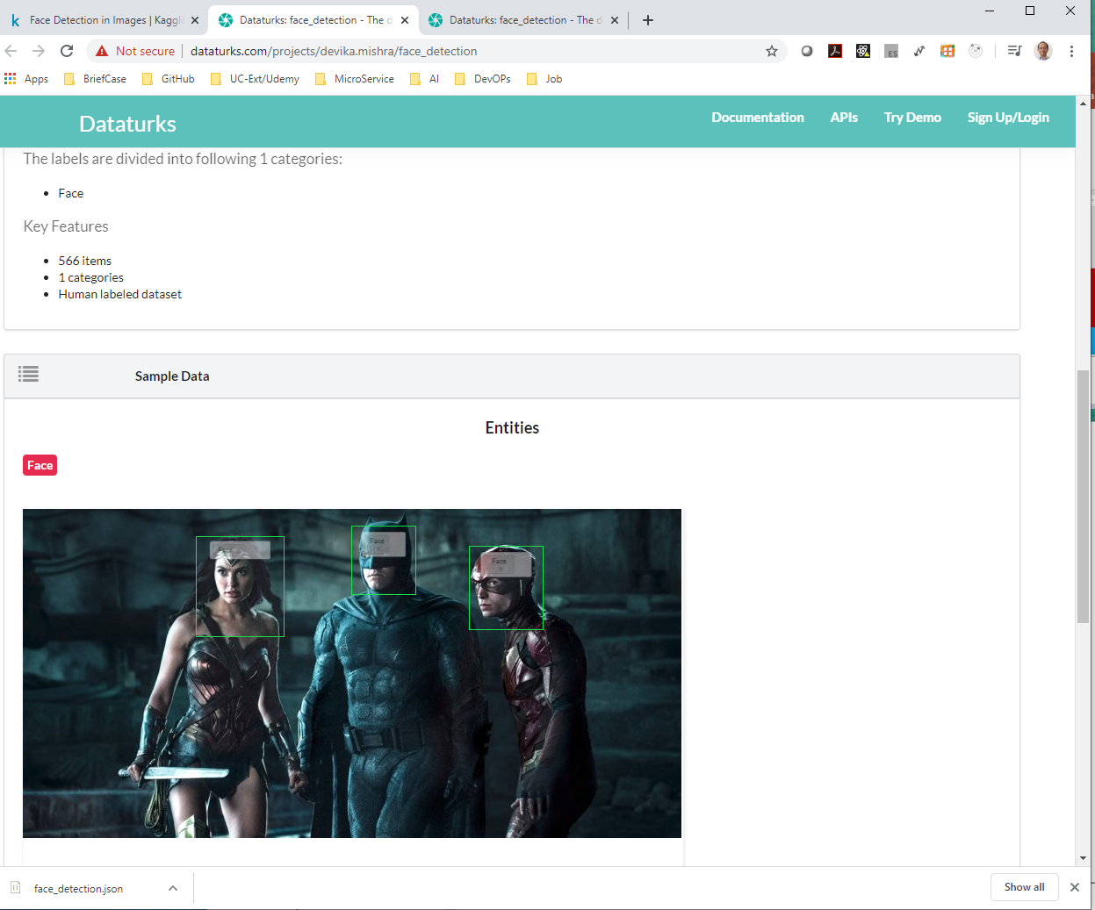
3 Dataset
https://www.kaggle.com/dataturks/face-detection-in-images
Some sample image of fact-detection-in-images.
It have around 500 images and 1,100 faces.
You can see all the images have the bounding box around the faces.

Slide 6
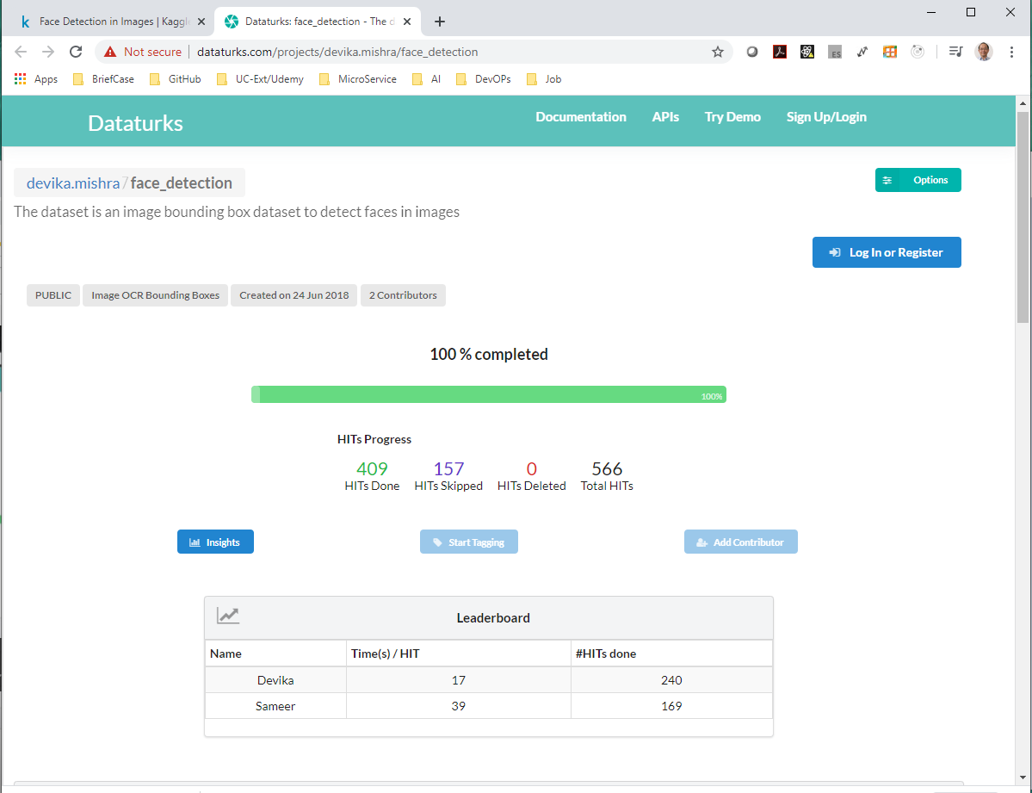
3 Dataset
https://www.kaggle.com/dataturks/face-detection-in-images
Scroll up. The URL is actually open from Kaggle.com.
You can see this has been 100% completed and there are some examples.

Slide 7
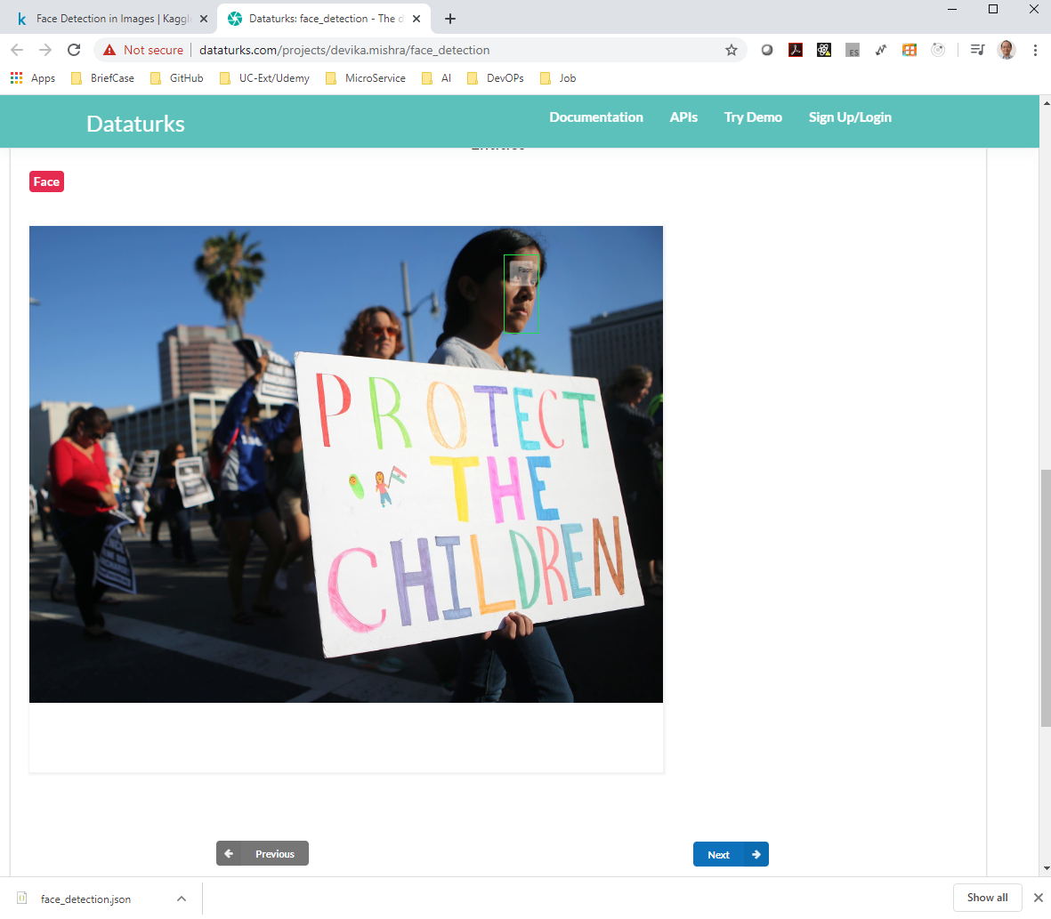
3 Dataset
https://www.kaggle.com/dataturks/face-detection-in-images
Scroll up. The URL is actually open from Kaggle.com.
You can see this has been 100% completed and there are some examples.
Click button “Next” to browse the images one-by-one.
You can see the annotation (bounding box) of some of the images is not complete.

Slide 8
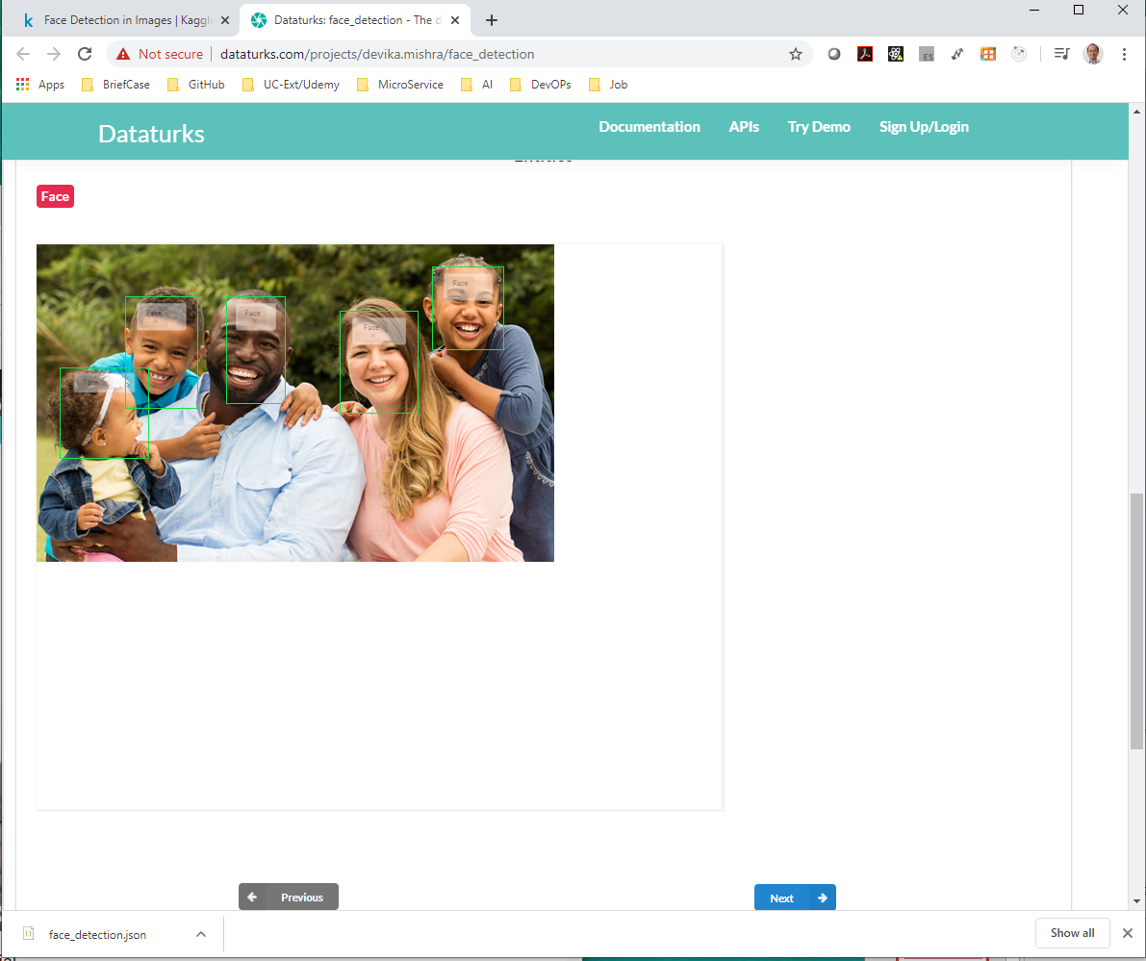
3 Dataset
https://www.kaggle.com/dataturks/face-detection-in-images
There are good examples of multiple faces annotation (bounding box) in the images.
Most of the labels are pretty good and correct.
We can open Jupyter Notebook and start coding.

Slide 9
End of Chapter

