Slide 1

4 Detectron 2 User Guide
Peter H. Chen

Slide 2
4 Detectron 2 User Guide
https://colab.research.google.com/drive/16jcaJoc6bCFAQ96jDe2HwtXj7BMD_-m5#scrollTo=9_FzH13EjseR
Detectron2 Model:
https://github.com/facebookresearch/detectron2
We will implement the facial recognition using Detectron2 Model.
The Detectron2 Model is very obstructed framework and hard to understand for object detection and image segmentation.

Slide 3
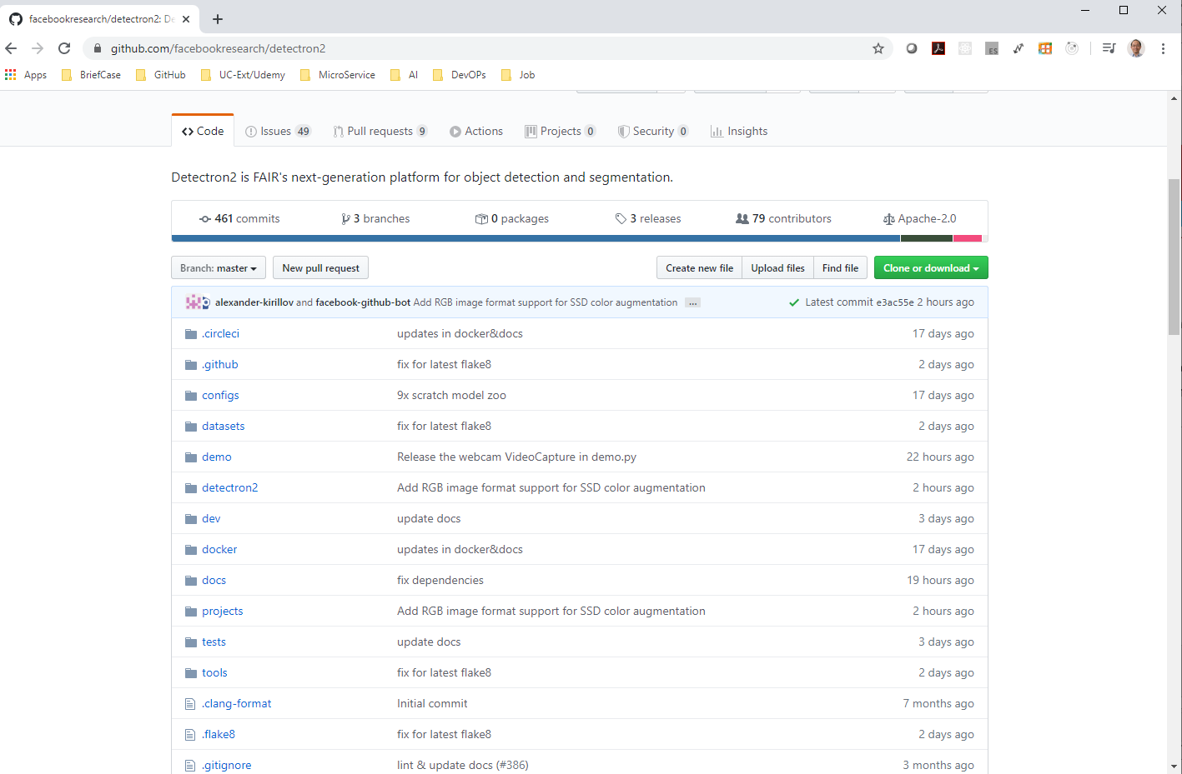
4 Detectron 2 User Guide
https://colab.research.google.com/drive/16jcaJoc6bCFAQ96jDe2HwtXj7BMD_-m5#scrollTo=9_FzH13EjseR
https://github.com/facebookresearch/detectron2
The backend is written in Python and the code of Detectron is really irritable.
You can dive in the GitHub site and understand what is going on.
Click detectron2 Link.

Slide 4
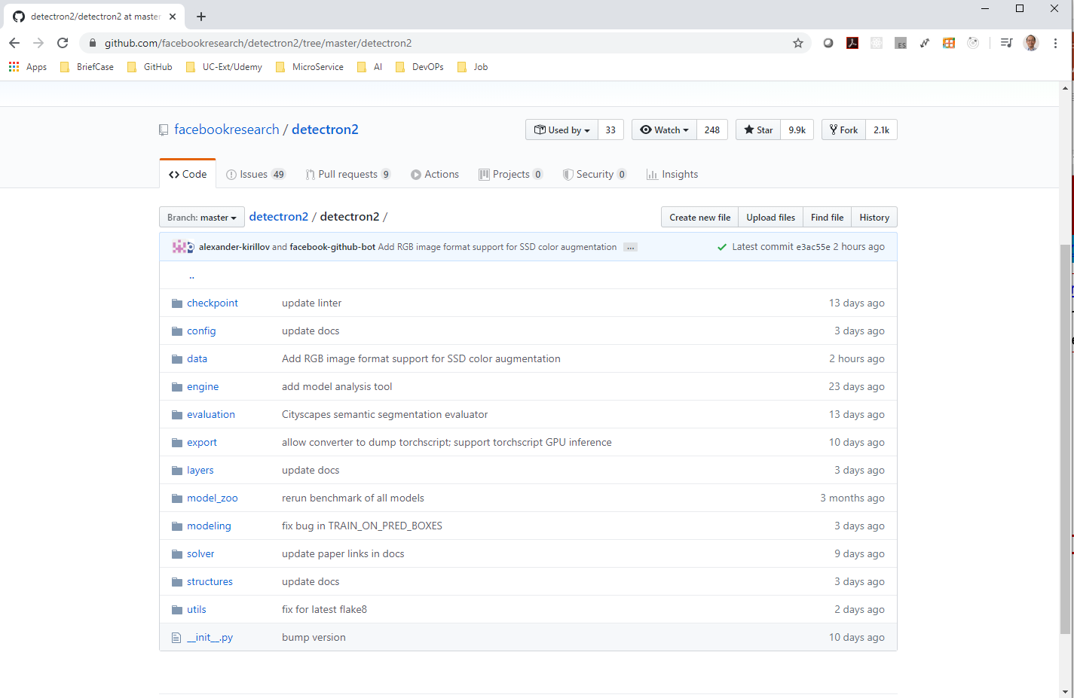
4 Detectron 2 User Guide
https://colab.research.google.com/drive/16jcaJoc6bCFAQ96jDe2HwtXj7BMD_-m5#scrollTo=9_FzH13EjseR
https://github.com/facebookresearch/detectron2/tree/master/detectron2
The detectron2 is very well structured project.

Slide 5
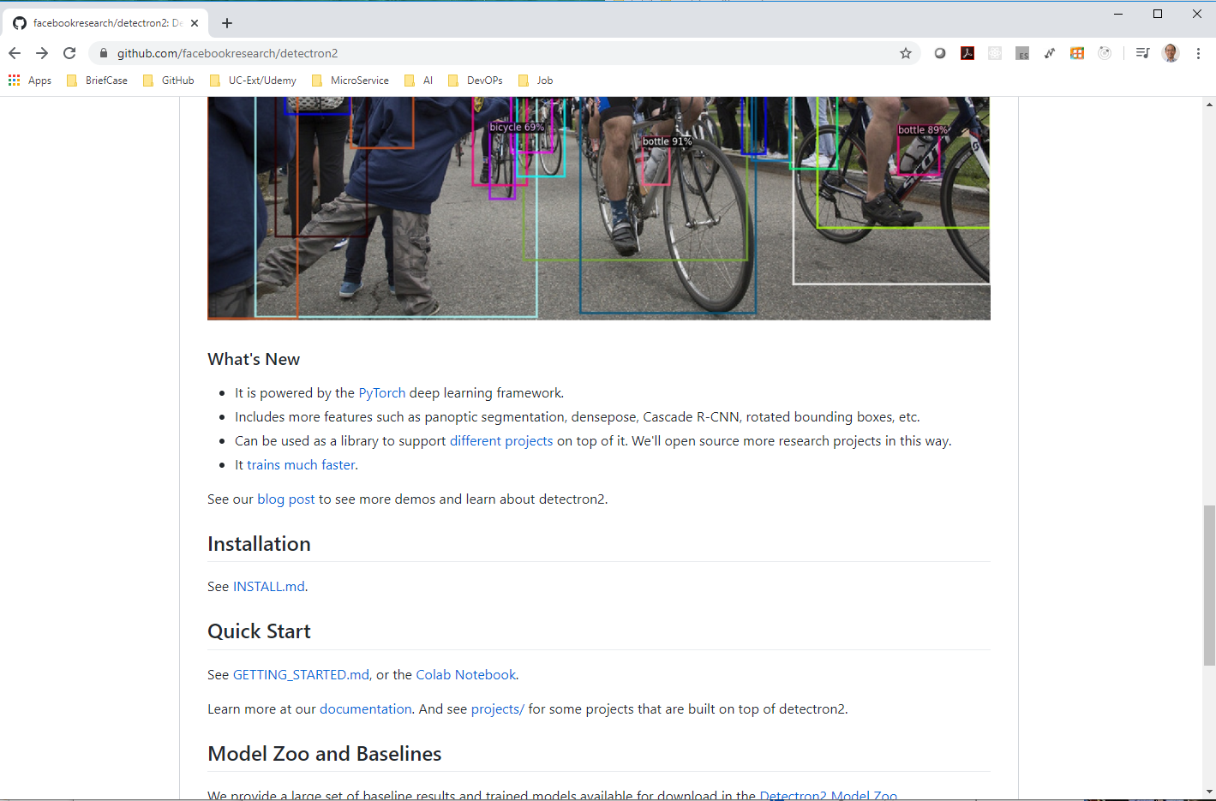
4 Detectron 2 User Guide
https://colab.research.google.com/drive/16jcaJoc6bCFAQ96jDe2HwtXj7BMD_-m5#scrollTo=9_FzH13EjseR
https://github.com/facebookresearch/detectron2
For Quick Start, there are GETTING_STARTED.md and Google Colab Notebook.

Slide 6
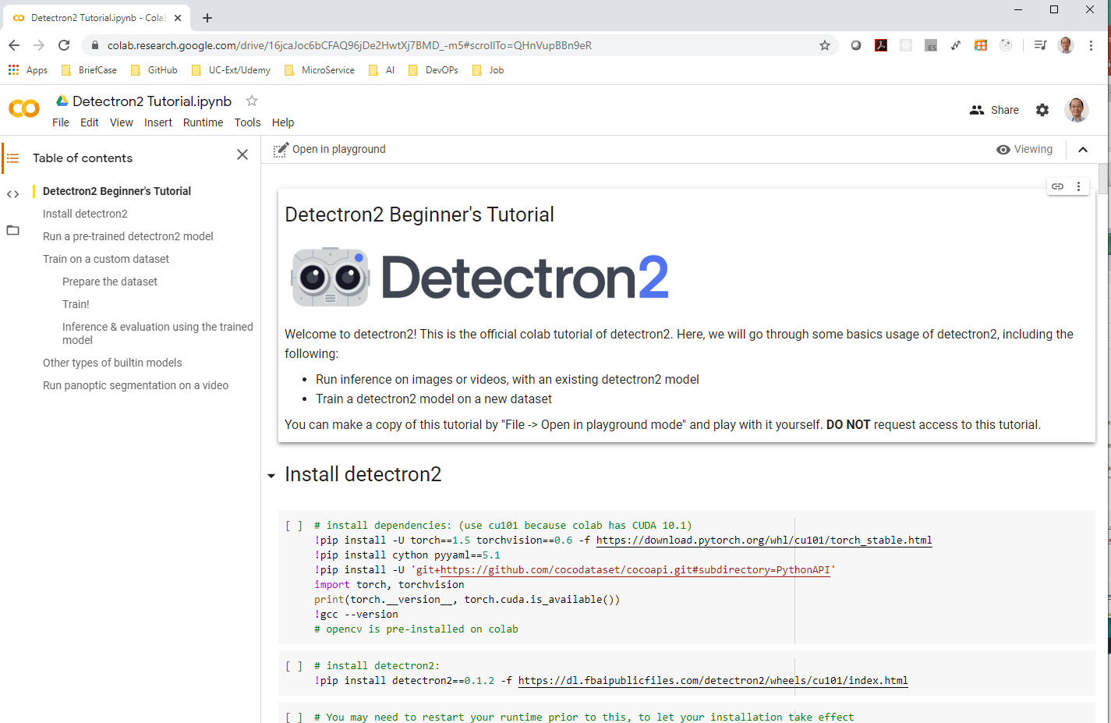
4 Detectron 2 User Guide
https://colab.research.google.com/drive/16jcaJoc6bCFAQ96jDe2HwtXj7BMD_-m5#scrollTo=9_FzH13EjseR
https://colab.research.google.com/drive/16jcaJoc6bCFAQ96jDe2HwtXj7BMD_-m5
Detectron 2 Beginner’s Tutorial

Slide 7
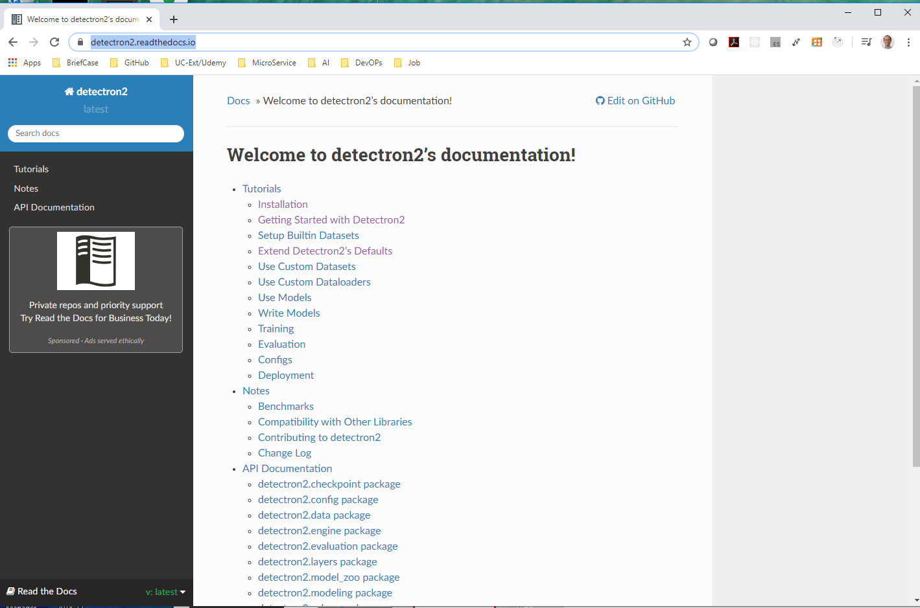
4 Detectron 2 User Guide
https://colab.research.google.com/drive/16jcaJoc6bCFAQ96jDe2HwtXj7BMD_-m5#scrollTo=9_FzH13EjseR
https://detectron2.readthedocs.io/
Google search “Welcome to detectron2’s documentation” (detectron2.readthedocs.io) or “detectron2 beginner tutorial”

Slide 8
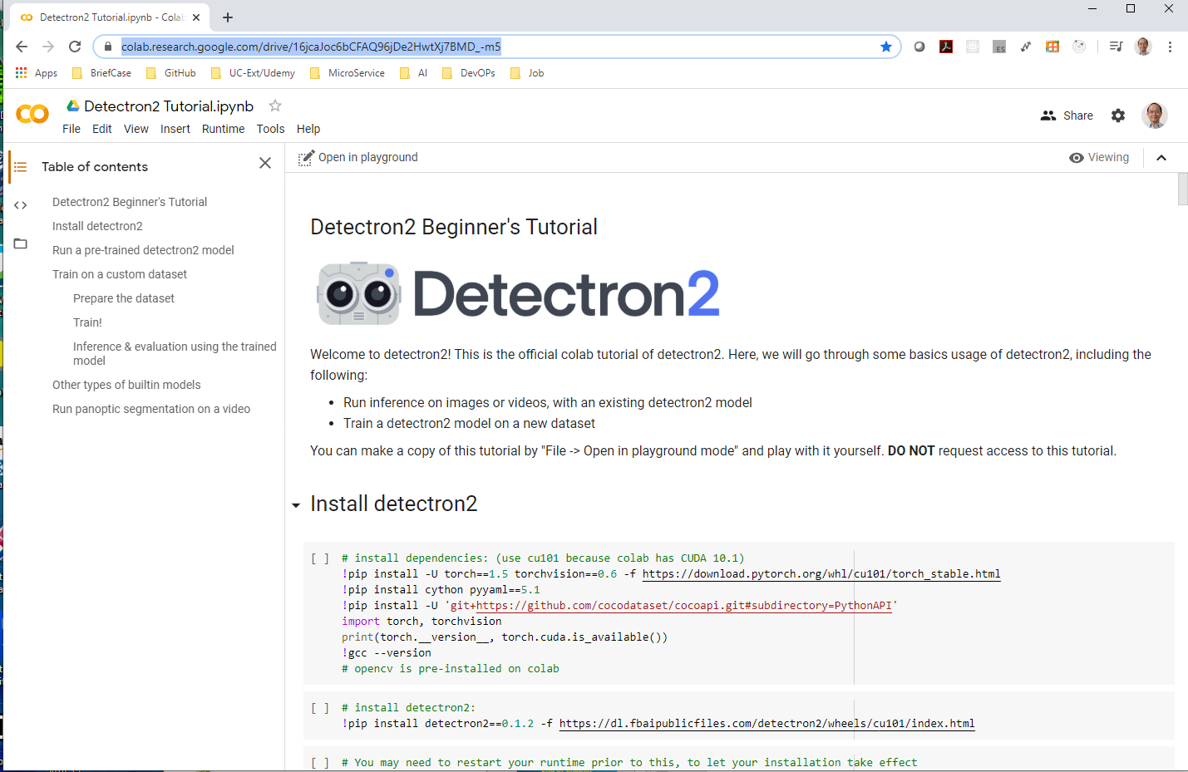
4 Detectron 2 User Guide
https://colab.research.google.com/drive/16jcaJoc6bCFAQ96jDe2HwtXj7BMD_-m5#scrollTo=9_FzH13EjseR
https://colab.research.google.com/drive/16jcaJoc6bCFAQ96jDe2HwtXj7BMD_-m5
We start from Google Colab Notebook.

Slide 9
End of Chapter

