Slide 1

5 Implement
Peter H. Chen

Slide 2
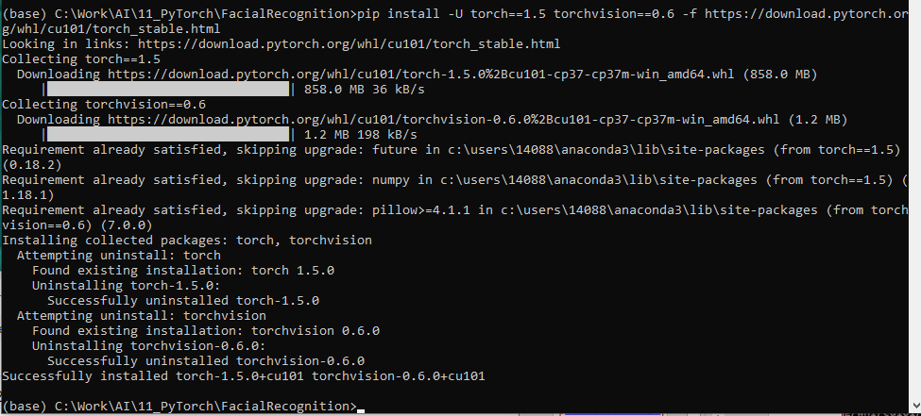
5 Implement
https://colab.research.google.com/drive/16jcaJoc6bCFAQ96jDe2HwtXj7BMD_-m5#scrollTo=QHnVupBBn9eR
https://colab.research.google.com/drive/16jcaJoc6bCFAQ96jDe2HwtXj7BMD_-m5#scrollTo=QHnVupBBn9eR
Open anaconda command prompt:
# Install dependencies:
> pip install -U torch==1.5 torchvision==0.6 -f https://download.pytorch.org/whl/cu101/torch_stable.html
> pip install cython pyyaml==5.1
> pip install -U 'git+https://github.com/cocodataset/cocoapi.git#subdirectory=PythonAPI'

Slide 3
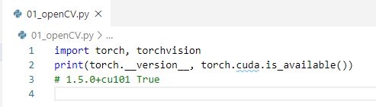

5 Implement
https://colab.research.google.com/drive/16jcaJoc6bCFAQ96jDe2HwtXj7BMD_-m5#scrollTo=QHnVupBBn9eR
https://colab.research.google.com/drive/16jcaJoc6bCFAQ96jDe2HwtXj7BMD_-m5#scrollTo=QHnVupBBn9eR
Print torch version (1.5.0)

Slide 4
End of Chapter

