Slide 1
Analog IPs Characterization
Peter H. Chen
Mar. 2, 2007

Slide 2
Why Analog IPs Characterization?
Characterization provides the size, height, width, function, delay, timing constraint, and power information for PVT corner. This information provides by the real-SPICE (Eldo) or near-SPICE (ADiT/Turbo) tools.
The analog block/macro can be translated into digital block to speed up the simulation time. The characterization of the analog block/macro is the step to transform the analog block into digital block.
Due to floating point nature of amplitude, waveform shape, and strength, the analog signal cannot be (or meaningless) digitally characterized. Only the digital signals in the analog block, i.e, such as, data line and clock line can be characterized.

Slide 3
Basic Characterization
Input Capacitance: Average of input capacitance characterization of all data waveform, i.e., waveform shape HL-HL/LH-LH/HL-LH/LH-HL.
Max Output Capacitance: Minimum of all the driving strengths of max output capacitance characterization of all data waveform
Static Power Model: Cell Leakage Power (average of all the states at power down mode) and Static Power (power of each state). The paths are required to search for fixed, duplicated test, bias structure are required to identify in order to reduce the number of tests.

Slide 4
Advanced Characterization
Synchronized Setup/Hold time: The Setup/Hold Time of all data waveform from the input pin to the first DFFs. Input pin to DFFs path are required to search.
Synchronous Delay Time: The Time Delay from the last DFF to the output pin for a related input pin. The input pin to the last DFF path and DFF to the output pin path are required to search.
Dynamic Power: Slew dependent of witching Power from each input to each out power pin.

Slide 5
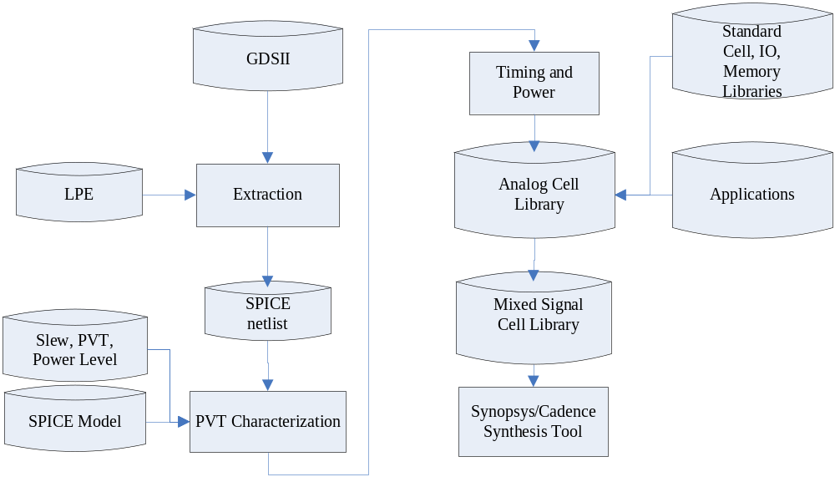
Characterization Flow

Slide 6
Library Format
Synopsys Liberty Format (Lib): Can be compiled into Binary DB format.
Cadence Timing Library Format (TLF).

Slide 7
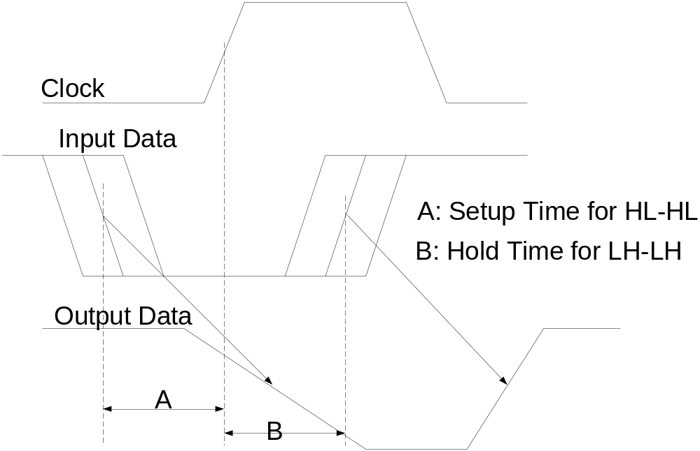
Terminology: Setup/Hold Time

Slide 8
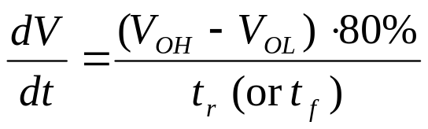



Terminology: Slew Rate
90%
Input
90%
Input
Output
Output
10%

Slide 9
NP Problems in Analog IPs Characterization
Since IP is getting very big (several million transistors), the simulation time lasts several weeks to several month due to the NP-effect. Traditional SPICE and Turbo SPICE will not help too much about this problem.
It is impractical to characterize the IP by using the traditional way for NP-problem. Do not try to resolve the problem directly since NP-problems are one of the three most difficult problems in the mathematical world.
To resolve NP-problem, think hierarchically, methodologically, knowledge-based short cut, and partial set.

