Slide 1
Input Capacitance Characterization
Peter H. Chen, PhDEE
Mar. 9, 2007

Slide 2
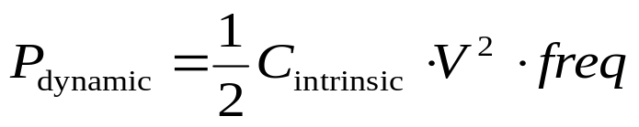
Capacitance Characterization
Capacitance Characterization includes Intrinsic Cap., Input Cap., max Cap. (max driving strength) characterization.
Intrinsic Capacitance is used in fast dynamic power calculation for full chip.
This dynamic power calculation is an informal way of power estimation.
Synopsys provides extra license for intrinsic capacitance characterization.

Slide 3
Intrinsic Capacitance Issues
The dynamic Power is calculated by summing all the state toggling of all input pins.
The Intrinsic Capacitance is not in the liberty attribute, i.e., there is no way to put the characterized Intrinsic capacitance in the Synopsys Library.
We will discuss Intrinsic Capacitance characterization in Dynamic Power Characterization.

Slide 4
Input Capacitance by XCalibre and StarRC
Input Capacitance can be roughly and very fast estimate by Mentor Graphics/XCalibre or Synopsys/ StarRC using the 3-D field solver.
Why we still need to characterize the input capacitance instead of using XCalibre?

Slide 5
SPICE vs. 3-D Solver Comparisons (I)
SPICE vs. 3-D Solver Comparison:
  First, 3-D field solver estimate the input capacitance based on dimension, it is not a real electrical signal characteristics.
  Second, 3-D field solver can only estimate the typical corner of input capacitance, i.e., Best Corner, Worst Corner, and any other conditions (10% below and etc.) are missing. SPICE characterization for input capacitance is needed in formal release. The 3-D field solve data can only used for QA or for to prevent the characterization mistake in SPICE testbench.

Slide 6
SPICE vs. 3-D Solver Comparisons (II)
SPICE vs. 3-D Solver Comparison (Continue):
  Third, so far, the 3-D field solver can only see the capacitance which is connected to the input pin. If the input pin is connected to a resistor, the 3-D field solver estimates input capacitance for resistor is 0 which is definitely wrong.
  Fourth, 3-D field solver can only lump the capacitances connected to input pin, i.e., the other layers or isolated by the resistors can not be lumped together.
For the above reasons, the SPICE is mandatory to characterize all corners/conditions of input capacitance.

Slide 7
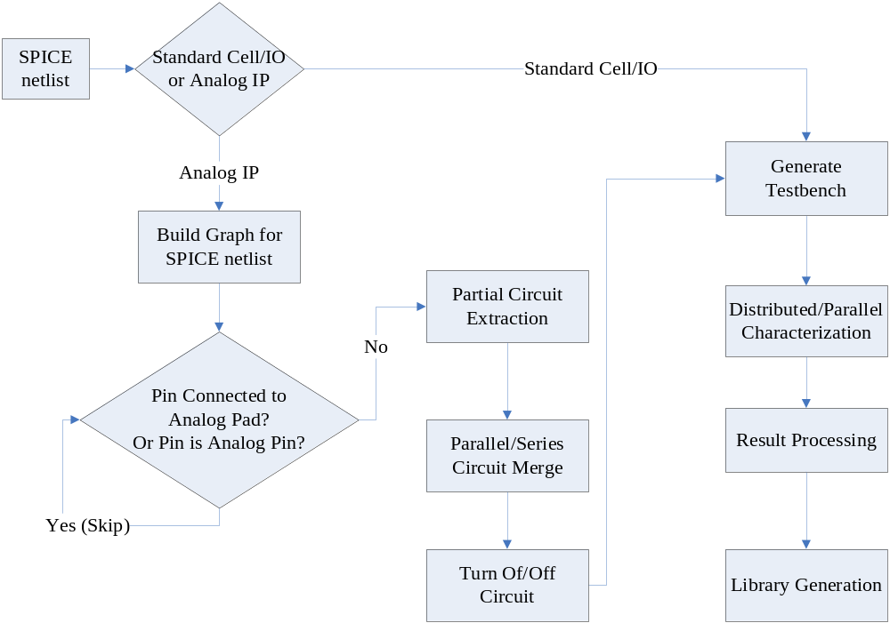
Input Cap. Characterization Flow

Slide 8
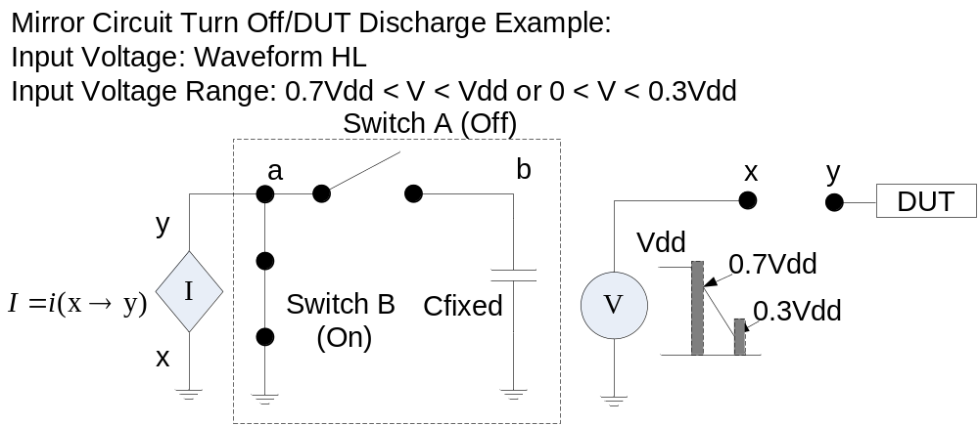
Mirror Circuit Turn Off/DUT Discharge

Slide 9
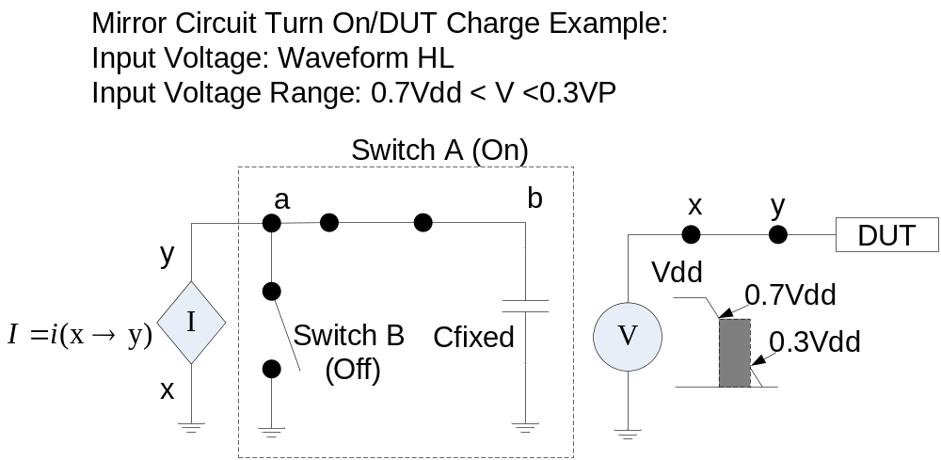
Mirror Circuit Turn On: DUT Charge

Slide 10


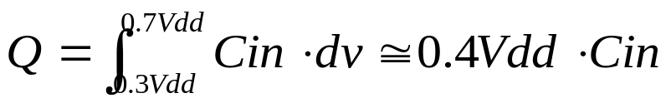
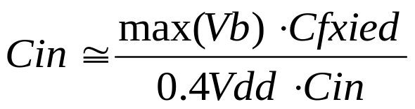
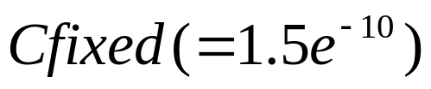
Formula for Input Cap Calculation
(1) Charge Formula:
(2) From the switch side:
(3) From the DUT side:
(4) From (1), (2), and (3)
(5) Therefore, we have:
Where Cfixed is any capacitor that is big enough to hold the DUT charge and discharge.

Slide 11


VCR Switch A/B
R
Switch A
GRA a_a_a b_b_b VCR PWL (1) CLK GND
+ 0.0, 1.e+15 ‘VP*0.3-0.001’, 1.0+15
+ ‘0.3*VP’, 1.e-5 ‘0.7*VP’, 1.0e-5
+ ‘0.7*VP+0.001’, 1.e+15 VP, 1.0e+15
V
0.3VP
0.7VP
VP
R
Switch B
GRB a_a_a gnd VCR PWL (1) CLK GND
+ 0.0, 1.e-5 ‘VP*0.3-0.001’, 1.0e-5
+ ‘0.3*VP’, 1.e+15 ‘0.7*VP’, 1.0e+15
+ ‘0.7*VP+0.001’, 1.e-5 VP, 1.0e-5
V
0.3VP
0.7VP
VP

Slide 12
Testbench (I): SPICE card and VCCS
.tran 0.001ns 7ns
.meas tran vc max v(b_b_b,gnd)
.meas cpin_a_0_0 param=‘(vc*Cfixed)/(0.4*VP)’
* Parameter
.param Cfxied = 1.0e-10
.param IVP = Vdd
.param sv = Vdd
.param ev = 0
.param Vdd = 1.98
* G: Voltage Control Current Source
* Control V=Vameter, Output I=i(x->y)
Vameter x CLK dc 0
GI a_a_a GND cur = ‘i1 (Vameter)’
Ccb b_b_b GND Cfixed

Slide 13
Testbench (II): Swicth
* Switch A
GRA a_a_a b_b_b VCR PWL (1) CLK GND
+ 0.00, 1.0e+15 ‘IVP*0.3-0.001’, 1.0e+15
+ ‘IVP*0.3’, 1.0e-5 ‘IVP*0.7’, 1.0e-05
+ ‘IVP*0.7+0.001’, 1.0e+15 IVP, 1.0e+15
* Switch B
GRB a_a_a gnd VCR PWL (1) CLK GND
+ 0.00, 1.0e-5 ‘IVP*0.3-0.001’, 1.0e-5
+ ‘IVP*0.3’, 1.0e+15 ‘IVP*0.7’, 1.0e+15
+ ‘IVP*0.7+0.001’, 1.0e-5 IVP, 1.0e-05

Slide 14
Testbench (III): Stimulus and DUT
* Control Voltage: Input Voltage (e.g., HL)
Vx x 0 PWL (0n sv 1n sv 4Ns ev)
* DUT:
* For standard cell/IO, it is full SUBCKT.
* For IP, it is Partial Circuit Extraction from entire IP.

Slide 15
Partial Circuit Extraction
In Transistor Levels:
  Extract the partial circuit from input pin to two levels of MOS gates.
  Resistors and Capacitors does not increase the levels, i.e., Resistors and Capacitors are always includes no matter what.
For Gate Levels:
  Extract the partial circuit from input pin to two levels of Gates.
  Resistors and Capacitors does not increase the levels.

Slide 16
Partial Circuit Extraction Accuracy vs. XCalibre
Almost 98%-100% identical to XCalibre for Typical corner for more than 2000 IPs.
IP selected from 0.35u, 0.25u, 0.18u, 0.13u, 65nm.
Other corners cannot be compared due to XCalibre can only estimate one corner only.

Slide 17
Partial Circuit Extraction Accuracy vs. Full IP
full IP always has run time problem (from weeks to months)
Occasionally, crash after run for weeks due to unknown reason (network, resources, etc).
Occasionally, get incredible funny answer and hard to justify.
Only very limited comparisons (1-2 cases) are examined and partially by human being modification. It is about 98%+ accurate

