Slide 1
Static Power Characterization
Peter H. Chen
Apr. 20, 2007

Slide 2
Agenda
Why Static Power Characterization?
Static Power and Leakage Power
Power Definition
Power Mode Classification
Existing / Traditional Way Static Power Characterization
DC Characterization
Automatic Circuit Classificatin (ACC) for Test Reduction
  Fixed Reference and Don’t Care Macros
  Path Connection Identification
Custom GUI for Test Reduction
Test Reduction Example
Library Static Power Expression Example

Slide 3
Static power and leakage power
In standard and IO cells, the static power is equal to leakage power. It is the power that the power is turn off.
In analog IP, the leakage power is a subset of the static power.
The static power includes the all the states switching when the analog IP is turn off (leakage power) and in standby.
Ideally, all the states of static power of analog IP are around micro-Watts or Pico-Watts.
If some of static power in mini-Watts or Watt in careless/mistaken design.
In Faraday, about 90% IP in first release have big static power problem.

Slide 4
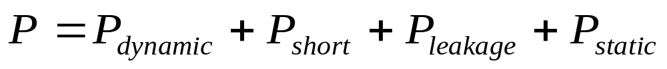
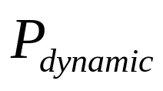
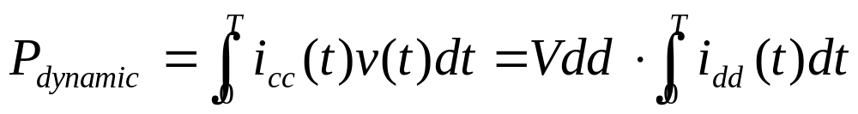
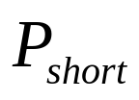
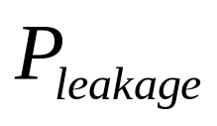
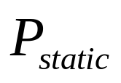
Power Definition (I)
: Dynamic (Switching/Internal) Power
: Short Circuit Power
: Gate to Source/Drain Leakage Power
: Static Power

Slide 5
Power Definition (II)
idd
Vdd
OUT
D
Analog IPs
.
.
.
icc
Cout
CLK

Slide 6
Power Modes Classification in IP (I)
Power Modes in IP are classified into the following categories:
  Dynamic (Switching/Internal) Power: System is power on and IP operation with clock/data toggling. This operating modes includes forward/backward transmit, high/low speed, etc. Power consumption in mini-Watts to Watts.
  Standby Power: System is power on and clock is on. Partial IP are power on. Some of bias is still alive. The time interval for standby mode to normal operation is shorter than power down required. Power consumption in micro-Watts to mini-Watts.

Slide 7
Power Modes Classification in IP (II)
Power Modes in IP are classified into the following categories (Cont):
  Power Down: The IP is power down and external clock/data toggling have no effect for IP. Power consumption is less than micro-Watts.
  Iddq (Quiet Current) mode System, is power on but clock/data are turn off. Iddq mode is closed to power down mode of IP. Power consumption is less than pico-Watts.
  System power off: Entire System is turn off. Nothing needs to be done. Power consumption is zero.

Slide 8
Why Static Power Characterization?
Static power is used in synthesis tools for minimum power consumption. Dynamic power is used in gated clock synthesis.
Layout power planning/cell placement used mimimum peak-to-peak cell placement (based on magic number or Chinese Lo Shu (洛書) square, http://en.wikipedia.org/wiki/Lo_Shu) and decap principle.
Customers want to know the total power consumption of an IP, especially the gate leakage below 65nm.
As the Ultra Deep Sub Micron (UDSM), the leakage powers (gate to bulk, gate to source, gate to drain) are becoming significant. Foundry MOS subckts are used to estimate the leakage power.

Slide 9
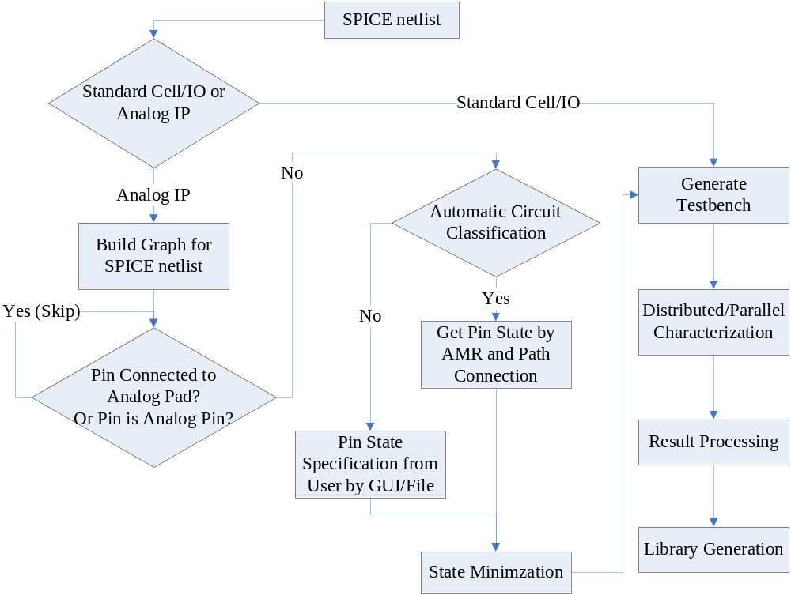
Static Power Characterization Flow

Slide 10
Existing / Traditional Way Static Power Characterization
Faraday’s existed static power characterization measured the leakage power (by turn of the chip operation) for a certain period), such as, 5 nsec.
Run time for TRAN measurement take at least 3-4 hours.
The DC characterization is good enough for static power characterization with acceptable run-time (2 minutes to 2 hours) with acceptable accuracy.
Static Power is input pin state independent, the number of state grows exponentially with input pin number, i.e., 2^n.

Slide 11
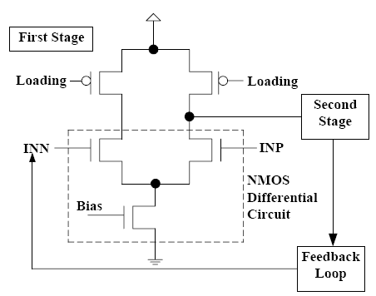
NMOS Reference Macro

Slide 12
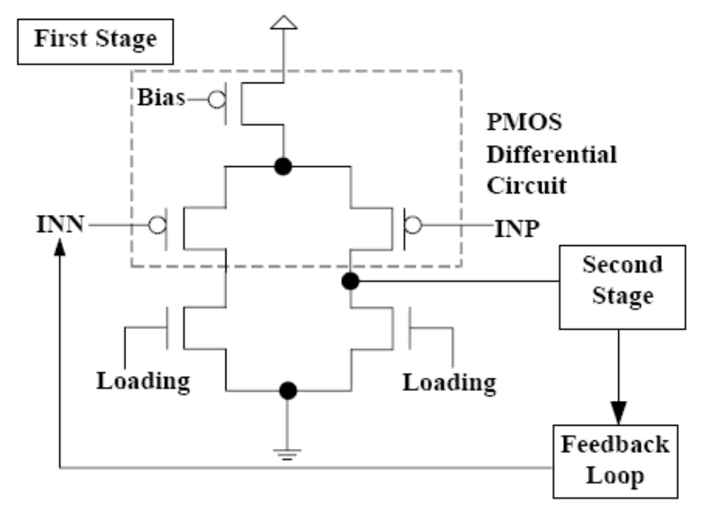
PMOS Reference Macro

Slide 13
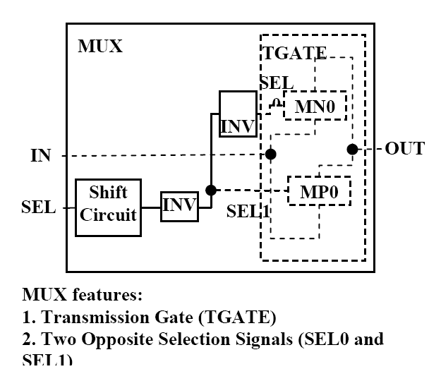
Don’t Care (Mux) Macro

Slide 14
Custom GUI for Test Reduction (AMR)
A GUI is used if the AMR algorithm fails to recognize the Fixed Reference or Don’t Care Macro.
Cute (Qt)-Programming Tool is used to generate a GUI and inheritance is used to separate the generated GUI and API code modification.
The Switch State, Fixed, or Don’t Care for Input Pins will be specified in the Excel table of GUI.

Slide 15
DAC010HA0L Example
Only the input pins are related to the state of static power.
The input pins for DAC010 are: Voltage Compensation (COMP), Reference Voltage Set (RSET), VREF, CLKIN, DACIN0-9, Power Down (PD), and VSL.
There are 16 input pins [3 (BC/TC/WC) * 2 ^16 = 192 Millions of test benches or 64 Million of states].
The 64 Millions of states entries is a problem for Liberty Library.
COMP and RSET are connected to Fixed Reference Macro.
DACIN0-9 are connected to Don’t Care (Mux) Macro.
Use the operation condition (.OP C) for static power characterization.

Slide 16
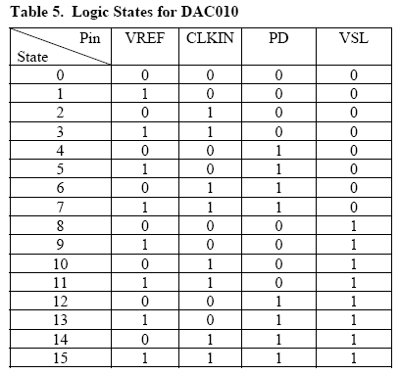
Logic States of DAC010HA0L

Slide 17
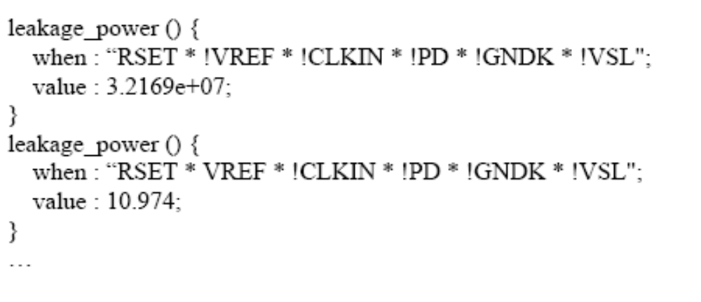
Liberty Static Power Example
cell_leakage_power: average of all the attribute of the leakage_power () shown below.

