Slide 1

5 AngularJS Directive
Peter H. Chen

Slide 2
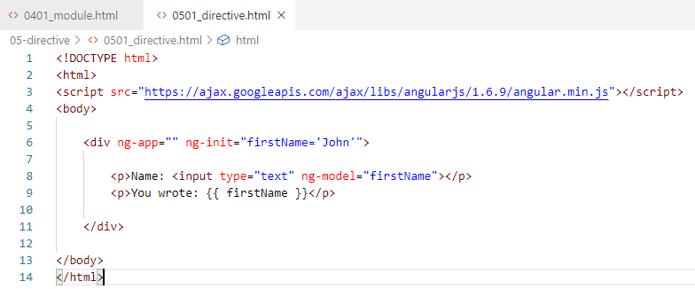
5 AngularJS Directive
https://www.w3schools.com/angular/angular_directives.asp
AngularJS Directives
AngularJS directives (instructions) are extended HTML attributes with the prefix ng-.
The ng-app directive initializes an AngularJS application.
The ng-init directive initializes application data.
The ng-model directive binds the value of HTML controls (input, select, textarea) to application data.

Slide 3
5 AngularJS Directive
https://www.w3schools.com/angular/angular_directives.asp
Data Binding
The {{ firstName }} expression, in the example above, is an AngularJS data binding expression.
Data binding in AngularJS binds AngularJS expressions with AngularJS data.
{{ firstName }} is bound with ng-model="firstName"

Slide 4
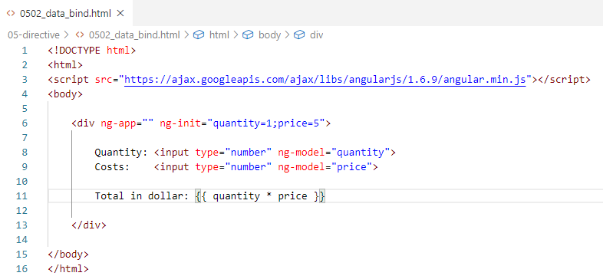
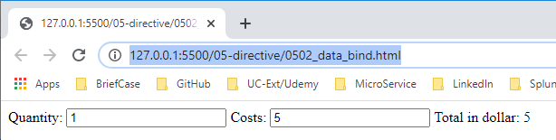
5 AngularJS Directive
https://www.w3schools.com/angular/angular_directives.asp
Data Binding
Example:

Slide 5
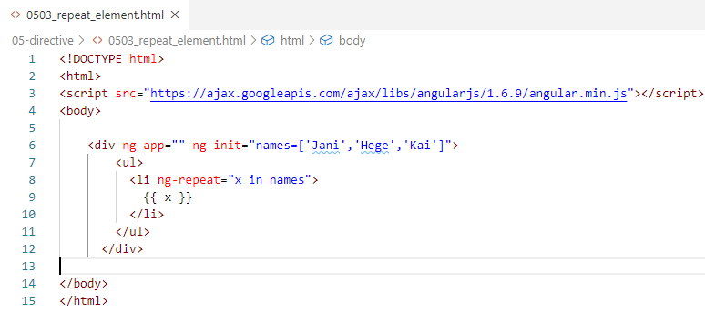
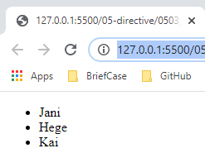
5 AngularJS Directive
https://www.w3schools.com/angular/angular_directives.asp
Data Binding
Repeat elements.

Slide 6
End of Chapter

