Slide 1

3 AngularJS Expression
Peter H. Chen

Slide 2
3 AngularJS Expression
https://www.w3schools.com/angular/angular_expressions.asp
AngularJS Expression
AngularJS binds data to HTML using Expressions.
AngularJS Expressions
AngularJS expressions can be written inside double braces: {{ expression }}.
AngularJS expressions can also be written inside a directive: ng-bind = "expression".
AngularJS will resolve the expression, and return the result exactly where the expression is written.
AngularJS expressions are much like JavaScript expressions: They can contain literals, operators, and variables.
Example {{ 5 + 5 }} or {{ firstName + " " + lastName }}

Slide 3
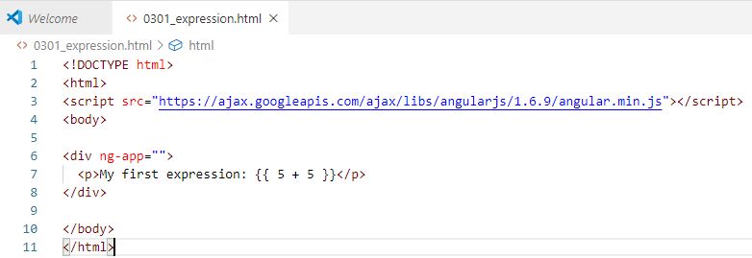
3 AngularJS Expression
https://www.w3schools.com/angular/angular_expressions.asp
AngularJS Expressions

Slide 4
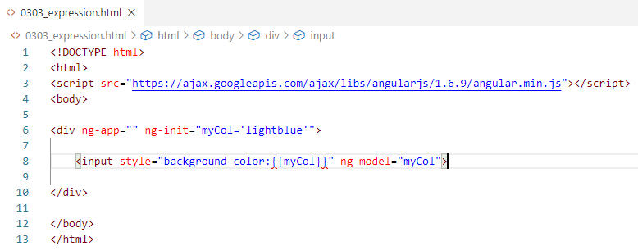
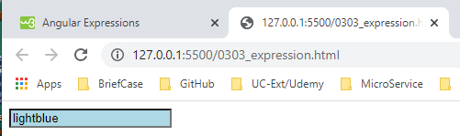
3 AngularJS Expression
https://www.w3schools.com/angular/angular_expressions.asp
AngularJS Expressions
You can write expressions wherever you like, AngularJS will simply resolve the expression and return the result.
Example: Let AngularJS change the value of CSS properties.
Change the color of the input box below, by changing its value:

Slide 5
End of Chapter

