Slide 1

1 AngularJS Home
Peter H. Chen

Slide 2
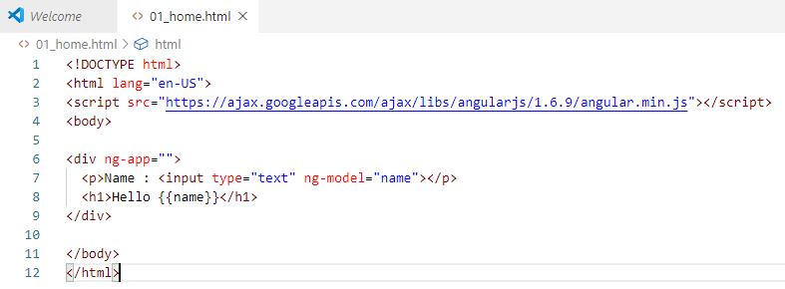
1 AngularJS Home
https://www.w3schools.com/angular/default.asp
First, you will learn the basics of AngularJS: directives, expressions, filters, modules, and controllers.
Then you will learn everything else you need to know about AngularJS:
Events, DOM, Forms, Input, Validation, Http, and more.

Slide 3
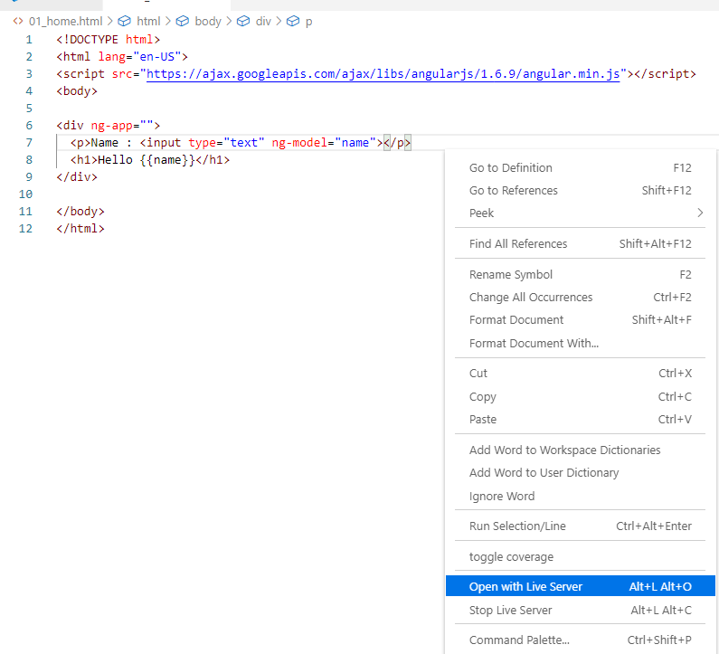
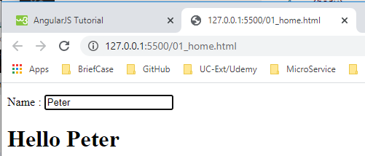
1 AngularJS Home
https://www.w3schools.com/angular/default.asp
> Open with Live Server

Slide 4
End of Chapter

