Slide 1

2 AngularJS Introduction
Peter H. Chen

Slide 2
2 AngularJS Introduction
https://www.w3schools.com/angular/angular_intro.asp
AngularJS Extends HTML
AngularJS extends HTML with ng-directives.
The ng-app directive defines an AngularJS application.
The ng-model directive binds the value of HTML controls (input, select, textarea) to application data.
The ng-bind directive binds application data to the HTML view.

Slide 3
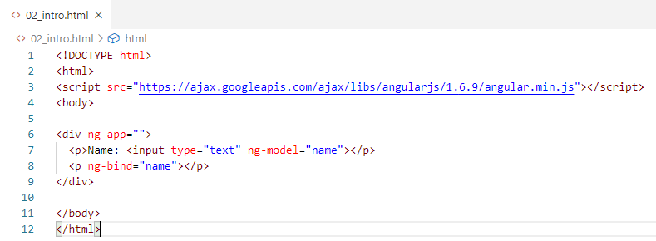
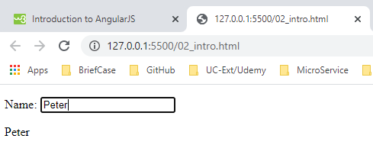
2 AngularJS Introduction
https://www.w3schools.com/angular/angular_intro.asp
> Open with Live Server

Slide 4
2 AngularJS Introduction
https://www.w3schools.com/angular/angular_intro.asp
Example explained:
AngularJS starts automatically when the web page has loaded.
The ng-app directive tells AngularJS that the <div> element is the "owner" of an AngularJS application.
The ng-model directive binds the value of the input field to the application variable name.
The ng-bind directive binds the content of the <p> element to the application variable name.

Slide 5
End of Chapter

