Slide 1

4 Research
Peter H. Chen

Slide 2
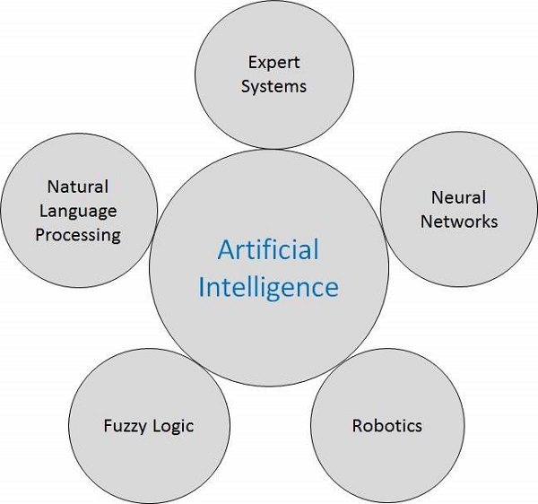
4 Research
https://www.tutorialspoint.com/artificial_intelligence/artificial_intelligence_research_areas.htm
Research Area
We discuss research areas of Artificial Intelligence

Slide 3
4 Research
https://www.tutorialspoint.com/artificial_intelligence/artificial_intelligence_research_areas.htm
Speech and Voice Recognition
These both terms are common in robotics, expert systems and natural language processing.
Speech Recognition | Voice Recognition
The speech recognition aims at understanding and comprehending WHAT was spoken. | The objective of voice recognition is to recognize WHO is speaking.
It is used in hand-free computing, map, or menu navigation. | It is used to identify a person by analysing its tone, voice pitch, and accent, etc.
Machine does not need training for Speech Recognition as it is not speaker dependent. | This recognition system needs training as it is person oriented.
Speaker independent Speech Recognition systems are difficult to develop. | Speaker dependent Speech Recognition systems are comparatively easy to develop.

Slide 4
4 Research
https://www.tutorialspoint.com/artificial_intelligence/artificial_intelligence_research_areas.htm
Real Life Applications of Research Areas
There is a large array of applications where AI is serving common people in their day-to-day lives
No | Research Areas
1 | Expert Systems: Examples − Flight-tracking systems, Clinical systems.
2 | Natural Language Processing: Examples: Google Now feature, speech recognition, Automatic voice output.
3 | Neural Networks: Examples − Pattern recognition systems such as face recognition, character recognition, handwriting recognition.
4 | Robotics: Examples − Industrial robots for moving, spraying, painting, precision checking, drilling, cleaning, coating, carving, etc.
5 | Fuzzy Logic Systems: Examples − Consumer electronics, automobiles, etc.

Slide 5
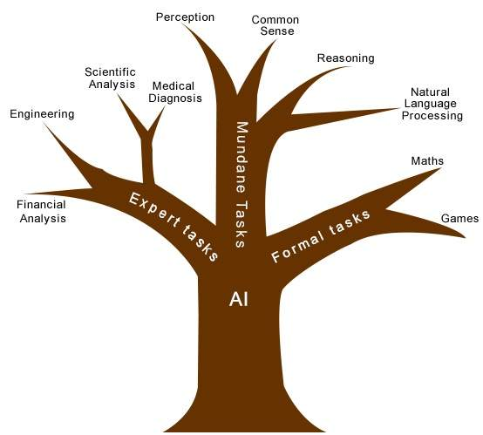
4 Research
https://www.tutorialspoint.com/artificial_intelligence/artificial_intelligence_research_areas.htm
Task Classification of AI
The domain of AI is classified into Formal tasks, Mundane (Ordinary) tasks, and Expert tasks.

Slide 6
4 Research
https://www.tutorialspoint.com/artificial_intelligence/artificial_intelligence_research_areas.htm
Task Domain of Artificial Intelligence
Mundane (Ordinary) Tasks | Formal Tasks | Expert Tasks
Perception Computer Vision Speech, Voice | Mathematics Geometry Logic Integration and Differentiation | Engineering Fault Finding Manufacturing Monitoring
Natural Language Processing Understanding Language Generation Language Translation | Games Go Chess (Deep Blue) Ckeckers | Scientific Analysis
Common Sense | Verification | Financial Analysis
Reasoning | Theorem Proving | Medical Diagnosis
Planning |  | Creativity
Robotics: Locomotive

Slide 7
4 Research
https://www.tutorialspoint.com/artificial_intelligence/artificial_intelligence_research_areas.htm
Humans learn mundane (ordinary) tasks since their birth.
They learn by perception, speaking, using language, and locomotives.
They learn Formal Tasks and Expert Tasks later, in that order.
For humans, the mundane tasks are easiest to learn.
The same was considered true before trying to implement mundane tasks in machines.
Earlier, all work of AI was concentrated in the mundane task domain.
Later, it turned out that the machine requires more knowledge, complex knowledge representation, and complicated algorithms for handling mundane tasks.
This is the reason why AI work is more prospering in the Expert Tasks domain now, as the expert task domain needs expert knowledge without common sense, which can be easier to represent and handle.

Slide 8
End of Chapter

