Slide 1

0102 Canvas
Peter H. Chen

Slide 2
0102 Canvas
https://ucsc-extension.instructure.com/courses/3825/pages/1-dot-1-welcome?module_item_id=42202
0102 Get Familiar with Canvas
New to Canvas?
Watch this short video to help you get an overview of the Canvas environment:

Slide 3
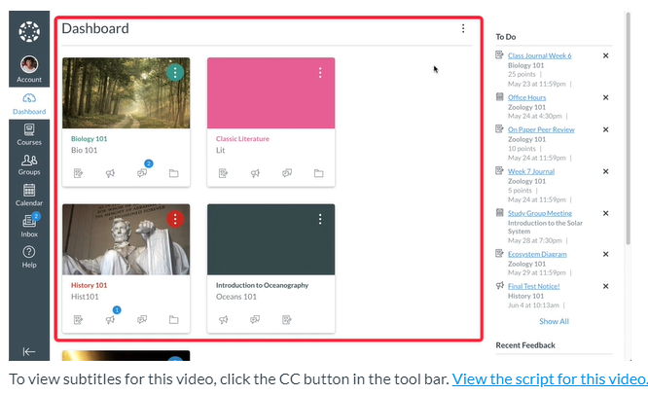
0102 Canvas
https://ucsc-extension.instructure.com/courses/3825/pages/1-dot-1-welcome?module_item_id=42202
Dashboard: High level of

Slide 4
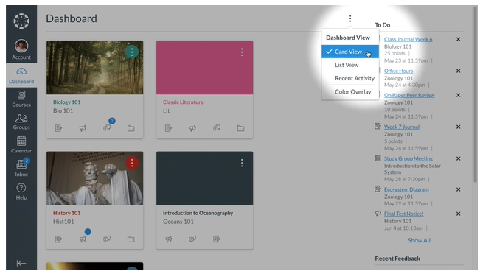
0102 Canvas
https://ucsc-extension.instructure.com/courses/3825/pages/1-dot-1-welcome?module_item_id=42202
Three different view options: Card View, List View, and Recent Activity

Slide 5
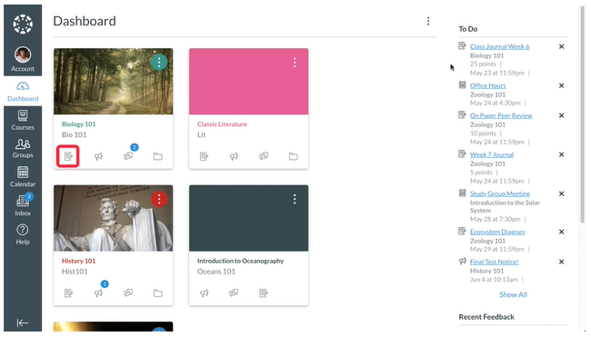
0102 Canvas
https://ucsc-extension.instructure.com/courses/3825/pages/1-dot-1-welcome?module_item_id=42202
Card View: Assignment, Announcement, Discussion, and Files

Slide 6
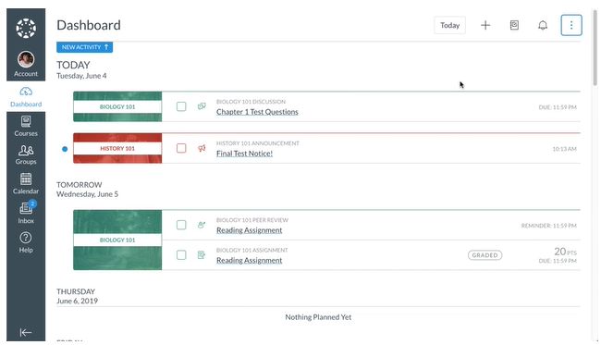
0102 Canvas
https://ucsc-extension.instructure.com/courses/3825/pages/1-dot-1-welcome?module_item_id=42202
List View: List all courses to do items. You can scroll up and down the page.

Slide 7
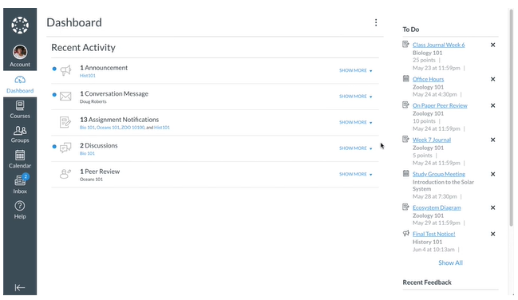
0102 Canvas
https://ucsc-extension.instructure.com/courses/3825/pages/1-dot-1-welcome?module_item_id=42202
Recent Activity:

Slide 8
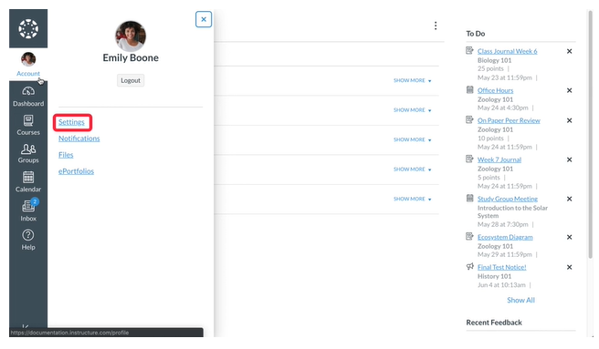
0102 Canvas
https://ucsc-extension.instructure.com/courses/3825/pages/1-dot-1-welcome?module_item_id=42202
Account:

Slide 9
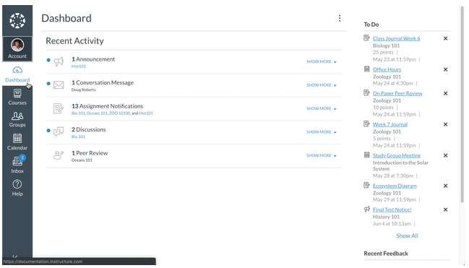
0102 Canvas
https://ucsc-extension.instructure.com/courses/3825/pages/1-dot-1-welcome?module_item_id=42202
Dashboard Link: Return to Dashboard

Slide 10
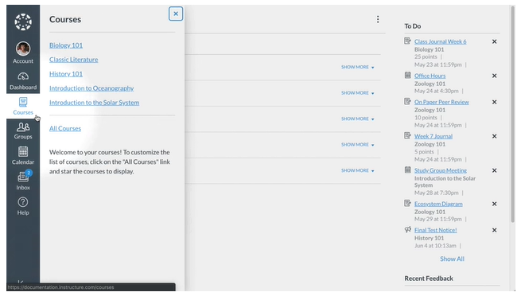
0102 Canvas
https://ucsc-extension.instructure.com/courses/3825/pages/1-dot-1-welcome?module_item_id=42202
Course Link: quickly access course

Slide 11
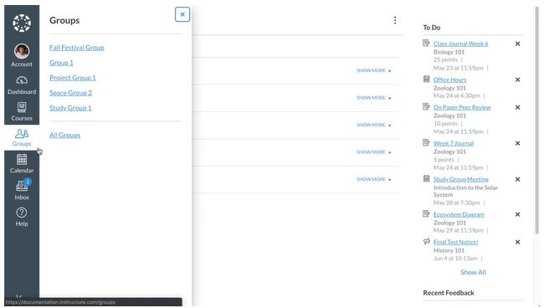
0102 Canvas
https://ucsc-extension.instructure.com/courses/3825/pages/1-dot-1-welcome?module_item_id=42202
Group: Access the group.

Slide 12
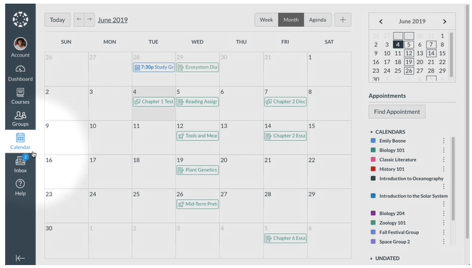
0102 Canvas
https://ucsc-extension.instructure.com/courses/3825/pages/1-dot-1-welcome?module_item_id=42202
Calendar: View Course or personal calendar.

Slide 13
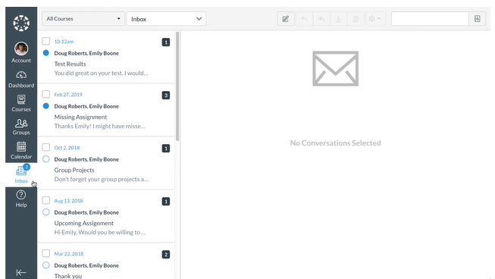
0102 Canvas
https://ucsc-extension.instructure.com/courses/3825/pages/1-dot-1-welcome?module_item_id=42202
Inbox: Conversation with your instructor.

Slide 14
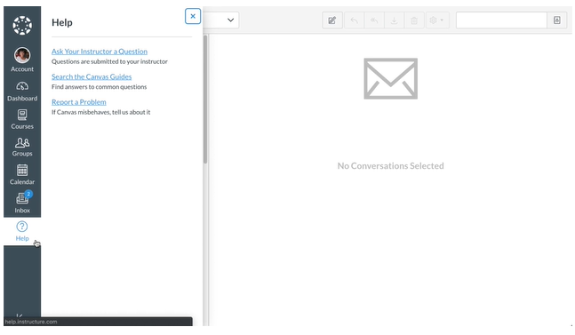
0102 Canvas
https://ucsc-extension.instructure.com/courses/3825/pages/1-dot-1-welcome?module_item_id=42202
Help: Help Resource for your institution.

Slide 15
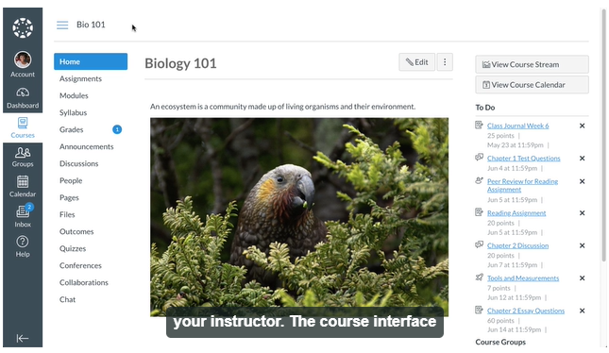
0102 Canvas
https://ucsc-extension.instructure.com/courses/3825/pages/1-dot-1-welcome?module_item_id=42202
Course Link: click it to access the all the courses.

Slide 16
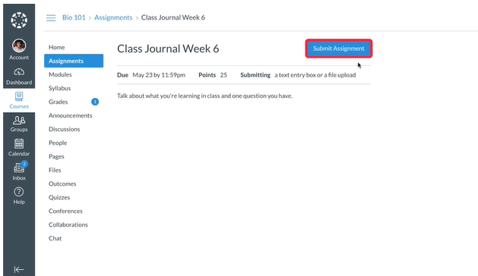
0102 Canvas
https://ucsc-extension.instructure.com/courses/3825/pages/1-dot-1-welcome?module_item_id=42202
Submit Assignment

Slide 17
0102.1 Use Student Canvas

Slide 18
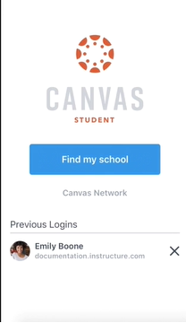
0102.1 Use Student Canvas
https://ucsc-extension.instructure.com/courses/3825/pages/1-dot-1-welcome?module_item_id=42202
Student Canvas

Slide 19
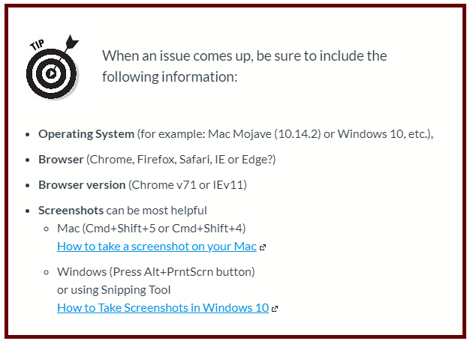
0102.1 Use Student Canvas
https://ucsc-extension.instructure.com/courses/3825/pages/1-dot-1-welcome?module_item_id=42202
When ask question: OS, Browser, Browser Version, Screen shot

Slide 20
End of Chapter

