Slide 1

0103 Feedback
Peter H. Chen

Slide 2
0103 Feedback
https://ucsc-extension.instructure.com/courses/3825/pages/1-dot-1-welcome?module_item_id=42202
0103 Getting Feedback
Grades and Feedback:
Getting feedback is an essential part of taking a course and so I want to ensure that you can "find" my feedback!
There are two elements in feedback.
Rubrics:
Each assignment is set up with a Grading Rubric.
Be sure to go through the Rubric to ensure you have completed the basic components of the assignment that I will be looking for in your submission.
When you get an Assignment graded, please click on the Rubric Icon to read my specific feedback (see instructions below).
Comments:
These are my overall, general comments.
You can access both types of feedback in two methods!

Slide 3
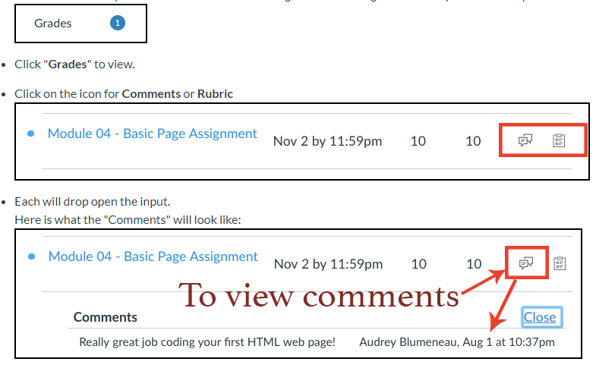
0103 Feedback
https://ucsc-extension.instructure.com/courses/3825/pages/1-dot-1-welcome?module_item_id=42202
#1: Viewing feedback via the Grades Menu option:
You will know that you have feedback or received a grade for an assignment when you see this in you left course navigation:

Slide 4
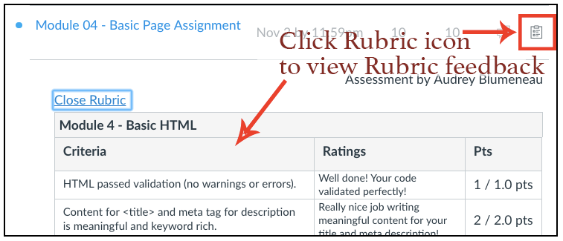
0103 Feedback
https://ucsc-extension.instructure.com/courses/3825/pages/1-dot-1-welcome?module_item_id=42202
And here is what the Rubric feedback will look like:

Slide 5
0103 Feedback
https://ucsc-extension.instructure.com/courses/3825/pages/1-dot-1-welcome?module_item_id=42202
2: View this information from the Assignment.
Go to the Assignment (there are two ways):
within Grades click on the Assignment (in above example it would be Homework 1-Basic Code) or
go to Assignments link on left menu.

Slide 6
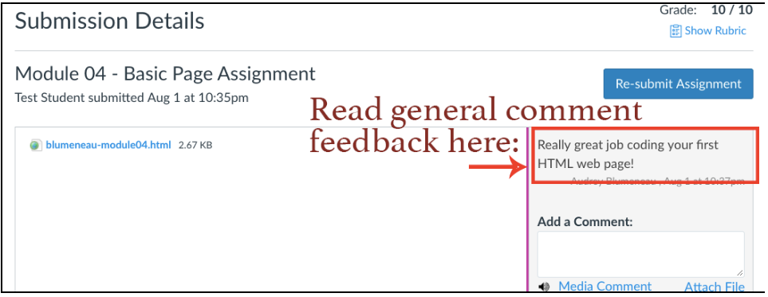
0103 Feedback
https://ucsc-extension.instructure.com/courses/3825/pages/1-dot-1-welcome?module_item_id=42202
To see Comments:

Slide 7
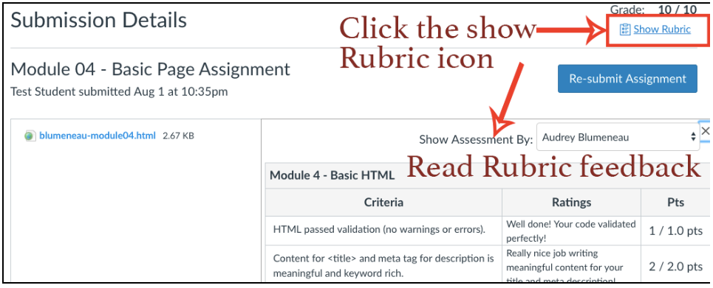
0103 Feedback
https://ucsc-extension.instructure.com/courses/3825/pages/1-dot-1-welcome?module_item_id=42202
To see Rubric feedback be sure to click on the Show Rubric text link on the right side

Slide 8
0103 Feedback
https://ucsc-extension.instructure.com/courses/3825/pages/1-dot-1-welcome?module_item_id=42202
Got Questions?
Send me a message via the Inbox!

Slide 9
End of Chapter

