Slide 1

0201 Internet History
Peter H. Chen

Slide 2
0201 Internet History
https://ucsc-extension.instructure.com/courses/3825/pages/1-dot-1-welcome?module_item_id=42202
2.1 - History of the Internet (in a Nutshell!): Nutshell (say in brief)
The Internet
The “Internet” is defined as simply being a large-scale network of millions of computers.
The Internet dates back to the 1960’s during the cold war between the United States and the former Soviet Union so that communications between military sites could be preserved in the event of nuclear war.
It came to include universities so that the military could keep in contact with the world's top scientists.
Initial sites were .gov and .edu. The Advanced Research Projects Agency Network (ARPANET) developed by ARPA of the U.S. Department of Defense was the world's first operational packet switching network, and the progenitor (pioneer) of the global Internet.

Slide 3
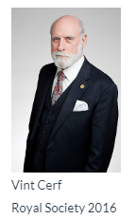
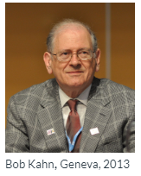
0201 Internet History
https://ucsc-extension.instructure.com/courses/3825/pages/1-dot-1-welcome?module_item_id=42202
2.1 - History of the Internet (in a Nutshell!): Nutshell (say in brief)
The fathers of the Internet, Vint Cerf and Bob Kahn defined the "Internet Protocol" (IP) by which packets are sent on from one computer to another until they reach their destination.
The mode in which we communicate through these different computers is called a “protocol”.

Slide 4
0201 Internet History
https://ucsc-extension.instructure.com/courses/3825/pages/1-dot-1-welcome?module_item_id=42202
Common Internet protocols that we use today include:
HTTP (Hyper Text Transfer Protocol) – allow us to access the World Wide Web
FTP (File Transfer Protocol) – used to upload or download web pages to and from a server)
E-Mail (Electronic mail) - Allows us to send and receive email
IRC (Internet Relay Chat) - allows you to connect to a chosen channel and talk in real-time to people with the same interests as you.
USENET (Unix User Network) - a system of bulletin boards where you and anyone else can post messages and people will read and reply to them.

Slide 5
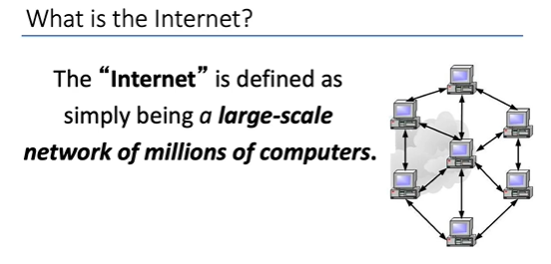
0201 Internet History
https://ucsc-extension.instructure.com/courses/3825/pages/1-dot-1-welcome?module_item_id=42202
What is intent?

Slide 6
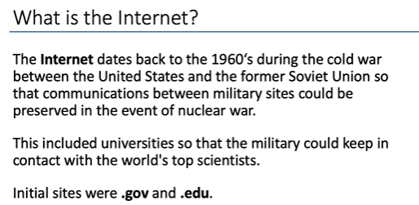
0201 Internet History
https://ucsc-extension.instructure.com/courses/3825/pages/1-dot-1-welcome?module_item_id=42202
What is intent?

Slide 7
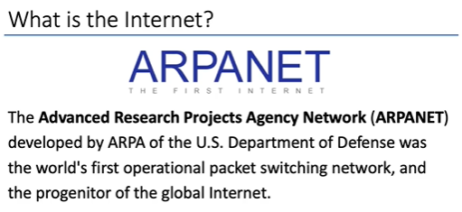
0201 Internet History
https://ucsc-extension.instructure.com/courses/3825/pages/1-dot-1-welcome?module_item_id=42202
What is intent?

Slide 8
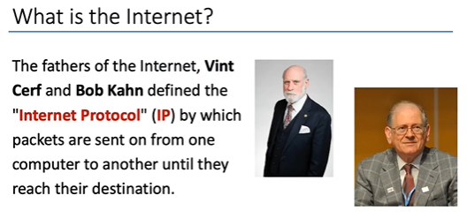
0201 Internet History
https://ucsc-extension.instructure.com/courses/3825/pages/1-dot-1-welcome?module_item_id=42202
What is intent?

Slide 9
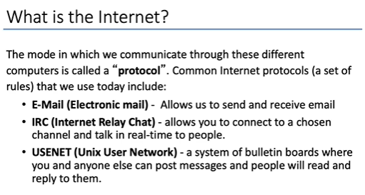
0201 Internet History
https://ucsc-extension.instructure.com/courses/3825/pages/1-dot-1-welcome?module_item_id=42202
What is intent?

Slide 10
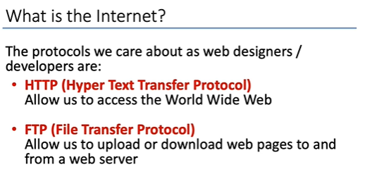
0201 Internet History
https://ucsc-extension.instructure.com/courses/3825/pages/1-dot-1-welcome?module_item_id=42202
What is intent?

Slide 11
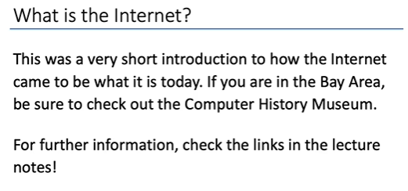
0201 Internet History
https://ucsc-extension.instructure.com/courses/3825/pages/1-dot-1-welcome?module_item_id=42202
What is intent?

Slide 12
End of Chapter

