Slide 1

0205 History Quiz
Peter H. Chen

Slide 2
0205 History Quiz
https://ucsc-extension.instructure.com/courses/3825/pages/1-dot-1-welcome?module_item_id=42202
Due Dec 17 at 11:59pm Points 10 Questions 10
Available Sep 17 at 12am - Dec 17 at 11:59pm 3 monthsTime Limit 30 Minutes
Allowed Attempts 3
Instructions
Review of Concepts covered in Module 2
Objectives:
Students should be able to:
Define key players in Internet, Web and HTML development
Identify key terms of Internet, Web and HTML development
About the Quiz:
This is a graded quiz
There are 10 questions for a total of 10 points.
You can take the quiz three times
Highest score is applied.
You will have 30 minutes to complete for each attempt.

Slide 3
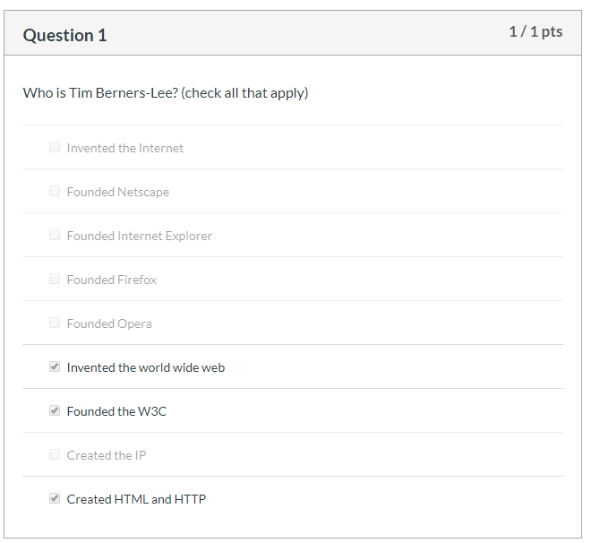

0205 History Quiz
https://ucsc-extension.instructure.com/courses/3825/pages/1-dot-1-welcome?module_item_id=42202
Questions:

Slide 4
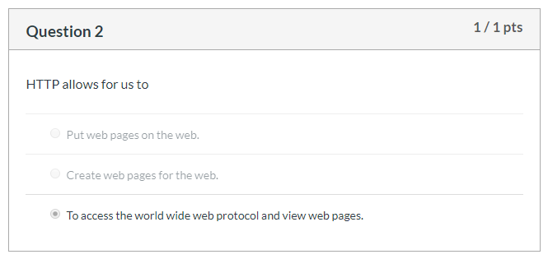
0205 History Quiz
https://ucsc-extension.instructure.com/courses/3825/pages/1-dot-1-welcome?module_item_id=42202
Questions:

Slide 5
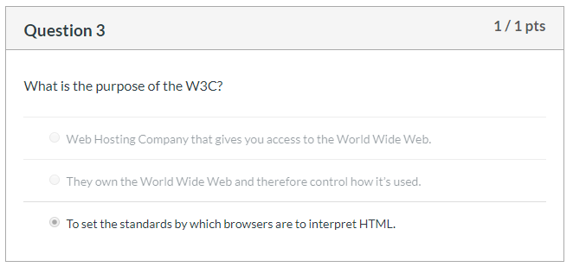
0205 History Quiz
https://ucsc-extension.instructure.com/courses/3825/pages/1-dot-1-welcome?module_item_id=42202
Questions:

Slide 6
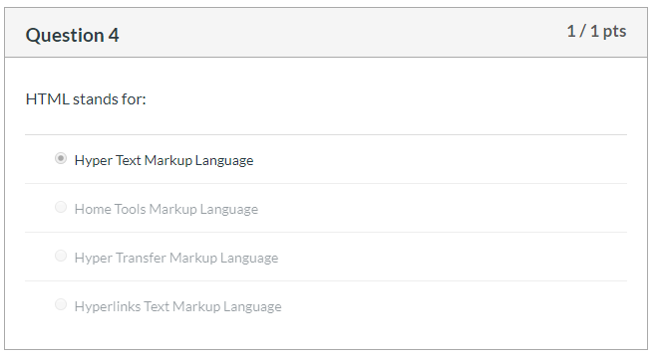
0205 History Quiz
https://ucsc-extension.instructure.com/courses/3825/pages/1-dot-1-welcome?module_item_id=42202
Questions:

Slide 7
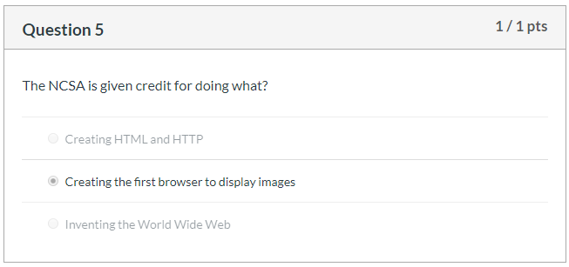
0205 History Quiz
https://ucsc-extension.instructure.com/courses/3825/pages/1-dot-1-welcome?module_item_id=42202
Questions:

Slide 8
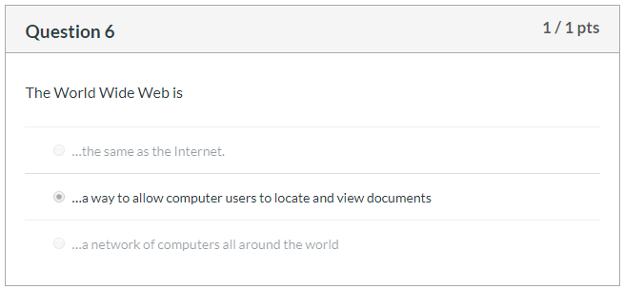
0205 History Quiz
https://ucsc-extension.instructure.com/courses/3825/pages/1-dot-1-welcome?module_item_id=42202
Questions:

Slide 9
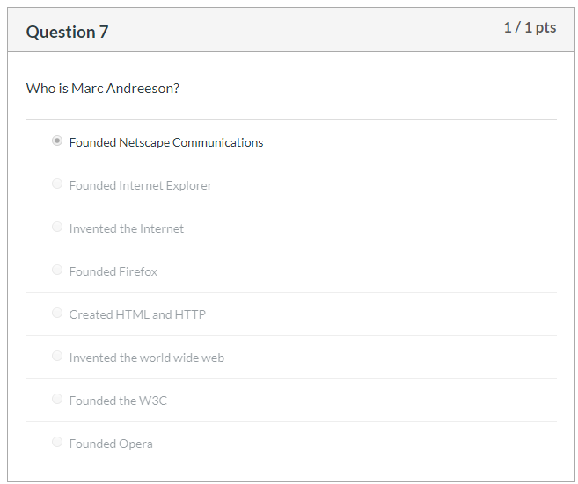
0205 History Quiz
https://ucsc-extension.instructure.com/courses/3825/pages/1-dot-1-welcome?module_item_id=42202
Questions:

Slide 10
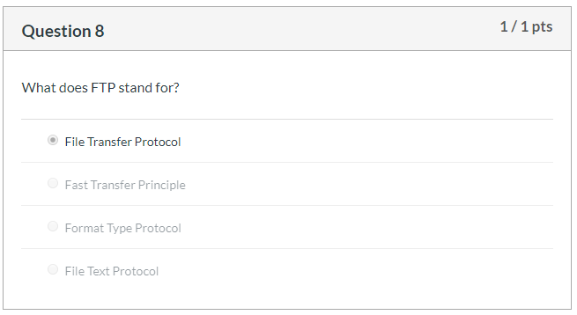
0205 History Quiz
https://ucsc-extension.instructure.com/courses/3825/pages/1-dot-1-welcome?module_item_id=42202
Questions:

Slide 11
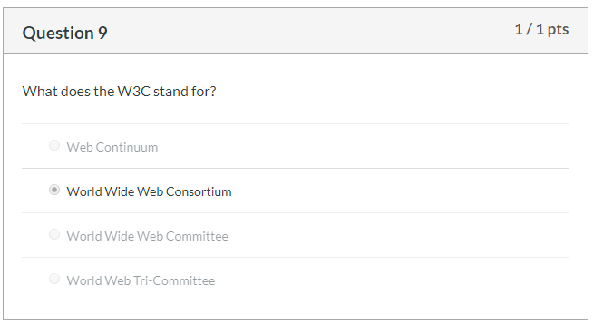
0205 History Quiz
https://ucsc-extension.instructure.com/courses/3825/pages/1-dot-1-welcome?module_item_id=42202
Questions:

Slide 12
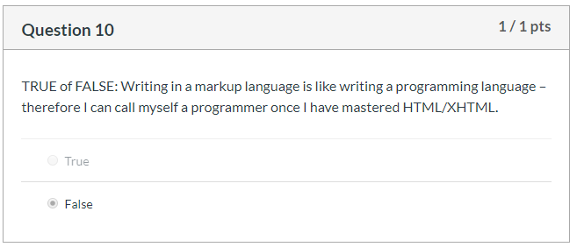

0205 History Quiz
https://ucsc-extension.instructure.com/courses/3825/pages/1-dot-1-welcome?module_item_id=42202
Questions:

Slide 13
End of Chapter

