Slide 1

0501 List
Peter H. Chen

Slide 2
0501 List
https://ucsc-extension.instructure.com/courses/3825/pages/1-dot-1-welcome?module_item_id=42202
0501 What are Lists?
Lists - An Overview
List may not seem like an exciting topic. We often make lists when we go grocery shopping or to-do lists at work or at home. Lists can be ingredients for a recipe or steps to bake cookies!
Why Use Lists?
Making lists for your web page content can be important for several reasons.
First of all, they make it easy to scan content or information, particularly, when there is a large amount of content.
It helps draw attention to key ideas or important details.
Secondly, by breaking up large amounts of dense content you create white-space, making the web page look less intimidating and more user-friendly.
It can simplify complex ideas for easier understanding helps improve website effectiveness.
And lastly, it can really helps both the writer and the reader get to the point quickly!

Slide 3
0501 List
https://ucsc-extension.instructure.com/courses/3825/pages/1-dot-1-welcome?module_item_id=42202
0501 What are Lists?
Different Types of Lists:
There are three types of lists used on the web. They consist of bulleted lists called unordered list in HTML and numbered lists known as ordered lists.
One would use bullet lists when the content does not involve steps or ideas that should be interpreted in a certain order.
One would use number points for lists involving steps that should be done in a specific order or points listed in order of importance.
The third type of list is a description list. These are used for creating glossary information (for example when you are explaining terminology) or for a question and answer set up.

Slide 4
0501 List
https://ucsc-extension.instructure.com/courses/3825/pages/1-dot-1-welcome?module_item_id=42202
0501 What are Lists?
Best Practices:
It's good to keep some best practices in mind for applying lists to your website These include:
Try to keep all lines in the list to a similar length.
Introduce bullet lists with a descriptive sentence or two.
Avoid repeating phrases; include only important details.
Use the same formatting and sentence structure in the list.
Don’t overuse bulleted lists or they lose their effectiveness.
So, let's explore how to hand-code these different types of lists!

Slide 5
0501.1 List Video

Slide 6

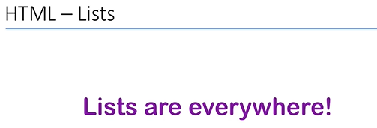
0501.1 List Video
https://ucsc-extension.instructure.com/courses/3825/pages/1-dot-1-welcome?module_item_id=42202
0501.1 List Video

Slide 7
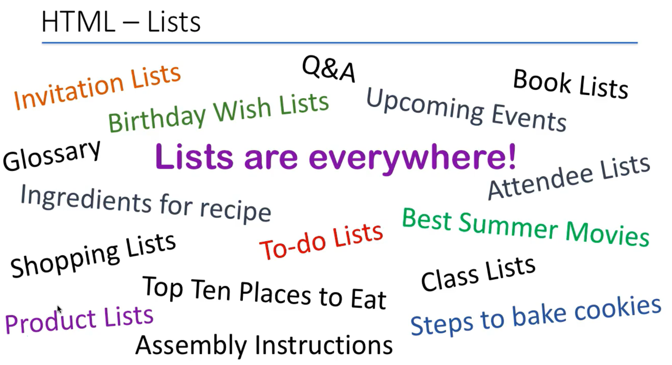
0501.1 List Video
https://ucsc-extension.instructure.com/courses/3825/pages/1-dot-1-welcome?module_item_id=42202
0501.1 List Video

Slide 8
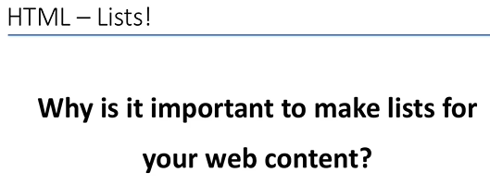
0501.1 List Video
https://ucsc-extension.instructure.com/courses/3825/pages/1-dot-1-welcome?module_item_id=42202
0501.1 List Video

Slide 9
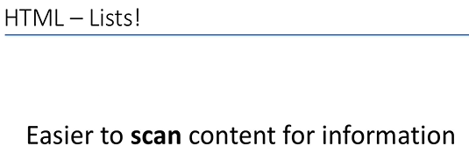
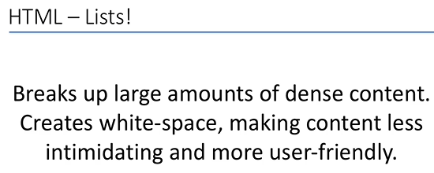
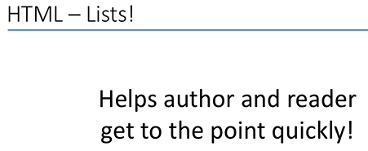
0501.1 List Video
https://ucsc-extension.instructure.com/courses/3825/pages/1-dot-1-welcome?module_item_id=42202
0501.1 List Video: Why use list? First, Second, Third.

Slide 10
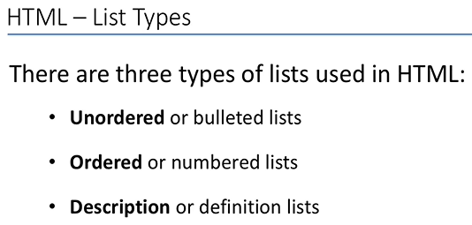
0501.1 List Video
https://ucsc-extension.instructure.com/courses/3825/pages/1-dot-1-welcome?module_item_id=42202
0501.1 List Video: Three kinds of list: Unorder, Order, and Description.

Slide 11
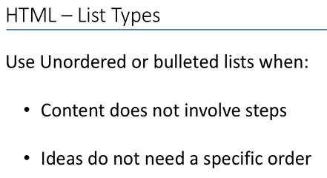
0501.1 List Video
https://ucsc-extension.instructure.com/courses/3825/pages/1-dot-1-welcome?module_item_id=42202
0501.1 List Video: Unorder.

Slide 12
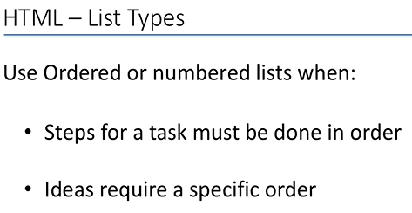
0501.1 List Video
https://ucsc-extension.instructure.com/courses/3825/pages/1-dot-1-welcome?module_item_id=42202
0501.1 List Video: Order.

Slide 13
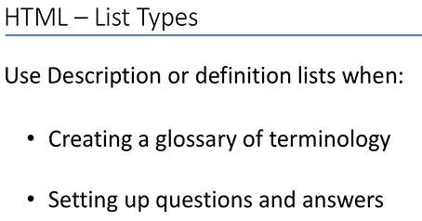
0501.1 List Video
https://ucsc-extension.instructure.com/courses/3825/pages/1-dot-1-welcome?module_item_id=42202
0501.1 List Video: Description.

Slide 14
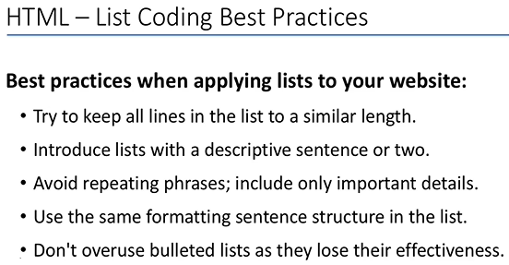
0501.1 List Video
https://ucsc-extension.instructure.com/courses/3825/pages/1-dot-1-welcome?module_item_id=42202
0501.1 List Video:

Slide 15
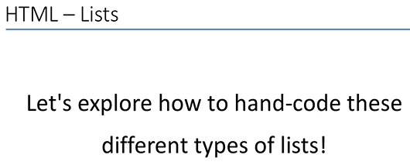
0501.1 List Video
https://ucsc-extension.instructure.com/courses/3825/pages/1-dot-1-welcome?module_item_id=42202
0501.1 List Video:

Slide 16
End of Chapter

