Slide 1

0504 Nested List
Peter H. Chen

Slide 2
0504 Nested List
https://ucsc-extension.instructure.com/courses/3825/pages/1-dot-1-welcome?module_item_id=42202
0504 Nested List
Nesting Lists:
The trick behind making a nested list not only look like a nested list but also validate, is that you need to put the closing </li> tag after the nested list!
<ol>
<li>Text 1 /* don't close the </li> here.... */
<ul>
<li>Nested List</li>
</ul>
</li>
<li>Text 2</li>
</ol>
So a real world list might look something like this (the video demos the code for this):

Slide 3
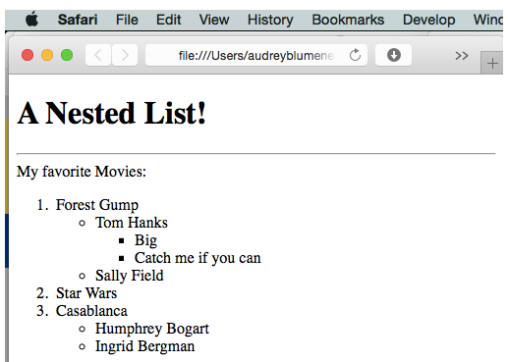
0504 Nested List
https://ucsc-extension.instructure.com/courses/3825/pages/1-dot-1-welcome?module_item_id=42202
0504 Nested List

Slide 4
0504.1 Nested List Video

Slide 5
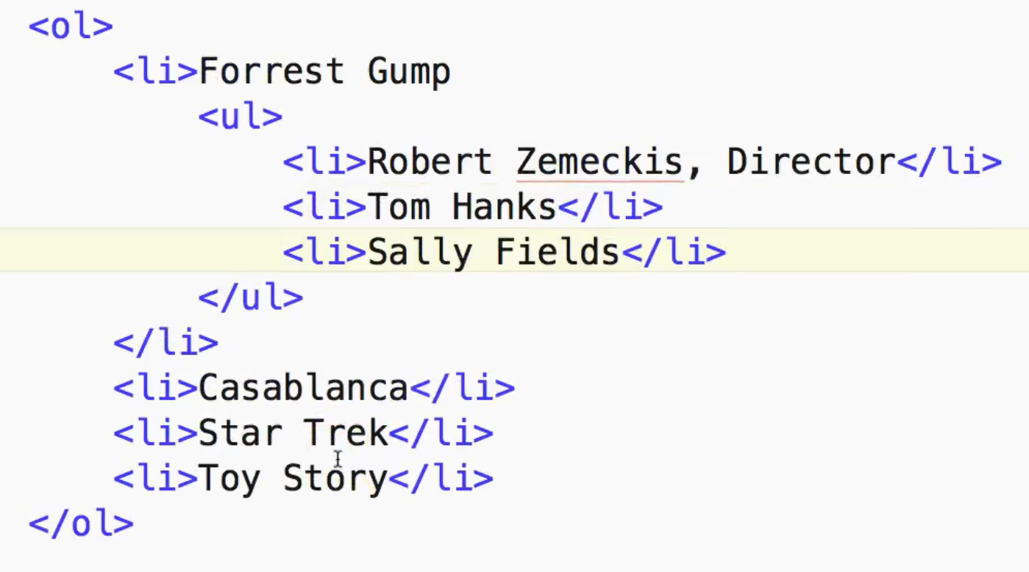
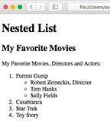
0504.1 Nested List Video
https://ucsc-extension.instructure.com/courses/3825/pages/1-dot-1-welcome?module_item_id=42202
0504.1 Nested List Video

Slide 6
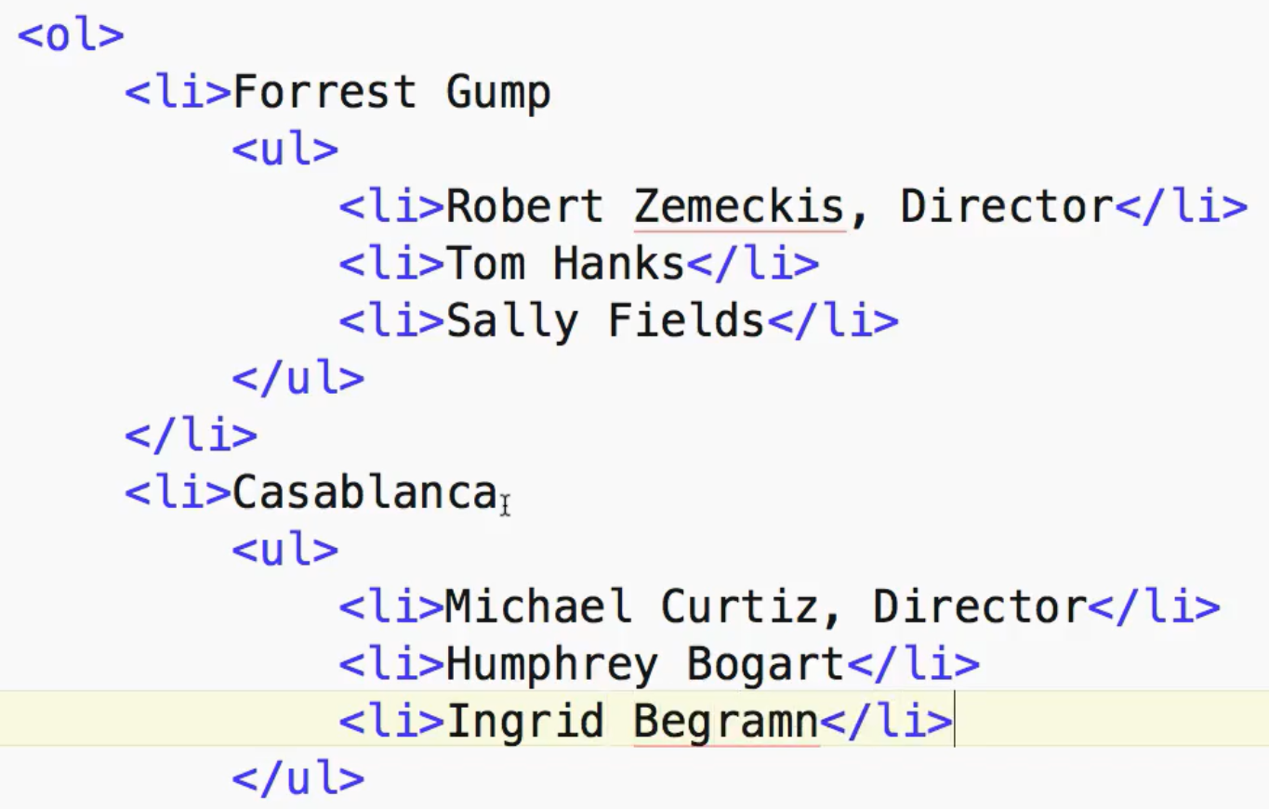
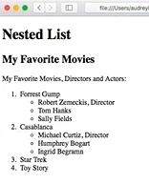
0504.1 Nested List Video
https://ucsc-extension.instructure.com/courses/3825/pages/1-dot-1-welcome?module_item_id=42202
0504.1 Nested List Video

Slide 7
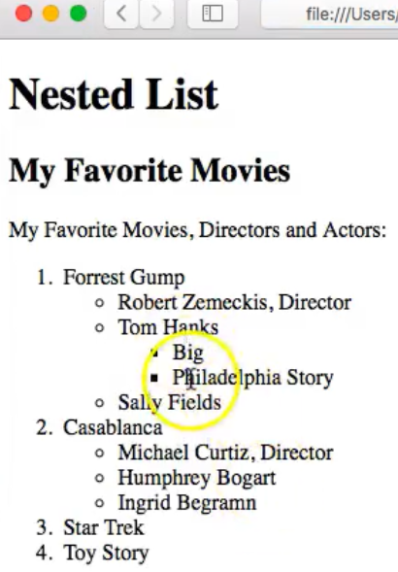
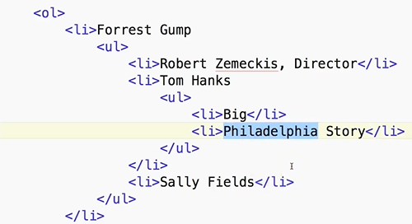
0504.1 Nested List Video
https://ucsc-extension.instructure.com/courses/3825/pages/1-dot-1-welcome?module_item_id=42202
0504.1 Nested List Video

Slide 8
End of Chapter

