Slide 1

0505 Description List
Peter H. Chen

Slide 2
0505 Description List
https://ucsc-extension.instructure.com/courses/3825/pages/1-dot-1-welcome?module_item_id=42202
0505 Description List
Description Lists: <dl> … </dl>
This is the third type of list and it follows a different structure.
Definition lists (as they are known in HTML 4.01 and XHTML) are now called Description Lists in HTML5.
They consist of name and value pairs, including but not limited to terms and definitions.
The name and value pairs can represent terms and definitions or questions and answers or other types of terms and their associated information.
These name and value pairs are block-level items.
That means that the list itself and the individual list items will start on a new line and have space above and below.

Slide 3
0505 Description List
https://ucsc-extension.instructure.com/courses/3825/pages/1-dot-1-welcome?module_item_id=42202
0505 Description List
The entire Description list is structured using the <dl>…</dl> tags.
Within these, each name is indicated with a <dt> tag (think of this as a “term”) and its’ value is marked with a <dd> (think of “definition”).
HTML allows for you to leave out the closing </dt> and closing </dd> tags but XHTML mandates all tags be closed, so, it’s good to get into the habit of closing all these tags no matter what you use – it makes more sense to say that the definition ends here by putting in the closing </dd> just like you do for the </dt> and the </dl> tags.

Slide 4
0505 Description List
https://ucsc-extension.instructure.com/courses/3825/pages/1-dot-1-welcome?module_item_id=42202
0505 Description List
Here is what the code might look like and how it is interpreted by the browser:
<dl>
<dt> HTML -- (HyperText Markup Language)</dt>
<dd>The coding language used to create Hypertext documents for use on the World Wide Web. The hyper in Hypertext comes from the fact that in HTML you can specify that a block of text, or an image, is linked to another file on the Internet. HTML files are meant to be viewed using a Web Browser. </dd>
<dt>Meta Tag</dt>
<dd> A specific kind of HTML tag that contains information not normally displayed to the user. Meta tags contain information about the page itself, hence the name ("meta" which means "about this subject"). Typical uses of Meta tags are to include information for search engines to help them better categorize a page.</dd>
</dl>

Slide 5
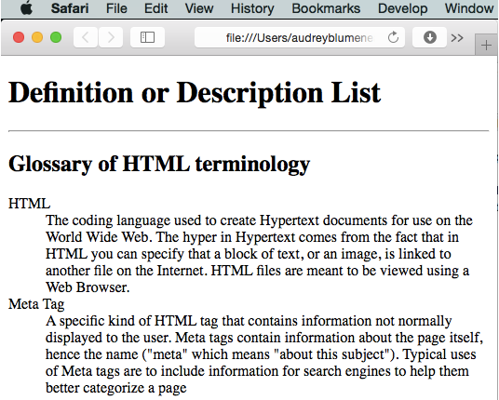
0505 Description List
https://ucsc-extension.instructure.com/courses/3825/pages/1-dot-1-welcome?module_item_id=42202
0505 Description List

Slide 6
0505.1 Description List Video

Slide 7
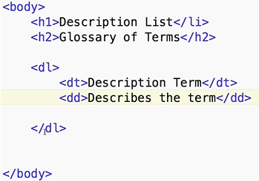
0505.1 Description List Video
https://ucsc-extension.instructure.com/courses/3825/pages/1-dot-1-welcome?module_item_id=42202
0505.1 Description List Video

Slide 8
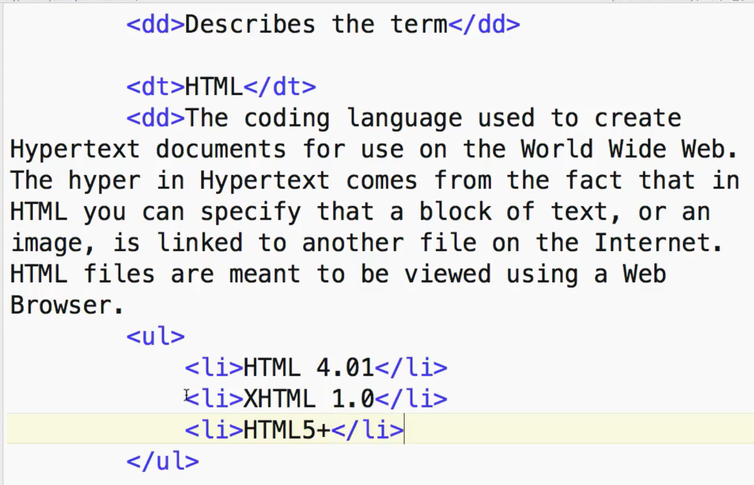
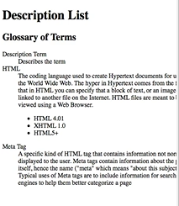
0505.1 Description List Video
https://ucsc-extension.instructure.com/courses/3825/pages/1-dot-1-welcome?module_item_id=42202
0505.1 Description List Video

Slide 9
End of Chapter

