Slide 1

0506 List Assignment
Peter H. Chen

Slide 2
0506 List Assignment
https://ucsc-extension.instructure.com/courses/3825/pages/1-dot-1-welcome?module_item_id=42202
0506 List Assignment
Due Dec 17 by 11:59pm Points 10
Submitting a file upload Available Sep 17 at 12am - Dec 17 at 11:59pm 3 months
Assignment: HTML Lists
Objective:
Be able to demonstrate writing code for:
Nested list
Description list
Meets and passes W3C Validation standards

Slide 3
0506 List Assignment
https://ucsc-extension.instructure.com/courses/3825/pages/1-dot-1-welcome?module_item_id=42202
0506 List Assignment
What you will do:
Open a new document and save/name it yourlastname-05-lists.html
Use the HTML5 doctype and meta tag for the charset.
Code a Nested List (this list can be of any topic of your choice).
Have at minimum, 3 main categories with at least 2 sub-categoies listed for each main category.
Code a Description List, again, any topic of your choice.
Provide a "glossary" or "FAQs" using the description list - have at minimum 3 terms/questions to describe/answer.
As always, make sure to keep a <title> that is good for search engines/bookmarking, write meta tags that have good descriptions (lots of keywords and key phrases relative to your content)
Validate your code per the W3C standards:
Use the HTML5 Nu validator (Links to an external site.) for the HTML5 doctype.
(check all the boxes for source, outline and image report).

Slide 4
0506 List Assignment
https://ucsc-extension.instructure.com/courses/3825/pages/1-dot-1-welcome?module_item_id=42202
0506 List Assignment
NOTE:
It is strongly recommended to use the HTML5 doctype and meta tag for this exercise. As long as you don't use any deprecated attributes (there is only one deprecated attribute in this module), which you shouldn't use anyway;
The HTML code here is exactly the same whether we use HTML 4.01 Transitional, XHTML 1.0 Transitional or HTML5!
What to Submit:
Double check Rubric Criteria (see below)
Submit your .html file here!
Example:
Here is an example of what your assignment might look like. Note usage of phrase elements including things like the <cite> element, which you can't 'see' here!

Slide 5
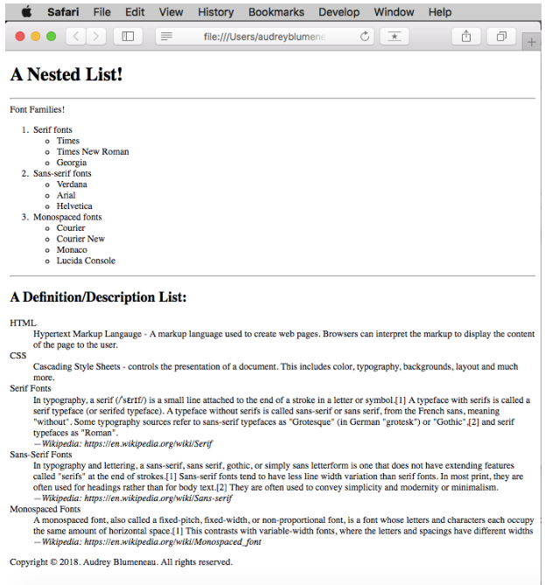
0506 List Assignment
https://ucsc-extension.instructure.com/courses/3825/pages/1-dot-1-welcome?module_item_id=42202
0506 List Assignment

Slide 6
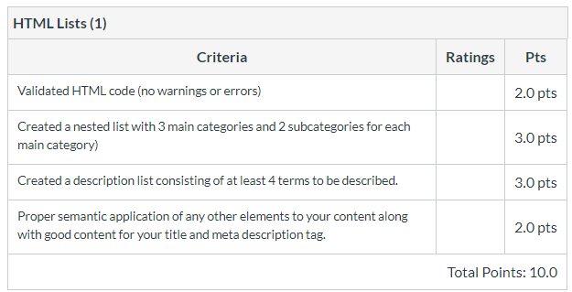
0506 List Assignment
https://ucsc-extension.instructure.com/courses/3825/pages/1-dot-1-welcome?module_item_id=42202
0506 List Assignment

Slide 7
End of Chapter

