Slide 1

0507 List Quiz
Peter H. Chen

Slide 2
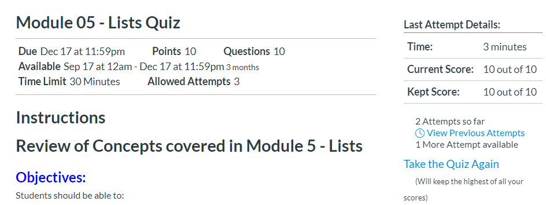
0507 List Quiz
https://ucsc-extension.instructure.com/courses/3825/pages/1-dot-1-welcome?module_item_id=42202
0507 Module 05 - Lists Quiz
Due Dec 17 at 11:59pm Points 10 Questions 10
Available Sep 17 at 12am - Dec 17 at 11:59pm 3 months
Time Limit 30 Minutes Allowed Attempts 3

Slide 3
0507 List Quiz
https://ucsc-extension.instructure.com/courses/3825/pages/1-dot-1-welcome?module_item_id=42202
0507 Module 05 - Lists Quiz
Instructions
Review of Concepts covered in Module 5 – List
Objectives:
Students should be able to:
Define HTML terminology regarding different types of lists
Identify correct HTML usage of elements and attributes for creating lists
About the Quiz:
This is a graded quiz
There are 10 questions for a total of 10 points.
You can take the quiz three times
Highest score is applied.
You will have 30 minutes to complete for each attempt.

Slide 4
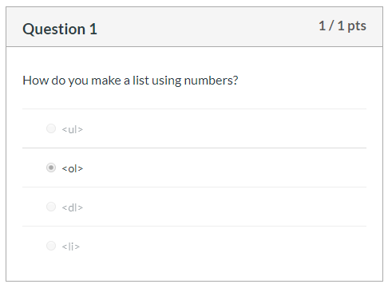
0507 List Quiz
https://ucsc-extension.instructure.com/courses/3825/pages/1-dot-1-welcome?module_item_id=42202
0507 Module 05 - Lists Quiz

Slide 5
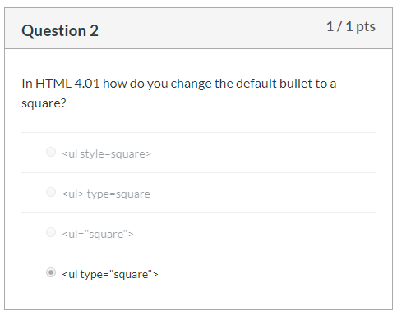
0507 List Quiz
https://ucsc-extension.instructure.com/courses/3825/pages/1-dot-1-welcome?module_item_id=42202
0507 Module 05 - Lists Quiz

Slide 6
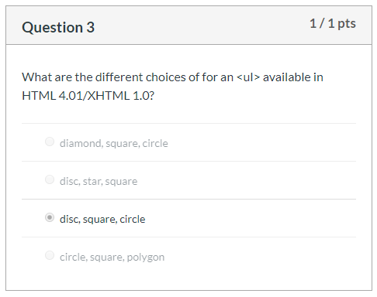
0507 List Quiz
https://ucsc-extension.instructure.com/courses/3825/pages/1-dot-1-welcome?module_item_id=42202
0507 Module 05 - Lists Quiz: Disc, Square, Circle

Slide 7
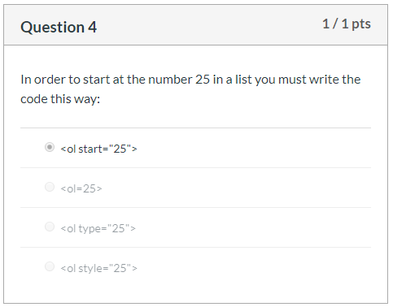
0507 List Quiz
https://ucsc-extension.instructure.com/courses/3825/pages/1-dot-1-welcome?module_item_id=42202
0507 Module 05 - Lists Quiz

Slide 8
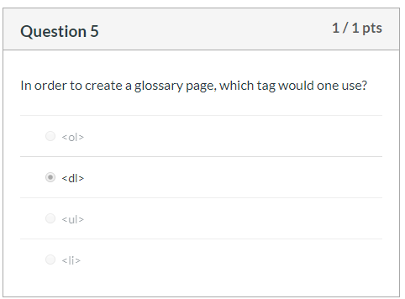
0507 List Quiz
https://ucsc-extension.instructure.com/courses/3825/pages/1-dot-1-welcome?module_item_id=42202
0507 Module 05 - Lists Quiz

Slide 9
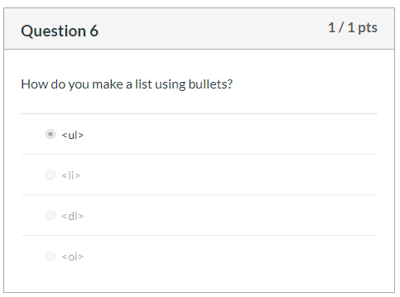
0507 List Quiz
https://ucsc-extension.instructure.com/courses/3825/pages/1-dot-1-welcome?module_item_id=42202
0507 Module 05 - Lists Quiz

Slide 10
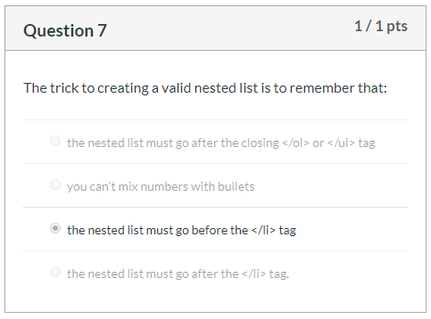
0507 List Quiz
https://ucsc-extension.instructure.com/courses/3825/pages/1-dot-1-welcome?module_item_id=42202
0507 Module 05 - Lists Quiz

Slide 11
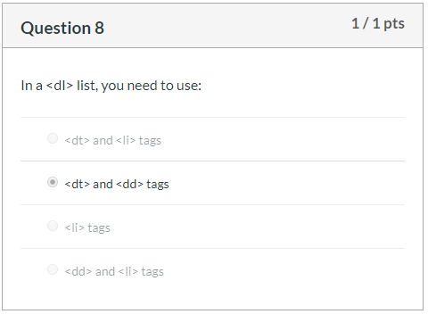
0507 List Quiz
https://ucsc-extension.instructure.com/courses/3825/pages/1-dot-1-welcome?module_item_id=42202
0507 Module 05 - Lists Quiz

Slide 12
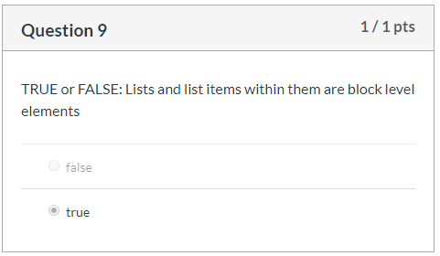
0507 List Quiz
https://ucsc-extension.instructure.com/courses/3825/pages/1-dot-1-welcome?module_item_id=42202
0507 Module 05 - Lists Quiz

Slide 13
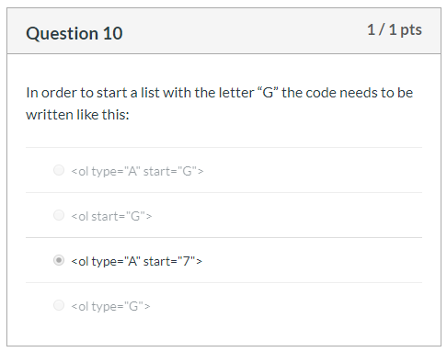

0507 List Quiz
https://ucsc-extension.instructure.com/courses/3825/pages/1-dot-1-welcome?module_item_id=42202
0507 Module 05 - Lists Quiz

Slide 14
End of Chapter

