Slide 1

1201 Final Project
Peter H. Chen

Slide 2
1201 Final Project
https://ucsc-extension.instructure.com/courses/3825/pages/1-dot-1-welcome?module_item_id=42202
1201 Final Project
Due Dec 17 by 11:59pm Points 100 Submitting a file upload
Available Sep 17 at 12am - Dec 17 at 11:59pm 3 months
Final Project - Hand-coding a Website:
This is your Final HTML Project to demonstrate your ability to hand-code a website incorporating all the wonderful HTML elements and attribute you have learned throughout this course. The topic can be about anything - your vacation, your cat, or a hobby.
Objective:
You should be able to demonstrate the ability to:
write valid, structurally sound HTML5 code [passing the W3C Nu Validator (https://validator.w3.org/nu/) Specification].
code with proper semantic application of HTML elements and attributes such as block level, inline level, and phrase elements
write code that will be seen by and aid the user in search engine optimization
write code that will aid the user and meet accessibility standards and practices

Slide 3
1201 Final Project
https://ucsc-extension.instructure.com/courses/3825/pages/1-dot-1-welcome?module_item_id=42202
1201 Final Project
What you will do:
This website should consist of 3 pages (for example: index.html, about.html and contact.html)!
Use HTML5 doctype. Make sure the website contains the following: (~5 points each).
Create a folder called yourlastname-12-final. Include a folder called images and save all files to this folder.
Create a home page introducing a topic (this home page must be named “index.html”)
Demonstrate ability to code various types of Links
Relative links: all the pages to each other (e.g. have a navigation bar on all pages!).
Absolute, named anchor, email, telephone links (e.g. on a contact page)

Slide 4
1201 Final Project
https://ucsc-extension.instructure.com/courses/3825/pages/1-dot-1-welcome?module_item_id=42202
1201 Final Project
What you will do:
Demonstrate ability to code a list.
Showcase: unordered, ordered, description and a nested lists!
Add images that have been properly optimized and cited. Make it so that some images will:
Link to a larger version of that image
Link to an absolute URL (i.e. http://www.ireland.com)
Contains an image map (just one area is fine)
Code a data table.

Slide 5
1201 Final Project
https://ucsc-extension.instructure.com/courses/3825/pages/1-dot-1-welcome?module_item_id=42202
1201 Final Project
Demonstrate the application of form elements (different from your previous assignment) that contains at the very least:
radio buttons
Checkboxes
Menus
text and textarea fields
fieldsets and buttons
Apply an iframe.
Pay attention to the semantic and structural meaning of your code when using block level, inline level and phrase elements.
Proper application of character entities for characters such as en dashes, em dashes and curly quotation marks (not limited to these (e.g. copyright symbol)).
Write meaningful content for title, meta tags for description and alt attributes (should be unique for each page/image)

Slide 6
1201 Final Project
https://ucsc-extension.instructure.com/courses/3825/pages/1-dot-1-welcome?module_item_id=42202
1201 Final Project
Check for spelling and grammar errors.
If you have copied someone else’s content (i.e. Wikipedia) cite your sources.
Validate all your pages! [you should have, by now, bookmarked that HTML5 Nu validator (https://validator.w3.org/nu/)! ]
Have fun!
You have learned a lot and are on your way to creating functional website pages that are structurally sound and meet all the standards for web designers.
It's highly recommended that you do not re-use your previous Homework Pages!
This is your time to review all the concepts learned in the course; a time to see if you remember how to do the things learned at the beginning!
The more you can practice hand-coding the easier and faster it will be to write this code.
It really is so critical to be able to read and write this code.

Slide 7
1201 Final Project
https://ucsc-extension.instructure.com/courses/3825/pages/1-dot-1-welcome?module_item_id=42202
1201 Final Project
What you will submit:
Be sure to review the Rubric to ensure you are meeting the criteria of this assignment.
Submit your .zip folder

Slide 8
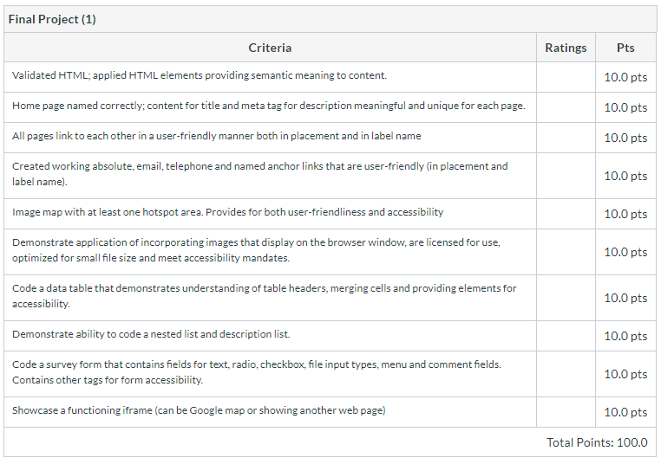
1201 Final Project
https://ucsc-extension.instructure.com/courses/3825/pages/1-dot-1-welcome?module_item_id=42202
1201 Final Project

Slide 9
End of Chapter

