Slide 1

1101 HTML5
Peter H. Chen

Slide 2
1101 HTML5
https://ucsc-extension.instructure.com/courses/3825/pages/1-dot-1-welcome?module_item_id=42202
1101 HTML 5: What Is It?, A Little History, What's Different?
HTML5 – The Official Standard!
It’s been talked about for some time but in mid 2009, the talk has turned into action and web sites are starting to demonstrate the newest version of HTML: HTML5.
As of October 28th, 2014 the W3C announced that: “HTML5 is an official Recommendation!” After 14 years of HTML 4.01 and XHTML 1.0, this was quite the anticipated and welcomed news!
Since then, we have had HTML5.1 come and go and now, as of December 14, 2017, we have HTML5.2 as the official W3C Recommendation! (Note my videos are being updated to keep up; when they are posted, I will let you know!). In addition, the first working draft of HTML5.3 has been started and the W3C plans to essentially release a new update each year! Phew!

Slide 3
1101 HTML5
https://ucsc-extension.instructure.com/courses/3825/pages/1-dot-1-welcome?module_item_id=42202
1101 HTML 5: What Is It?, A Little History, What's Different?
For this module, we will stay with the “fundamentals”! Needless to say, there is a TON more to learn and explore in HTML but everything we have done so far is the foundation for all things to come.
Read the article: W3C Blog: HTML5.2 is here and HTML5.3 is coming! (https://www.w3.org/blog/2017/12/html-5-2-is-done-html-5-3-is-coming/)
Read the specification: HTML5.2 Recommendation (https://www.w3.org/TR/2017/REC-html52-20171214/)

Slide 4
1101 HTML5
https://ucsc-extension.instructure.com/courses/3825/pages/1-dot-1-welcome?module_item_id=42202
1101 HTML 5: What Is It?, A Little History, What's Different?
What took so long in the first place?
Remember that HTML4.01 and XHTML1.0 were the joint standards for 14 years... and now all of a sudden we are back to every year, there is a new update!
The problem that kept us from truly using HTML5 earlier was that Internet Explorer 8.0 (IE 8) did not fully support HTML5 and it was at the time the dominant browser being used.
None-the-less, people started to create websites using HTML5 because the new versions of Firefox, Safari, Opera and Chrome all supported many of the new HTML5 elements (although there are still elements that are not fully supported even on these browsers!
When IE 9 was released March 14th, 2011, there was better support for HTML5, however, you have to remember that IE 9 will not work on XP and XP was still used a lot at that time!

Slide 5
1101 HTML5
https://ucsc-extension.instructure.com/courses/3825/pages/1-dot-1-welcome?module_item_id=42202
1101 HTML 5: What Is It?, A Little History, What's Different?
You may think that this is no longer a problem but there still are today (2017) companies rely on XP because it is compatible with other software that would cost a lot of money to upgrade so they choose to stay with XP (Microsoft had to issue an extension for support for XP for many European companies and government agencies (yes, they are paying Microsoft to keep XP updated!!) I am hoping that in 2018, this will cease.
The rate is changing, thankfully, but do a search for “windows xp” in the News section, there is still a lot going on.
We can only hope that people on XP are not using IE for their primary browser! IE 11 is out and includes improved support of HTML5 and of course, now we have Edge and the latest version of that browser actually is stellar.
To find out how well your browsers score in terms of support for HTML5’s new elements go to: HTML5 Test (http://html5test.com/)

Slide 6
1101 HTML5
https://ucsc-extension.instructure.com/courses/3825/pages/1-dot-1-welcome?module_item_id=42202
1101 HTML 5: What Is It?, A Little History, What's Different?
The thing about HTML5 is that, at this point in our learning of web design, nothing too spectacular will happen to our pages.
In fact, your pages will look downright boring.
That is because HTML 5 works closely together with CSS and JavaScript API’s (Application Programming Interfaces).
The way some people describe HTML5 is: Markup + JavaScript API’s + CSS = HTML5.
This gives you the full strength of HTML5 technology.
This, in other words goes beyond the scope of this class.
Most books coming out on HTML5 all expect you to know and understand the fundamentals of HTML 4.01 and XHTML 1.0 because HTML5 is a superset of HTML 4.01.

Slide 7
1101 HTML5
https://ucsc-extension.instructure.com/courses/3825/pages/1-dot-1-welcome?module_item_id=42202
1101 HTML 5: What Is It?, A Little History, What's Different?
In other words, HTML5 is built on top of the existing standard HTML 4.01.
When using HTML5, like XHTML Strict, you will need to ensure that all deprecated tags/attributes have been removed from your web pages.
There are several other tags that will no longer be supported by HTML5.
Keep this in mind as you try your hand at this new format.

Slide 8
1101 HTML5
https://ucsc-extension.instructure.com/courses/3825/pages/1-dot-1-welcome?module_item_id=42202
1101 HTML 5: What Is It?, A Little History, What's Different?
A little History:
I should back up and talk about “what HTML 5 is”.
Why HTML5 instead of the intended XHTML 2.0?
In fact, XHTML 2.0 was in development up until 2009.
Then, due to pressure of HTML5, the XHTML 2.0 working group was officially closed down in 2009 and is no longer part of the W3C specs.
Without going into great detail of the evolution, the concept of HTML 5 was brought to the table in 2004 by a joint presentation by Mozilla and Opera (Opera had already proposed draft a year earlier which sparked interest).
Initially, the W3C rejected this proposal (because they were working on XHTML2.0!), however, Apple, Mozilla and Opera jointly announced that they would continue working on this effort through a venue called the WHATWG (Web Hypertext Application Technology Working Group (https://whatwg.org/).
In 2006 the W3C joined in on the development of HTML5 and since then, both groups, the WHATWG and the W3C have worked together on this project.

Slide 9
1101 HTML5
https://ucsc-extension.instructure.com/courses/3825/pages/1-dot-1-welcome?module_item_id=42202
1101 HTML 5: What Is It?, A Little History, What's Different?
HTML5 is a new version of HTML 4, XHTML 1 and DOM Level 2 HTML.
The purpose of HTML5 was to make it easier to develop web applications.
When we look at how we have currently structured our pages (from what we have learned in this course thus far), we have not yet indicated the areas of the web page such as header, navigation, sidebar, main content or footer.
These are things that we do when incorporating Cascading Style Sheets (CSS), because we can then use CSS to set the styling for these areas or “divisions” of our web page.
Using CSS we would set up specific styles for a header, content, footer, etc. and use HTML tags called the <div> or <span> tags.

Slide 10
1101 HTML5
https://ucsc-extension.instructure.com/courses/3825/pages/1-dot-1-welcome?module_item_id=42202
1101 HTML 5: What Is It?, A Little History, What's Different?
The code will look something like this (don’t worry about what the id is all about—we cover this in great length in the CSS Fundamentals class!):
<div id="header">Head content goes here</div>
<div id="nav">Navigation goes here</div>
<div id="content">All content goes here</div>
<div id="footer">Footer information goes here</div>
In HTML 4.01 or in XHTML 1.0 there is no way to mark up these elements in a semantic way because there is no such thing as a header tag or a footer tag. Instead we use a <div> tag or sometimes a <span> tag to take care of these divisions.

Slide 11
1101 HTML5
https://ucsc-extension.instructure.com/courses/3825/pages/1-dot-1-welcome?module_item_id=42202
1101 HTML 5: What Is It?, A Little History, What's Different?
When HTML5 was in early development, Ian Hickson of Google and current spokesman for WHATWG (Web Hypertext Application Technology Work Group), analyzed over a billion pages and found the top 20 class names that were being used.
As a result a bunch of new structural tags including header, footer, and nav among others were added to the structural semantic language of HTML5!
So, our code above will look more like this:
<header>Head content goes here</header>
<nav>Navigation goes here</nav>
<section>All content goes here</section>
<footer>Footer information goes here</footer>

Slide 12
1101 HTML5
https://ucsc-extension.instructure.com/courses/3825/pages/1-dot-1-welcome?module_item_id=42202
1101 HTML 5: What Is It?, A Little History, What's Different?
The updated Document Type Declaration:
As we have seen already in the this class, one of the most exciting features of HTML5 is the doctype.
The doctype got truncated from what we have had to write for HTML 4.01 and XHTML 1.0.
Here is how the new doctype is written:
<!doctype html>
Crazy simple!
To make this even more exciting is that it is backward compatible; all the old and new browsers understand it, even all versions of IE!

Slide 13
1101 HTML5
https://ucsc-extension.instructure.com/courses/3825/pages/1-dot-1-welcome?module_item_id=42202
1101 HTML 5: What Is It?, A Little History, What's Different?
WHATWG maintains that HTML is a “living standard” and therefore shouldn’t be called HTML“5” but simply HTML with updates happening periodically.
We shall see how that evolves.
For now, everyone is calling it HTML5 even with the updates to 5.1 and 5.2!

Slide 14
1101 HTML5
https://ucsc-extension.instructure.com/courses/3825/pages/1-dot-1-welcome?module_item_id=42202
1101 HTML 5: What Is It?, A Little History, What's Different?
The updated <meta> tag:
The other notable and wonderful change is the <meta> tag for the character encoding. It too has been truncated to a very simple line of code:
<meta charset="utf-8">
The charset for utf-8 is now the set standard and, like the doctype, this newly written meta tag is backward compatible and all browsers (old and new) understand it.
The only stipulation is that that you write it immediately after the <head> tag so that it is within the first 1024 bytes of the page.
The reason for this is that some browsers look at these first bytes before choosing a character set for the page.

Slide 15
1101 HTML5
https://ucsc-extension.instructure.com/courses/3825/pages/1-dot-1-welcome?module_item_id=42202
1101 HTML 5: What Is It?, A Little History, What's Different?
So now a simple web page could be written to look like this:
<!doctype html>
<html>
<head>
<meta charset="utf-8">
<title>Using some new HTML 5 structural tags</title>
</head>

Slide 16
1101 HTML5
https://ucsc-extension.instructure.com/courses/3825/pages/1-dot-1-welcome?module_item_id=42202
1101 HTML 5: What Is It?, A Little History, What's Different?
<body>
<header><h1>Welcome to the Zoo!</h1></header>
<nav><a href="index.html">Home</a></nav>
<section>
<h2> The Reptile House</h2>
<article>
<h3>A new snake</h3>
<p>Snakes are… </p></article>
</section>
<footer><p>The footer – for copyright and other stuff</p></footer>
</body>
</html>

Slide 17
1101 HTML5
https://ucsc-extension.instructure.com/courses/3825/pages/1-dot-1-welcome?module_item_id=42202
1101 HTML 5: What Is It?, A Little History, What's Different?
Dealing with Internet Explorer 6, 7, 8 and 9:
Of course, we are not out of the woods yet.
Internet Explorer doesn’t understand/support these new tags.
In the early days, in order for this to work in IE we have to use some JavaScript (!).

Slide 18
1101 HTML5
https://ucsc-extension.instructure.com/courses/3825/pages/1-dot-1-welcome?module_item_id=42202
1101 HTML 5: What Is It?, A Little History, What's Different?
We use to add this code to the <head> tag, just as it is written:
<!--[if IE]>
<script>
document.createElement("header");
document.createElement("footer");
document.createElement("nav");
document.createElement("article");
document.createElement("section");
</script>
<![endif]-->

Slide 19
1101 HTML5
https://ucsc-extension.instructure.com/courses/3825/pages/1-dot-1-welcome?module_item_id=42202
1101 HTML 5: What Is It?, A Little History, What's Different?
This would fix things for IE.
A better method is to use something called a “shiv” or “shim” (meaning “a compatibility workaround”) that you can add to your code (which is the typical way these days) to address not only issues with IE (6, 7, 8 and 9).
So…
You will have to download and set up this htmlshiv from https://github.com/aFarkas/html5shiv (https://github.com/aFarkas/html5shiv).
I talk about this much more in the HTML5 class.

Slide 20
1101 HTML5
https://ucsc-extension.instructure.com/courses/3825/pages/1-dot-1-welcome?module_item_id=42202
1101 HTML 5: What Is It?, A Little History, What's Different?
What HTML5 Doesn't Support...
It is probably a good idea to also be aware of what tags will NOT be supported by HTML5 – many of these I did not include in the first place as web designers don’t really use them to begin with.
Others you may have seen or used and but are now replaced by CSS).
You will note that many have been deprecated, but not all of them!
Short List of Tags NOT Supported by HTML 5 as of October 28, 2014 (http://www.w3.org/TR/html5/obsolete.html#non-conforming-features (https://html.spec.whatwg.org/multipage/obsolete.html#non-conforming-featuress) )

Slide 21
1101 HTML5
https://ucsc-extension.instructure.com/courses/3825/pages/1-dot-1-welcome?module_item_id=42202
1101 HTML 5: What Is It?, A Little History, What's Different?
(Note that I did not cover all these tags as some just have not been used for many years nor have I seen them used).
<acronym> Use <abbr> instead
<applet> Use embed or object instead.
<basefont> Deprecated anyway!
<bgsound>
<big>
<blink>
<center> Use CSS.
<dir>
<font>
<frame>

Slide 22
1101 HTML5
https://ucsc-extension.instructure.com/courses/3825/pages/1-dot-1-welcome?module_item_id=42202
1101 HTML 5: What Is It?, A Little History, What's Different?
<frameset> (CSS will replace these).
<noframes>
<hgroup> This was actually a new HTML5 tag but was removed.
<marquee>
<spacer>
<strike> Use del or s instead!
<tt>
<xmp> Use pre or code instead.

Slide 23
1101 HTML5
https://ucsc-extension.instructure.com/courses/3825/pages/1-dot-1-welcome?module_item_id=42202
1101 HTML 5: What Is It?, A Little History, What's Different?
Some of the New Tags in HTML 5:
There are lots of new tags some of which aren't even supported by all the browsers just yet, so here is a quick sampling of the some of the elements that are making people excited:
<article> defines an article
<aside> defines content aside from the page content
<audio> defines sound content
<canvas> defines graphics
<embed> defines external interactive content or plugin (has been used for years, but you could never validate a web page with it!).
<figcaption> defines the caption of a figure element
<figure> defines a group of media content, and their caption
<footer> defines a footer for a section or a page
<header> defines a header for a section or a page

Slide 24
1101 HTML5
https://ucsc-extension.instructure.com/courses/3825/pages/1-dot-1-welcome?module_item_id=42202
1101 HTML 5: What Is It?, A Little History, What's Different?
<mark> defines marked text
<nav> defines navigation links
<rp> used in ruby annotations to define what to show browsers that do not support the ruby element.
<ruby> defines ruby annotations
<section> defines a section
<source> defines media resources
<summary> defines the header of a “detail” element
<video> defines a video
HTML 5 is all about semantics.
You will need to really think about how you can best accurately describe your contents meaning.

Slide 25
1101.1 HTML5 Video

Slide 26

1101.1 HTML5 Video
https://ucsc-extension.instructure.com/courses/3825/pages/1-dot-1-welcome?module_item_id=42202
1101.1 HTML 5 Video

Slide 27
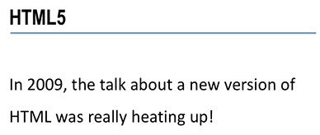
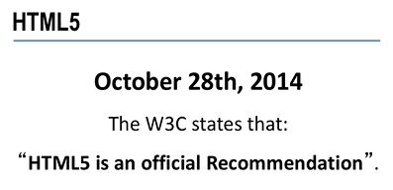
1101.1 HTML5 Video
https://ucsc-extension.instructure.com/courses/3825/pages/1-dot-1-welcome?module_item_id=42202
1101.1 HTML 5 Video

Slide 28
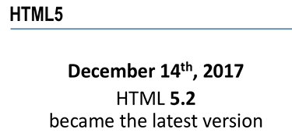
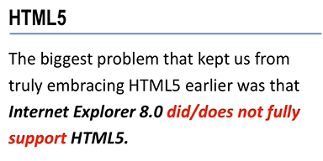
1101.1 HTML5 Video
https://ucsc-extension.instructure.com/courses/3825/pages/1-dot-1-welcome?module_item_id=42202
1101.1 HTML 5 Video

Slide 29
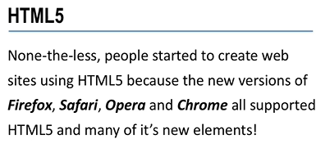
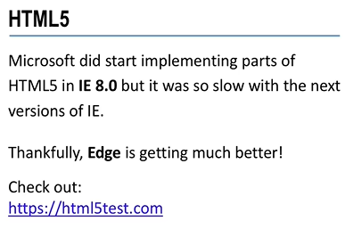
1101.1 HTML5 Video
https://ucsc-extension.instructure.com/courses/3825/pages/1-dot-1-welcome?module_item_id=42202
1101.1 HTML 5 Video

Slide 30
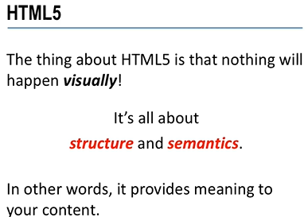
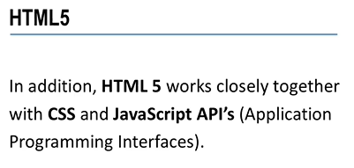
1101.1 HTML5 Video
https://ucsc-extension.instructure.com/courses/3825/pages/1-dot-1-welcome?module_item_id=42202
1101.1 HTML 5 Video

Slide 31
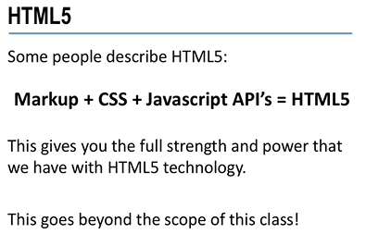
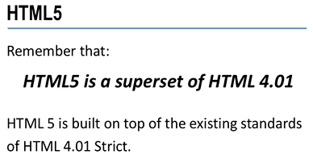
1101.1 HTML5 Video
https://ucsc-extension.instructure.com/courses/3825/pages/1-dot-1-welcome?module_item_id=42202
1101.1 HTML 5 Video

Slide 32
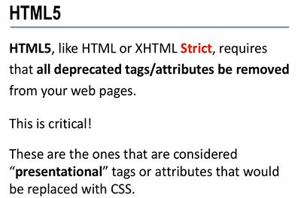
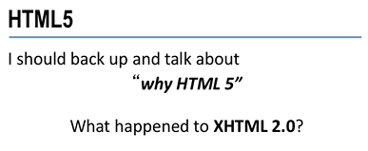
1101.1 HTML5 Video
https://ucsc-extension.instructure.com/courses/3825/pages/1-dot-1-welcome?module_item_id=42202
1101.1 HTML 5 Video

Slide 33
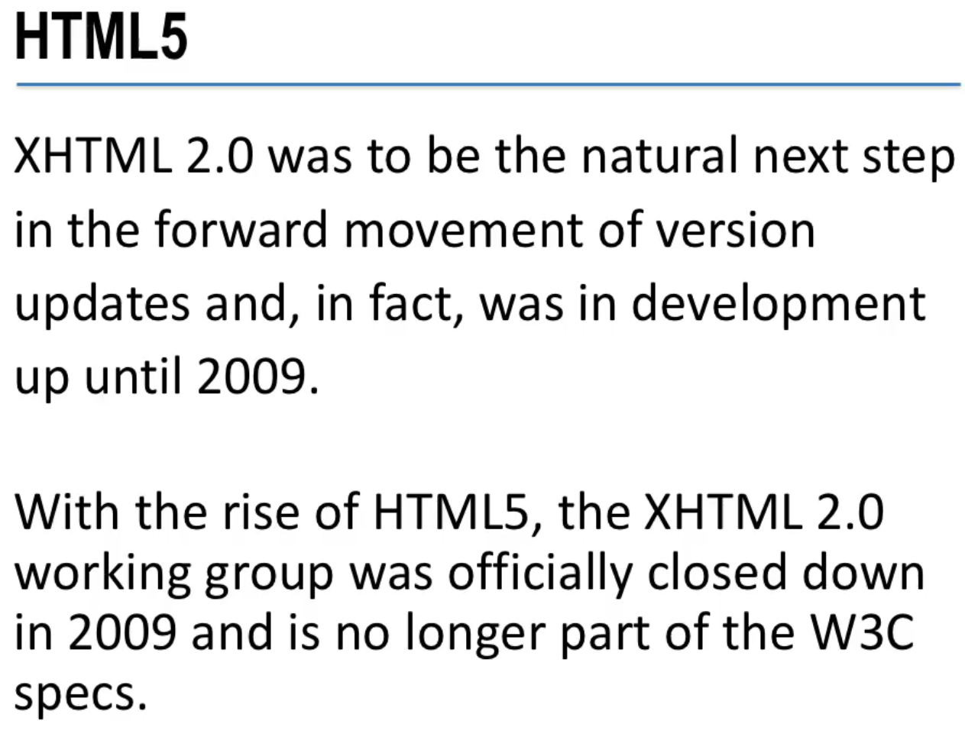
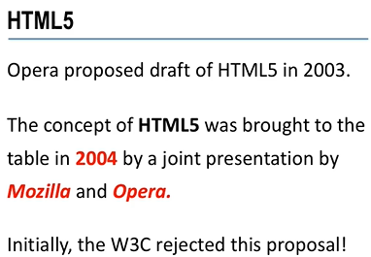
1101.1 HTML5 Video
https://ucsc-extension.instructure.com/courses/3825/pages/1-dot-1-welcome?module_item_id=42202
1101.1 HTML 5 Video

Slide 34
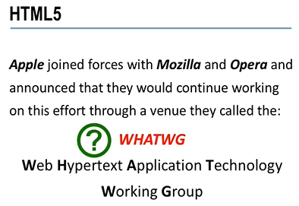
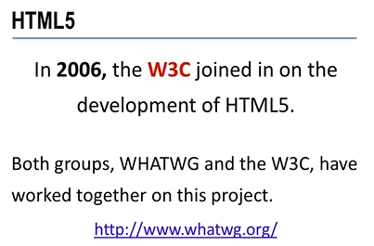
1101.1 HTML5 Video
https://ucsc-extension.instructure.com/courses/3825/pages/1-dot-1-welcome?module_item_id=42202
1101.1 HTML 5 Video

Slide 35
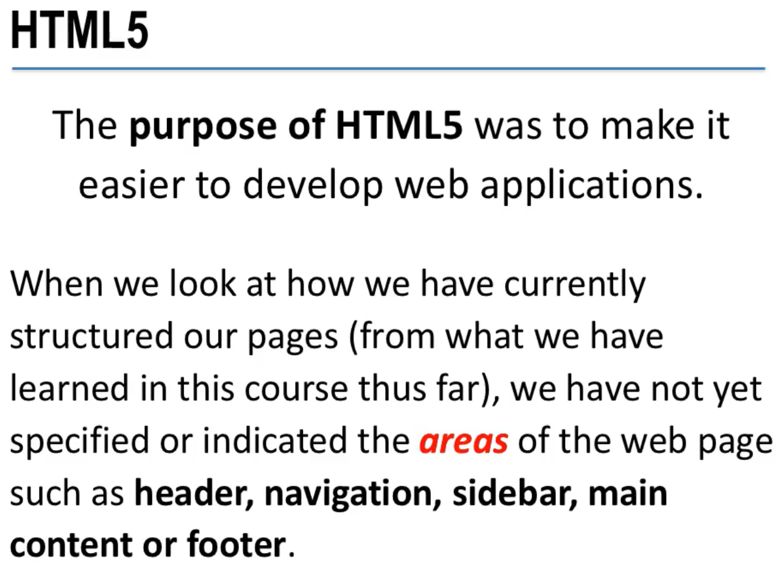
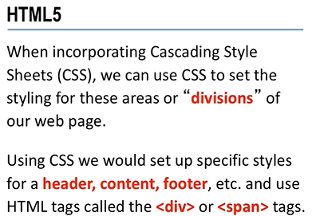
1101.1 HTML5 Video
https://ucsc-extension.instructure.com/courses/3825/pages/1-dot-1-welcome?module_item_id=42202
1101.1 HTML 5 Video

Slide 36
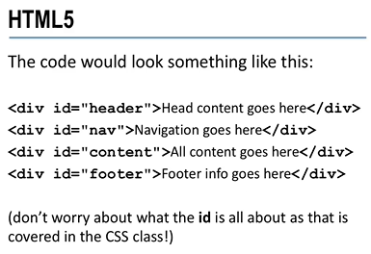
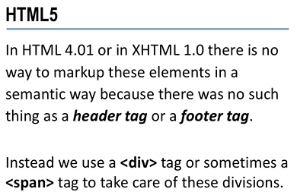
1101.1 HTML5 Video
https://ucsc-extension.instructure.com/courses/3825/pages/1-dot-1-welcome?module_item_id=42202
1101.1 HTML 5 Video

Slide 37
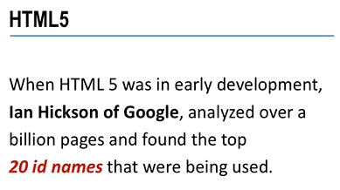
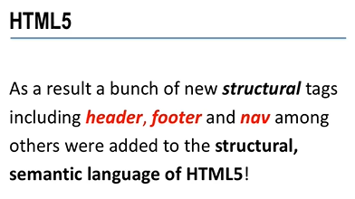
1101.1 HTML5 Video
https://ucsc-extension.instructure.com/courses/3825/pages/1-dot-1-welcome?module_item_id=42202
1101.1 HTML 5 Video

Slide 38
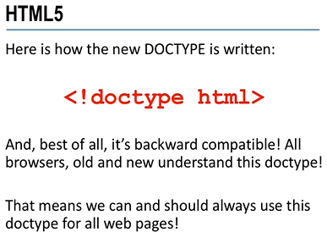
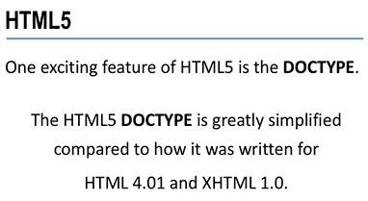
1101.1 HTML5 Video
https://ucsc-extension.instructure.com/courses/3825/pages/1-dot-1-welcome?module_item_id=42202
1101.1 HTML 5 Video

Slide 39
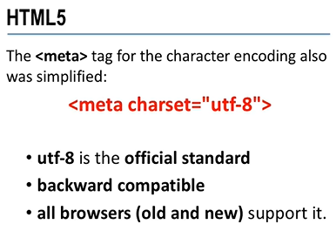
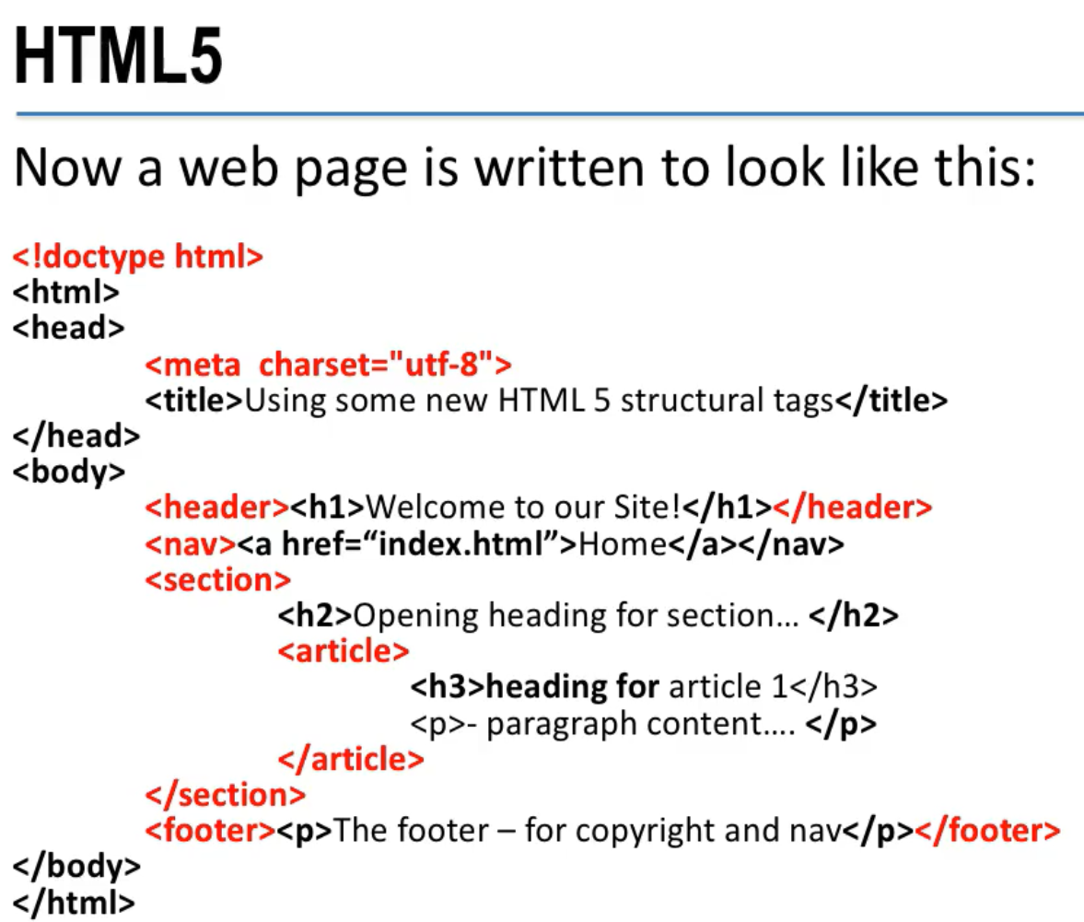
1101.1 HTML5 Video
https://ucsc-extension.instructure.com/courses/3825/pages/1-dot-1-welcome?module_item_id=42202
1101.1 HTML 5 Video

Slide 40
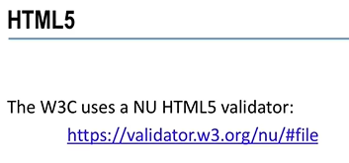
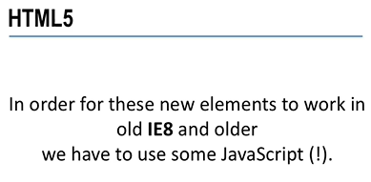
1101.1 HTML5 Video
https://ucsc-extension.instructure.com/courses/3825/pages/1-dot-1-welcome?module_item_id=42202
1101.1 HTML 5 Video

Slide 41
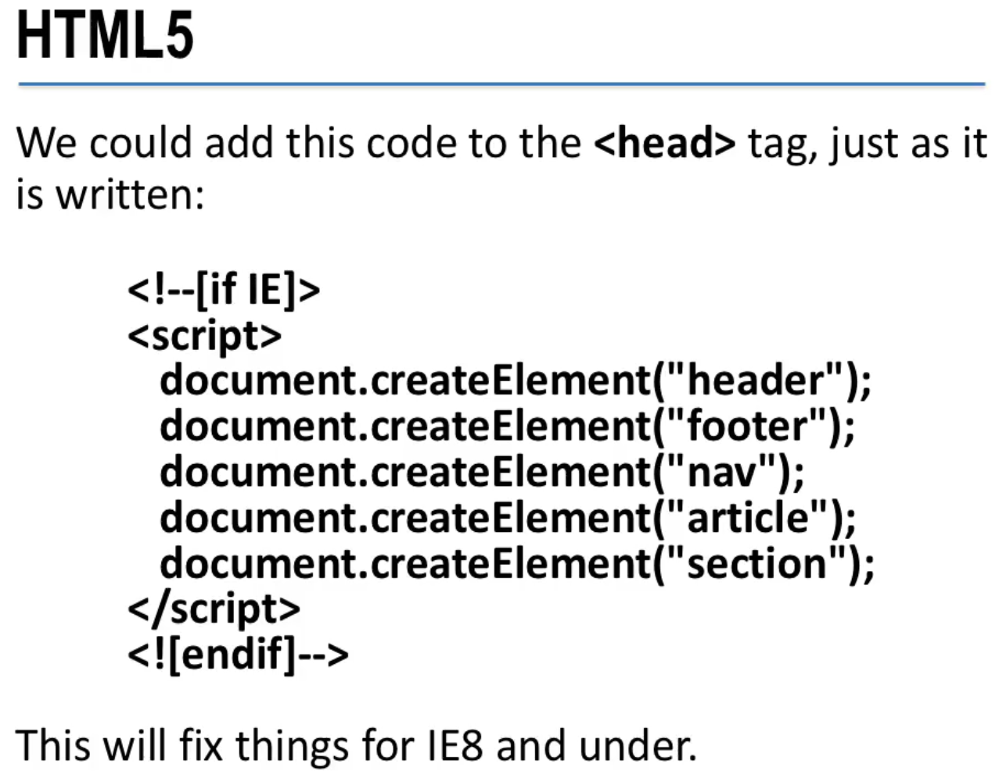
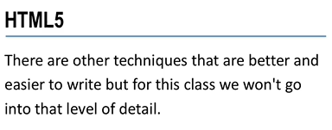
1101.1 HTML5 Video
https://ucsc-extension.instructure.com/courses/3825/pages/1-dot-1-welcome?module_item_id=42202
1101.1 HTML 5 Video

Slide 42
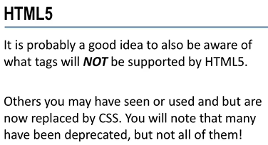
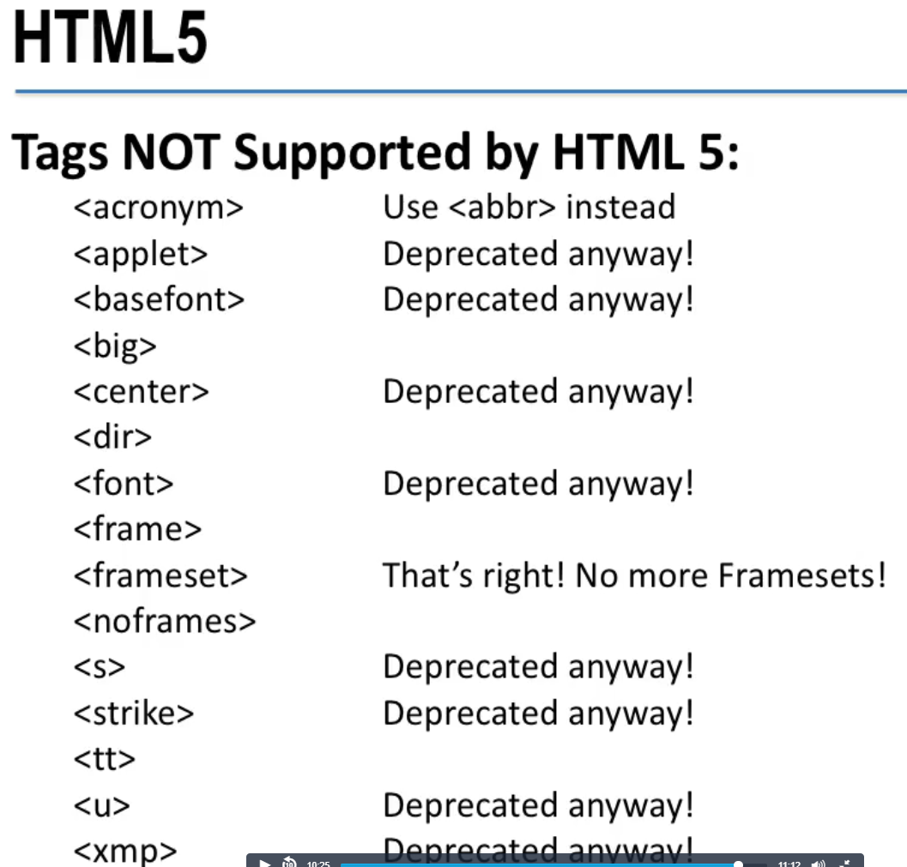
1101.1 HTML5 Video
https://ucsc-extension.instructure.com/courses/3825/pages/1-dot-1-welcome?module_item_id=42202
1101.1 HTML 5 Video

Slide 43
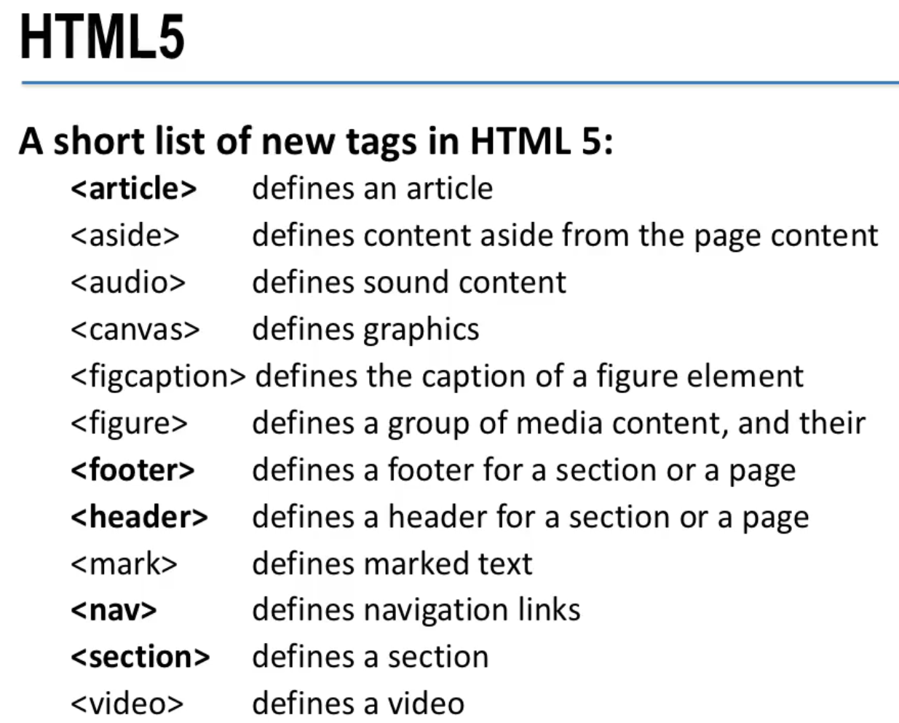
1101.1 HTML5 Video
https://ucsc-extension.instructure.com/courses/3825/pages/1-dot-1-welcome?module_item_id=42202
1101.1 HTML 5 Video

Slide 44
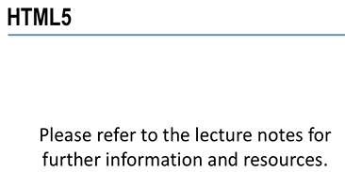
1101.1 HTML5 Video
https://ucsc-extension.instructure.com/courses/3825/pages/1-dot-1-welcome?module_item_id=42202
1101.1 HTML 5 Video

Slide 45
End of Chapter

