Slide 1

1104 HTML5 Quiz
Peter H. Chen

Slide 2
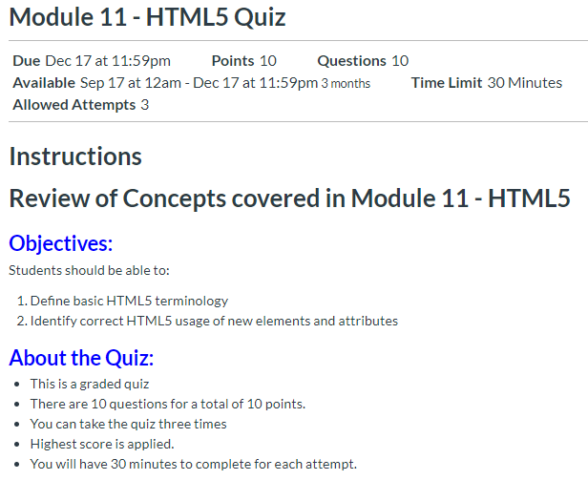
1104 HTML5 Quiz
https://ucsc-extension.instructure.com/courses/3825/pages/1-dot-1-welcome?module_item_id=42202
1104 HTML5 Quiz

Slide 3
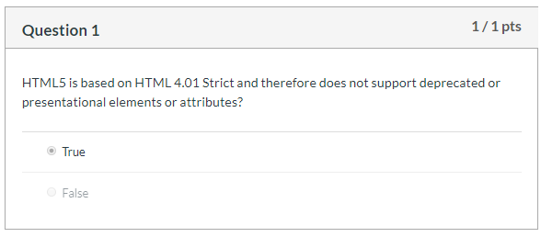
1104 HTML5 Quiz
https://ucsc-extension.instructure.com/courses/3825/pages/1-dot-1-welcome?module_item_id=42202
1104 HTML5 Quiz

Slide 4
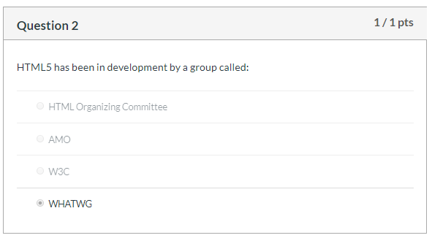
1104 HTML5 Quiz
https://ucsc-extension.instructure.com/courses/3825/pages/1-dot-1-welcome?module_item_id=42202
1104 HTML5 Quiz

Slide 5
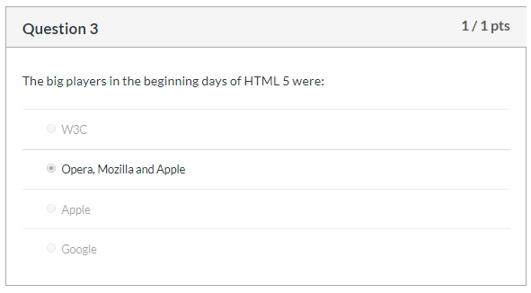
1104 HTML5 Quiz
https://ucsc-extension.instructure.com/courses/3825/pages/1-dot-1-welcome?module_item_id=42202
1104 HTML5 Quiz

Slide 6
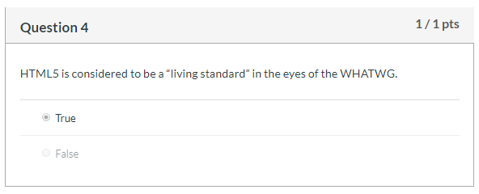
1104 HTML5 Quiz
https://ucsc-extension.instructure.com/courses/3825/pages/1-dot-1-welcome?module_item_id=42202
1104 HTML5 Quiz

Slide 7
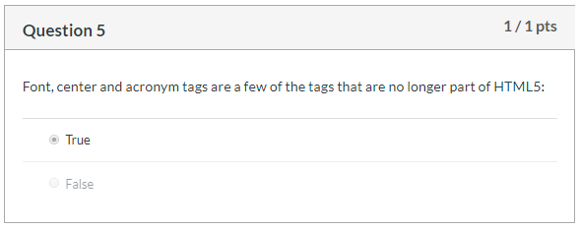
1104 HTML5 Quiz
https://ucsc-extension.instructure.com/courses/3825/pages/1-dot-1-welcome?module_item_id=42202
1104 HTML5 Quiz

Slide 8
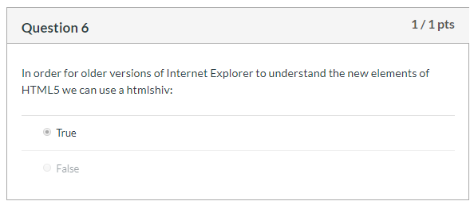
1104 HTML5 Quiz
https://ucsc-extension.instructure.com/courses/3825/pages/1-dot-1-welcome?module_item_id=42202
1104 HTML5 Quiz

Slide 9
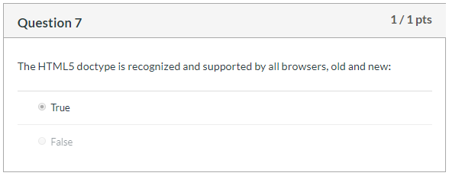
1104 HTML5 Quiz
https://ucsc-extension.instructure.com/courses/3825/pages/1-dot-1-welcome?module_item_id=42202
1104 HTML5 Quiz

Slide 10
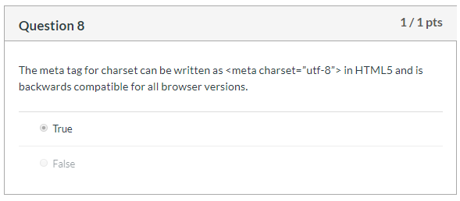
1104 HTML5 Quiz
https://ucsc-extension.instructure.com/courses/3825/pages/1-dot-1-welcome?module_item_id=42202
1104 HTML5 Quiz

Slide 11
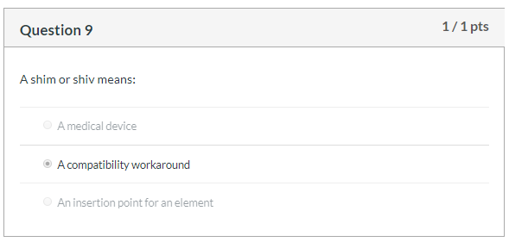
1104 HTML5 Quiz
https://ucsc-extension.instructure.com/courses/3825/pages/1-dot-1-welcome?module_item_id=42202
1104 HTML5 Quiz

Slide 12
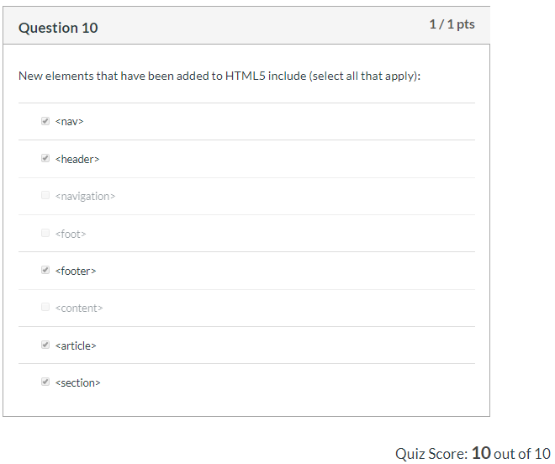
1104 HTML5 Quiz
https://ucsc-extension.instructure.com/courses/3825/pages/1-dot-1-welcome?module_item_id=42202
1104 HTML5 Quiz

Slide 13
End of Chapter

