Slide 1

0701 HTML Link
Peter H. Chen

Slide 2
0701 HTML Link
https://ucsc-extension.instructure.com/courses/3825/pages/1-dot-1-welcome?module_item_id=42202
0701 Introduction HTML Link
Links!
A link is made up of 2 parts: destination and a label.
The destination is just that – the destination the user wants to go to by clicking on the link; the user doesn’t see this unless they look at the browser status bar on desktop browsers.
The label is the part the user sees which can be either text or an image.
By browser default, the text will be blue and underlined, purple if the link has been visited and red if the link is active (hold down your mouse on a link that has not been styled using CSS).
It’s important these days to remember that we don't just “click” on links, we can now tap or use a trackball or use the keyboard to activate a link. In fact, to meet accessibility mandates, it will be critical to ensure that our links allow for using the keyboard to navigate links.

Slide 3
0701 HTML Link
https://ucsc-extension.instructure.com/courses/3825/pages/1-dot-1-welcome?module_item_id=42202
0701 Introduction HTML Link
The Link <a> Tag and mandatory attribute
A typical “link” code will look something like this:
<a href="http://www.amazon.com">Go To Amazon</a>
The <a> is the tag that glues the Web together!
This is how you provide links to URL’s (Uniform Resource Locator).
The href stands for hypertext reference and is what tells the link where to go!
There are many different types of values for the href attribute which we will look at in the following content pages!

Slide 4
0701.1 HTML Link Video

Slide 5

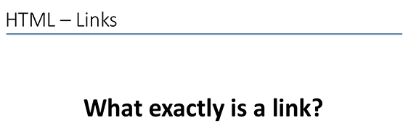
0701.1 HTML Link Video
https://ucsc-extension.instructure.com/courses/3825/pages/1-dot-1-welcome?module_item_id=42202
0701.1 Introduction HTML Link Video

Slide 6
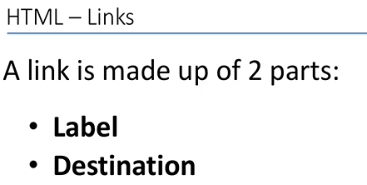
0701.1 HTML Link Video
https://ucsc-extension.instructure.com/courses/3825/pages/1-dot-1-welcome?module_item_id=42202
0701.1 Introduction HTML Link Video

Slide 7
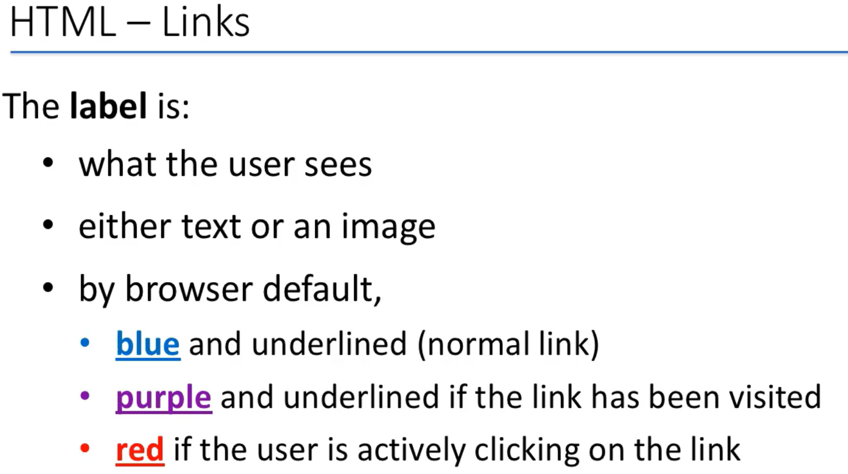
0701.1 HTML Link Video
https://ucsc-extension.instructure.com/courses/3825/pages/1-dot-1-welcome?module_item_id=42202
0701.1 Introduction HTML Link Video

Slide 8
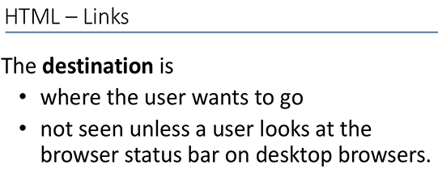
0701.1 HTML Link Video
https://ucsc-extension.instructure.com/courses/3825/pages/1-dot-1-welcome?module_item_id=42202
0701.1 Introduction HTML Link Video

Slide 9
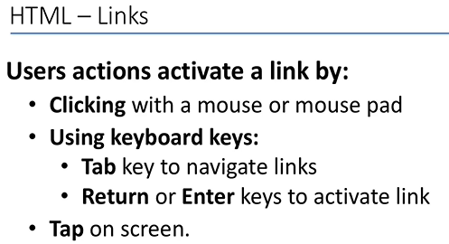
0701.1 HTML Link Video
https://ucsc-extension.instructure.com/courses/3825/pages/1-dot-1-welcome?module_item_id=42202
0701.1 Introduction HTML Link Video

Slide 10
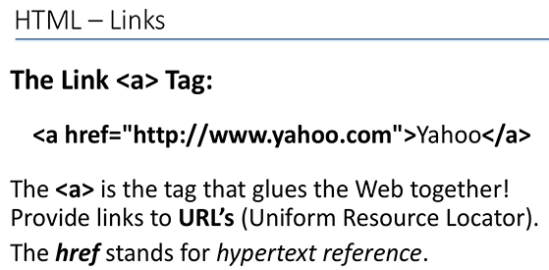
0701.1 HTML Link Video
https://ucsc-extension.instructure.com/courses/3825/pages/1-dot-1-welcome?module_item_id=42202
0701.1 Introduction HTML Link Video

Slide 11
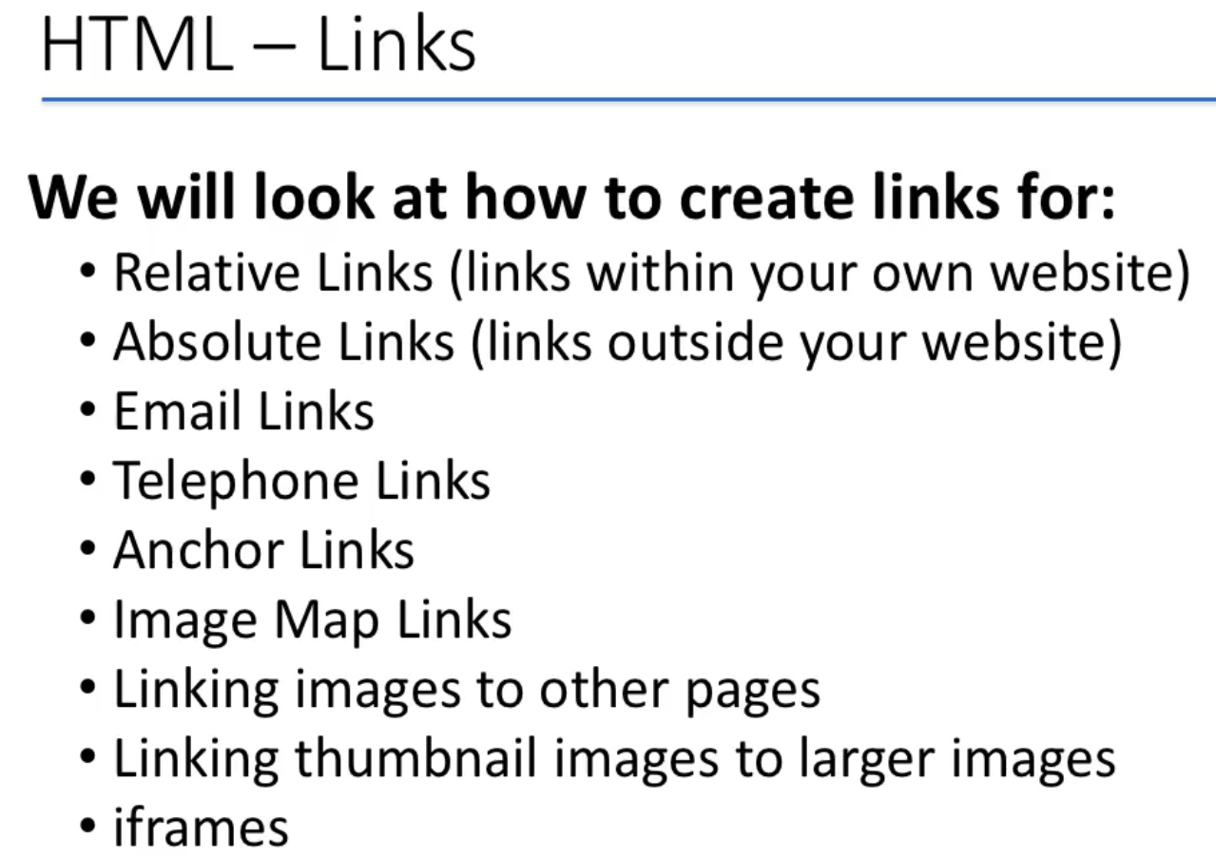
0701.1 HTML Link Video
https://ucsc-extension.instructure.com/courses/3825/pages/1-dot-1-welcome?module_item_id=42202
0701.1 Introduction HTML Link Video

Slide 12
End of Chapter

