Slide 1

0703 Absolute Link
Peter H. Chen

Slide 2

0703 Absolute Link
https://ucsc-extension.instructure.com/courses/3825/pages/1-dot-1-welcome?module_item_id=42202
0703 Absolute Link
Absolute links simply refer to links that are outside of your server or root folder.
These links must go out using the HTTP protocol to access the Web, rather than just look for a file within your directory.
Creating an absolute link:
<a href="http://www.amazon.com">Amazon</a>
Make sure to type in the http:// or https:// properly for this to work.

Slide 3
0703.1 Absolute Link Video

Slide 4
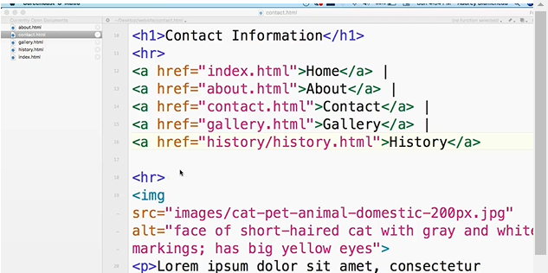
0703.1 Absolute Link Video
https://ucsc-extension.instructure.com/courses/3825/pages/1-dot-1-welcome?module_item_id=42202
0703.1 Absolute Link Video: Absolute link is another type of link.

Slide 5
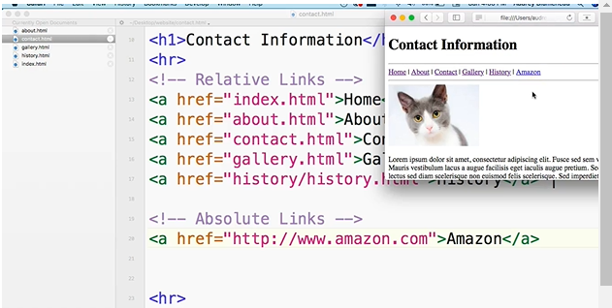
0703.1 Absolute Link Video
https://ucsc-extension.instructure.com/courses/3825/pages/1-dot-1-welcome?module_item_id=42202
0703.1 Absolute Link Video: Add Absolute link.

Slide 6
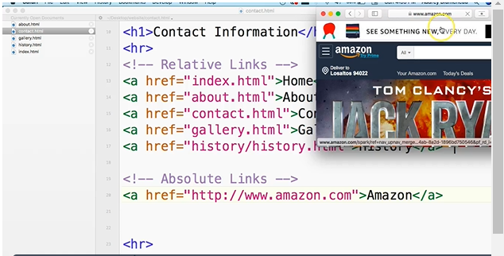
0703.1 Absolute Link Video
https://ucsc-extension.instructure.com/courses/3825/pages/1-dot-1-welcome?module_item_id=42202
0703.1 Absolute Link Video: Click Absolute link.

Slide 7
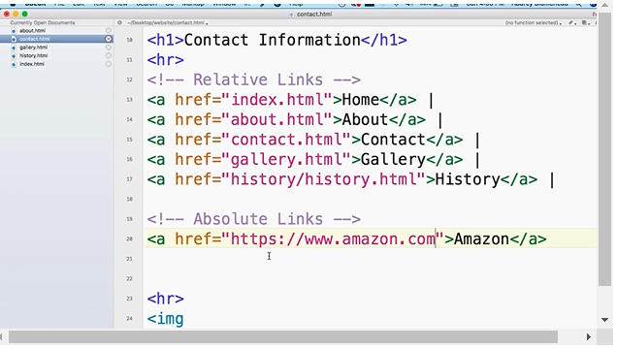
0703.1 Absolute Link Video
https://ucsc-extension.instructure.com/courses/3825/pages/1-dot-1-welcome?module_item_id=42202
0703.1 Absolute Link Video: Actual “https”.

Slide 8
0703.2 Attribute <a> Tag

Slide 9
0703.2 Attribute <a> Tag
https://ucsc-extension.instructure.com/courses/3825/pages/1-dot-1-welcome?module_item_id=42202
0703.2 Attributes of the <a> tag:
Attributes that one can use with the <a> element include title, rel, and target. All of these provide the user or the browser with additional information about the type of link and how to implement the result.
target attribute:
The target attribute, allows you to open a URL page on a new browser window or tab by using the value "_blank";
This attribute is not part of a Strict XHTML doctype specifications.
The reason it was eliminated or frowned upon is it has usability and accessibility issues.
Many people don’t realize a new tab or window was opened when they click on the link.
For a screen reader they have to negotiate their way to the new window or tab and possibly back again.
NOTE: HTML5 will validate with the target attribute.
<a href="http://www.amazon.com" target="_blank">Amazon</a>

Slide 10
0703.3 Attribute <a> Tag Video

Slide 11
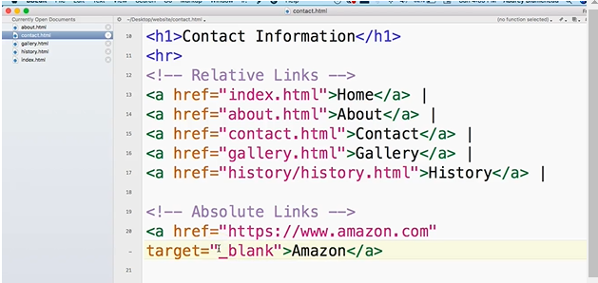
0703.3 Attribute <a> Tag Video
https://ucsc-extension.instructure.com/courses/3825/pages/1-dot-1-welcome?module_item_id=42202
0703.3 Attributes of the <a> tag Video

Slide 12
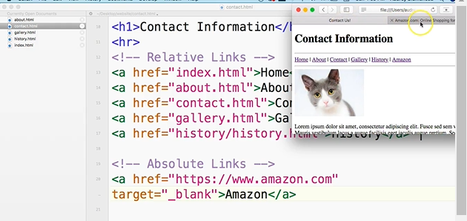
0703.3 Attribute <a> Tag Video
https://ucsc-extension.instructure.com/courses/3825/pages/1-dot-1-welcome?module_item_id=42202
0703.3 Attributes of the <a> tag Video: open a new URL page on a new Window and Tab.

Slide 13
0703.4 Title Attribute

Slide 14
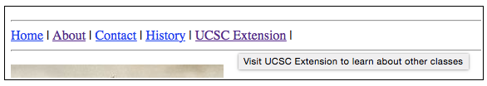
0703.4 Title Attribute
https://ucsc-extension.instructure.com/courses/3825/pages/1-dot-1-welcome?module_item_id=42202
0703.4 Title Attribute
The title attribute is an optional attribute that provides a tooltip popup message giving users more information about a link and where it will take them
This can be useful when you (the user) are unsure about where a link is really going and why the site (owner) wants you to go there.
<a href="http://www.amazon.com" title="Visit Amazon to buy the book" >Amazon</a>

Slide 15
0703.5 Title Attribute Video

Slide 16
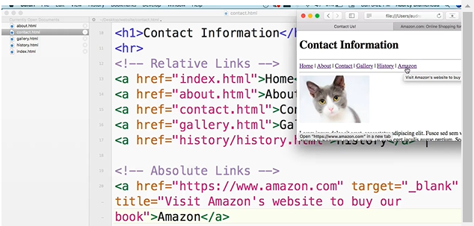
0703.5 Title Attribute Video
https://ucsc-extension.instructure.com/courses/3825/pages/1-dot-1-welcome?module_item_id=42202
0703.5 Title Attribute Video

Slide 17
0703.6 rel Attribute

Slide 18
0703.6 rel Attribute
https://ucsc-extension.instructure.com/courses/3825/pages/1-dot-1-welcome?module_item_id=42202
0703.6 rel Attribute
The rel attribute is an optional attribute that is new in the world of HTML links.
This attribute describes the relationship between the page containing the link and the page to which you are linking.
It’s a way to improve the semantics of your web page and search engines may use this information also. Ones that you may take advantage are: external, next, prev (for previous).
<a href="http://www.amazon.com" title="Visit Amazon to buy the book" rel="external">Amazon</a>

Slide 19
0703.6 rel Attribute
https://ucsc-extension.instructure.com/courses/3825/pages/1-dot-1-welcome?module_item_id=42202
0703.6 rel Attribute
Here is a list of some of the values one can use with the rel attribute:
Value | Description
alternate | Provides a link to an alternate representation of the document (i.e. print page, translated or mirror)
author | Provides a link to the author of the document
bookmark | Permanent URL used for bookmarking
external | Indicates that the referenced document is not part of the same site as the current document
help | Provides a link to a help document
license | Provides a link to copyright information for the document
next | Provides a link to the next document in the series
tag | A tag (keyword) for the current document

Slide 20
0703.6 rel Attribute
https://ucsc-extension.instructure.com/courses/3825/pages/1-dot-1-welcome?module_item_id=42202
0703.6 rel Attribute
Here is a list of some of the values one can use with the rel attribute:
Value | Description
nofollow | Links to an unendorsed document, like a paid link. ("nofollow" is used by Google, to specify that the Google search spider should not follow that link)
noreferrer | Requires that the browser should not send an HTTP referer header if the user follows the hyperlink
noopener | Requires that any browsing context created by following the hyperlink must not have an opener browsing context
prev | The previous document in a selection
search | Links to a search tool for the document
tag | A tag (keyword) for the current document
For more information, refer to the W3C's specification for HTML5 (https://www.w3.org/TR/2011/WD-html5-20110113/links.html#linkTypes):

Slide 21
0703.7 rel Attribute Video

Slide 22
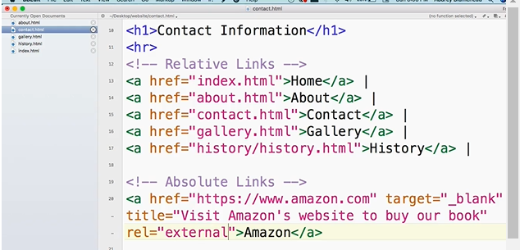
0703.7 rel Attribute Video
https://ucsc-extension.instructure.com/courses/3825/pages/1-dot-1-welcome?module_item_id=42202
0703.7 rel Attribute Video: Amazon is external web site. No change any visibility.

Slide 23
End of Chapter

