Slide 1

0704 Email Link
Peter H. Chen

Slide 2
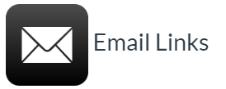
0704 Email Link
https://ucsc-extension.instructure.com/courses/3825/pages/1-dot-1-welcome?module_item_id=42202
0704 Email Link
To create an email link, you will change the protocol from http:// to mailto: Simply set the <a> to read:
<a href="mailto:webmaster@webpage.com">Contact Me</a>
Notice there are no spaces in this value at all!

Slide 3
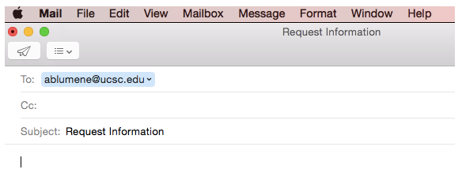
0704 Email Link
https://ucsc-extension.instructure.com/courses/3825/pages/1-dot-1-welcome?module_item_id=42202
0704 Email Link
Adding additional information:
Use a question mark after the final "To" email address to indicate you want more than just a "To" line. Then you specify what other elements you would like:
cc - to send a carbon copy
bcc - to send a blind carbon copy
subject - for the subject line
<a href="mailto:webmaster@webpage.com?Subject=Request%20Info"> Send Mail</a>
In URL, %20 is a space, %30 is the number 0, %3b is semicolon and so on.

Slide 4
0704 Email Link
https://ucsc-extension.instructure.com/courses/3825/pages/1-dot-1-welcome?module_item_id=42202
0704 Email Link
Put the %20 to make sure that the browser will display the text properly and that it validates!
To add multiple elements, separate the second and subsequent elements with an ampersand (&).
mailto:toaddress?cc=ccaddress&bcc=bccaddress

Slide 5
0704 Email Link
https://ucsc-extension.instructure.com/courses/3825/pages/1-dot-1-welcome?module_item_id=42202
0704 Email Link
How this works if you do not have an email client (software) on your computer?
It’s important to understand that when the user clicks on the email link it will open the users default email application on their machine.
If you do not have a default email application nothing will happen depending on the browser used.
There is no way to force it to open someone’s yahoo or Gmail account, unless they specify through the preferences of their browser that Yahoo or Gmail their preferred browser.
That being said, Firefox will pop up a window asking which email account you would like to use.

Slide 6
0704 Email Link
https://ucsc-extension.instructure.com/courses/3825/pages/1-dot-1-welcome?module_item_id=42202
0704 Email Link
Preventing Spam:
Be aware that putting your email on a website will open up your address to spambots and will cause some bombardment of spam to that account.
Generally, you will use some sort of captcha system but that goes beyond the scope of this class.
It might be possible to add in some JavaScript to encrypt your email address (but I do not guarantee it's effectiveness).
Just enter in your email and then copy and the paste the code.
Here is a website that will do this for you: http://hivelogic.com/enkoder/

Slide 7
0704.1 Email Link Video

Slide 8
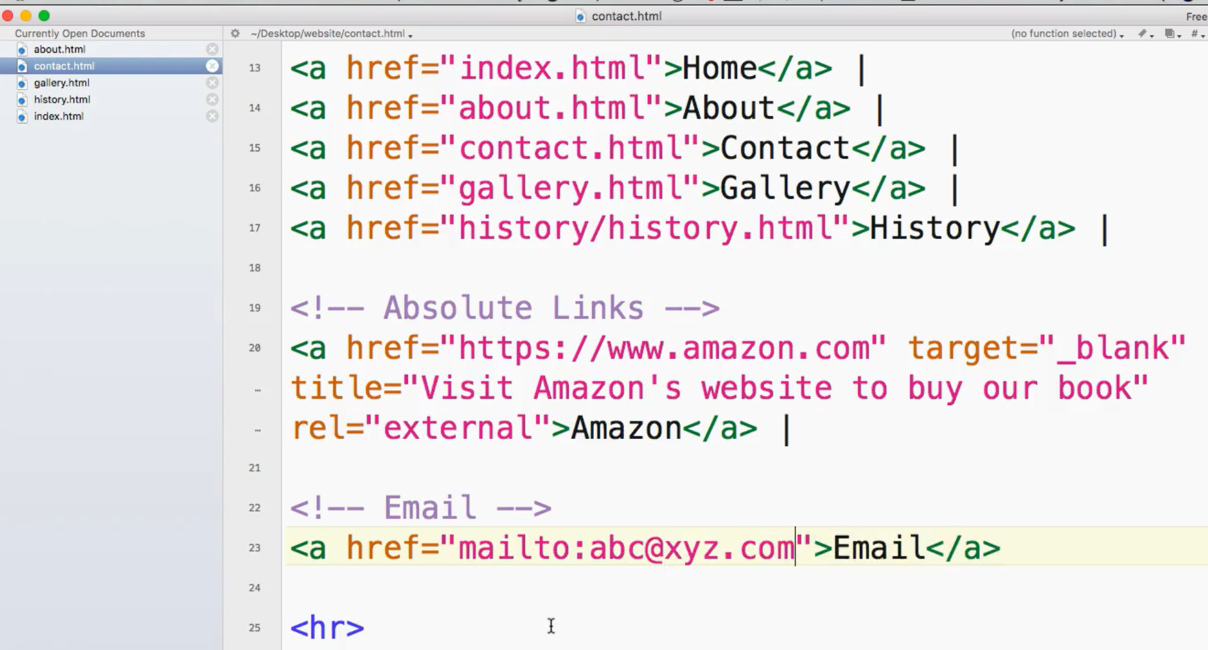
0704.1 Email Link Video
https://ucsc-extension.instructure.com/courses/3825/pages/1-dot-1-welcome?module_item_id=42202
0704.1 Email Link Video:

Slide 9
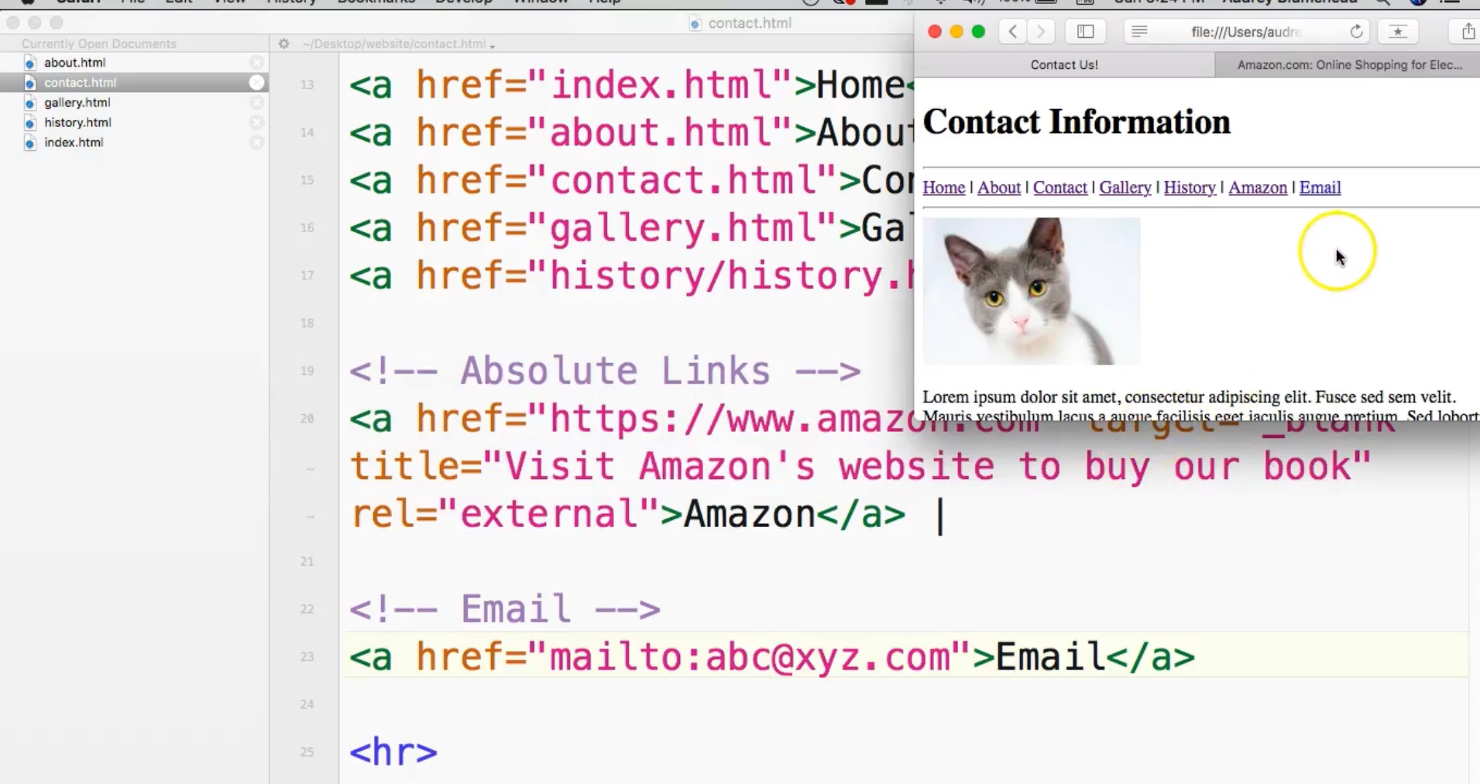
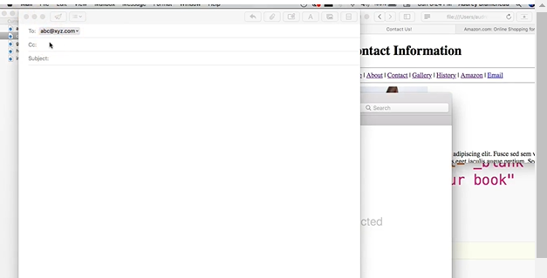
0704.1 Email Link Video
https://ucsc-extension.instructure.com/courses/3825/pages/1-dot-1-welcome?module_item_id=42202
0704.1 Email Link Video:

Slide 10
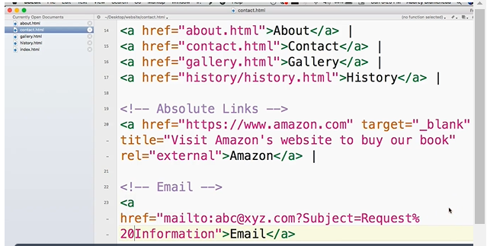
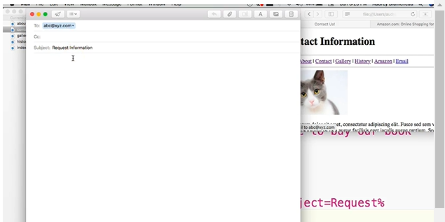
0704.1 Email Link Video
https://ucsc-extension.instructure.com/courses/3825/pages/1-dot-1-welcome?module_item_id=42202
0704.1 Email Link Video: In URL, %20 is a space, %30 is the number 0, %3b is semicolon and so on.

Slide 11
End of Chapter

