Slide 1

0705 Telephone Link
Peter H. Chen

Slide 2

0705 Telephone Link
https://ucsc-extension.instructure.com/courses/3825/pages/1-dot-1-welcome?module_item_id=42202
0705 Telephone Link
As with the email link, we are simply going to change the protocol in the href value.
<a href="tel:+1222-555-1212">Call us to get more information!</a>
Primarily, this is for when a mobile phone user taps on the link, they will get an alert box asking them to confirm that they would like to call this number.
This is supported on many devices including iOS, Android, Blackberry, Symbian, IE and Opera Mini.
When a user clicks on a telephone link on a desktop on most browsers, depending on your setup will look for a suitable application.
If none exists, nothing will happen.
For example, on my laptop, browsers will prompt me to select Skype or FaceTime.

Slide 3
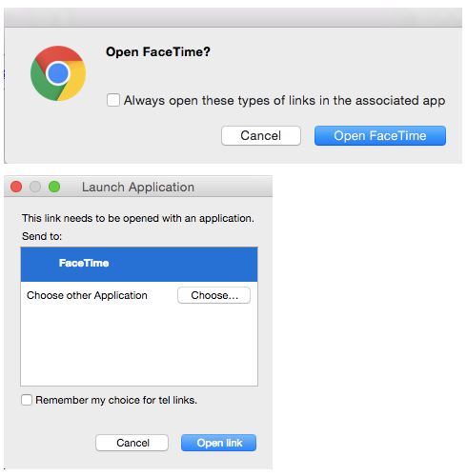
0705 Telephone Link
https://ucsc-extension.instructure.com/courses/3825/pages/1-dot-1-welcome?module_item_id=42202
0705 Telephone Link

Slide 4
0705 Telephone Link
https://ucsc-extension.instructure.com/courses/3825/pages/1-dot-1-welcome?module_item_id=42202
0705 Telephone Link
Some tips on best practices include:
Providing full international dialing number, which includes the country code.
Include the number as part of the content
Android and iPhone have an auto detection feature that will automatically turn phone numbers into links.
However, not all numbers on your website might be phone numbers (10 digits), so you may want/need to add in a meta tag to tell the browser not to do that! It looks like this:
<meta name="format-detection" content="telephone=no">

Slide 5
0705.1 Telephone Link Video

Slide 6
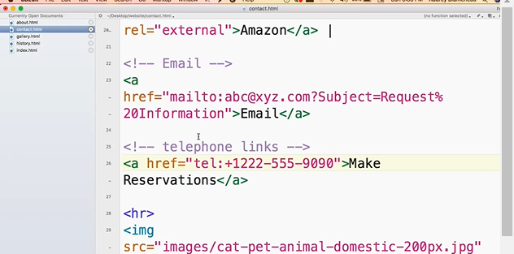
0705.1 Telephone Link Video
https://ucsc-extension.instructure.com/courses/3825/pages/1-dot-1-welcome?module_item_id=42202
0705.1 Telephone Link Video:

Slide 7
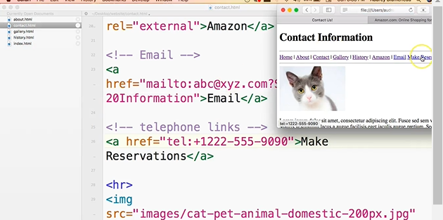
0705.1 Telephone Link Video
https://ucsc-extension.instructure.com/courses/3825/pages/1-dot-1-welcome?module_item_id=42202
0705.1 Telephone Link Video:

Slide 8
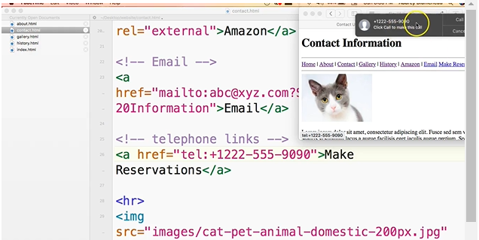
0705.1 Telephone Link Video
https://ucsc-extension.instructure.com/courses/3825/pages/1-dot-1-welcome?module_item_id=42202
0705.1 Telephone Link Video:

Slide 9
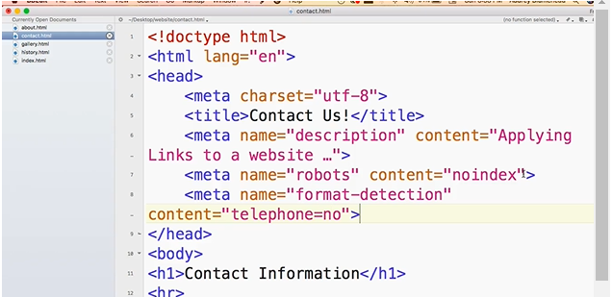
0705.1 Telephone Link Video
https://ucsc-extension.instructure.com/courses/3825/pages/1-dot-1-welcome?module_item_id=42202
0705.1 Telephone Link Video:

Slide 10
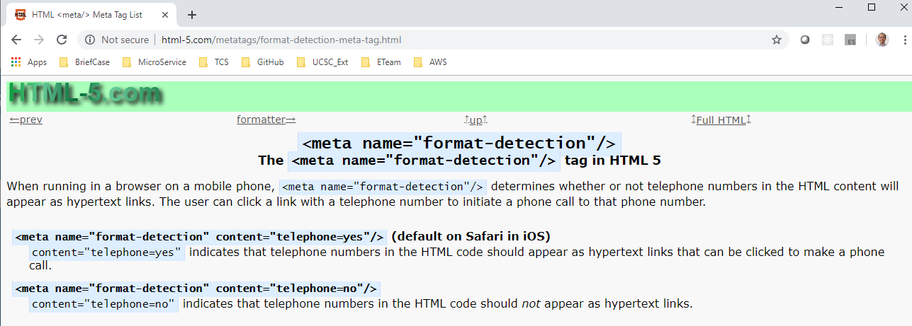
0705.1 Telephone Link Video
https://ucsc-extension.instructure.com/courses/3825/pages/1-dot-1-welcome?module_item_id=42202
0705.1 Telephone Link Video: content=“telephone=no” means the click will not dial out.

Slide 11
End of Chapter

