Slide 1

0706 Link Color
Peter H. Chen

Slide 2
0706 Link Color
https://ucsc-extension.instructure.com/courses/3825/pages/1-dot-1-welcome?module_item_id=42202
0706 Best Practices for Links and Old code (Link Colors)
User Design / User Friendly “Linking” Tips:
Keep the label concise! Don’t link long sentences or paragraphs.
Keep labels meaningful. In other words, don’t use the cliché “Click Here” label! It’s bad for usability and accessibility. “Click here” doesn’t give the user information—why should I click here? “Get more information” is more informative and will also bide well with the search engines.
Don’t put one link next to another link. It can be hard for people to see that there are two links. Put either some space between words or, for now, put in the vertical bar to provide some visual separation. Again, in the CSS Fundamentals class we look at how to style navigation so here we simply need to set up the structure and functionality.

Slide 3
0706 Link Color
https://ucsc-extension.instructure.com/courses/3825/pages/1-dot-1-welcome?module_item_id=42202
0706 Best Practices for Links and Old code (Link Colors)
A blast from the past: Link Color Attributes! (DO NOT USE!)
You may have noticed that all your links are coming up on your page as underlined and blue in color.
If you clicked on the link and returned to the page, it was purple and if you hold down your mouse on the link, you will see that it will be red (on most browsers).
These are the default link attributes defined by all browsers (color and underline).
Back in the olden days, using HTML4.01 or XHTML 1.0, we use to adjust the color but would not be able to remove the underline (that is done using CSS).
To adjust the color in the OLD HTML4.01 / XHTML1.0, you had to add these attributes to the <body> tag (not in the <a> tag like you might have thought!).

Slide 4
0706 Link Color
https://ucsc-extension.instructure.com/courses/3825/pages/1-dot-1-welcome?module_item_id=42202
0706 Best Practices for Links and Old code (Link Colors)
AGAIN, please NOTE: YOU WILL NOT DO THIS!!!
I show this only to educate you on what was done in the old days and is considered old school.
We will use CSS to control these issues at a later time.
I still come across old websites with this code in it so I just want you to be aware and educated and know that this is not new code, but old!!
<body link="#somecolor" vlink="#somecolor" alink="somecolor">
link = original link color
vlink = visited link color
alink = active link color
Note: Again, these are deprecated and will be replaced with CSS (we do this in the CSS Fundamentals class)!

Slide 5
0706.1 Link Color Video

Slide 6
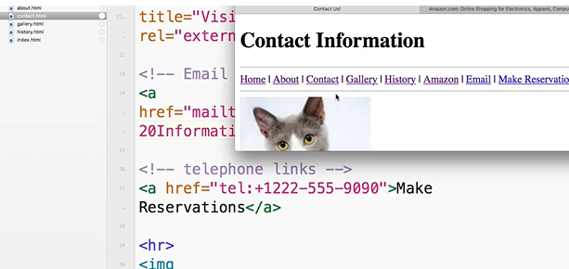
0706.1 Link Color Video
https://ucsc-extension.instructure.com/courses/3825/pages/1-dot-1-welcome?module_item_id=42202
0706.1 Link Color Video:

Slide 7
End of Chapter

