Slide 1

0707 Anchor Link
Peter H. Chen

Slide 2

0707 Anchor Link
https://ucsc-extension.instructure.com/courses/3825/pages/1-dot-1-welcome?module_item_id=42202
0707 Anchor Link
Coding A Named Anchor Link
Tips and Tricks
Linking to other Pages

Slide 3
0707 Anchor Link
https://ucsc-extension.instructure.com/courses/3825/pages/1-dot-1-welcome?module_item_id=42202
0707 Anchor Link
Coding a named anchor link
Anchors are used for creating links within a HTML/XHTML page.
If you have a long document or you want the user to be able to jump back to the top of the page quickly (i.e. an FAQ’s page)
<a href="#intro">Introduction</a> <!-- this is the link -->
…. Further down the page…..
<a id="intro"> </a> Introduction… (old method)….. rest of paragraph…..

Slide 4
0707 Anchor Link
https://ucsc-extension.instructure.com/courses/3825/pages/1-dot-1-welcome?module_item_id=42202
0707 Anchor Link
The first line is the link that the user will click on to jump down to the “destination” anchor or <a id="">.
There are some older sites that still use the name attribute but this is not advisable as it is old and will not validate in when using a HTML5 doctype.
It is now a common practice to use the id attribute for anchor links.
What is being used these days is simply putting that id attribute into any element you wish to jump to.
For example, we can write this anchor name within an <hr> tag and the link simply looks for the id name (it doesn’t care if what element that id attribute is written in).
It would look like:
<hr id="intro">

Slide 5
0707 Anchor Link
https://ucsc-extension.instructure.com/courses/3825/pages/1-dot-1-welcome?module_item_id=42202
0707 Anchor Link
Tips and Tricks - Best Practices:
Give these id names meaningful names (don’t write link1, link2). This increases the semantic meaning to your website.
Spaces are not allowed in id names.
These id attributes should be written within other tags and therefore you don't need this additional <a> tag at all. All new websites are now being written this way (placing the id attribute within a main element like a <p> or <hr> tag (or any tag!).

Slide 6
0707.1 Anchor Link Video

Slide 7
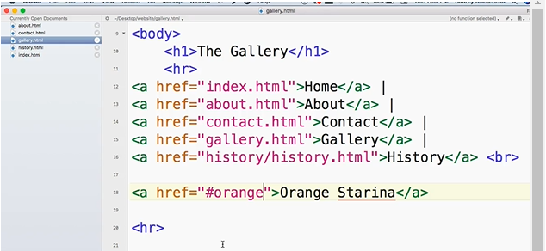
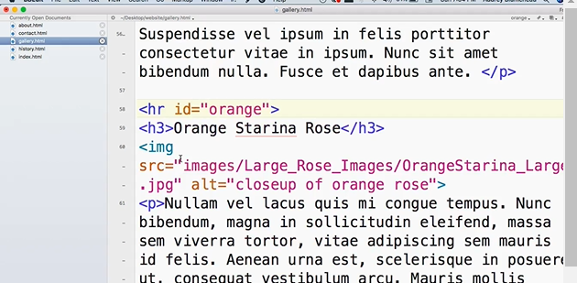
0707.1 Anchor Link Video
https://ucsc-extension.instructure.com/courses/3825/pages/1-dot-1-welcome?module_item_id=42202
0707.1 Anchor Link Video:
Click Anchor Link and navigate the section with ID.

Slide 8
0707.2 Link Other Pages

Slide 9
0707.2 Link Other Pages
https://ucsc-extension.instructure.com/courses/3825/pages/1-dot-1-welcome?module_item_id=42202
0707.2 Link Other Pages:
Linking from other pages to specific location:
It’s good to know that you can link from a different HTML page and go directly to that location within the other web page using an anchor link. The code would look like this:
On the history.html page I may have a link like this
<h3 id="myStory">Our company history</h3>
From my index page I may have a link that takes me to that history.html page and directly to that spot on the page talking about the history of the company.
<a href="history.html#myStory">Learn about our company history.</a>

Slide 10
0707.3 Link Other Pages Video

Slide 11
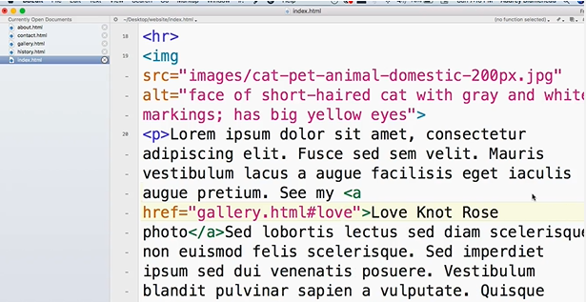
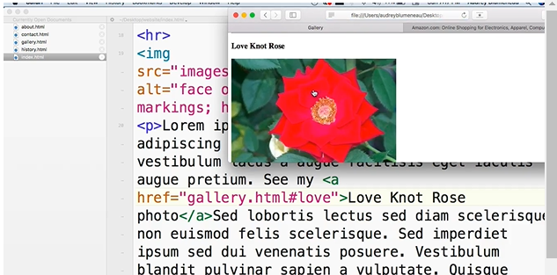
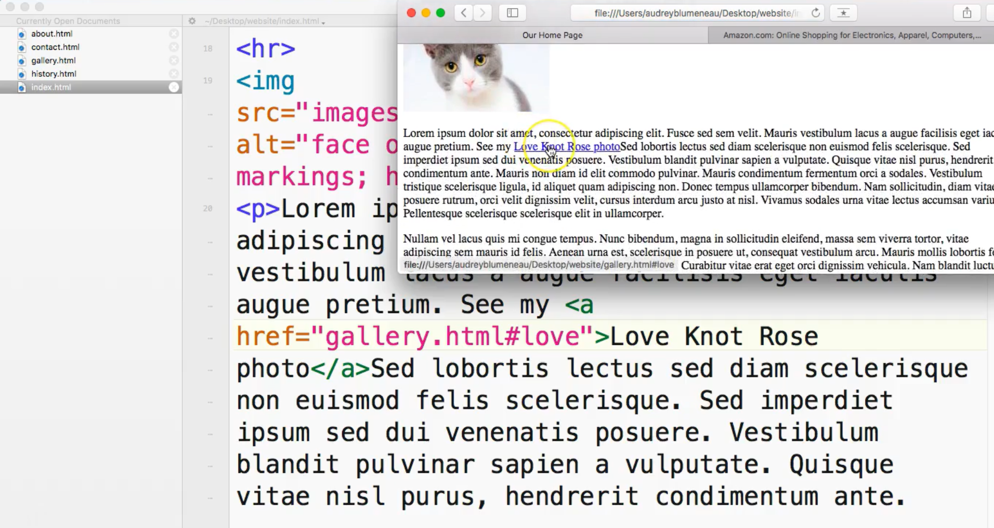
0707.3 Link Other Pages Video
https://ucsc-extension.instructure.com/courses/3825/pages/1-dot-1-welcome?module_item_id=42202
0707.3 Link Other Pages Video:

Slide 12
End of Chapter

