Slide 1

0709 Image Link
Peter H. Chen

Slide 2
0709 Image Link
https://ucsc-extension.instructure.com/courses/3825/pages/1-dot-1-welcome?module_item_id=42202
0709 Image Link:
Using Images as links
You can use an image as a link.
You may do this because of the nature of the design of your page.
Take a graphic image and write the code so that it is on your page.
<img src="images/rose.jpg" alt="Home button" width="69" height="24">
Place your link code on either side of the image.
<a href="index.html" title="Home Page">
<img src="images/rose.jpg" alt="Home button" width="69" height="24">
</a>

Slide 3
0709 Image Link
https://ucsc-extension.instructure.com/courses/3825/pages/1-dot-1-welcome?module_item_id=42202
0709 Image Link:
If you don’t want a blue border around your image (although I am treading into the world of visual design that is CSS rather than structure), you can add the attribute to your image tag: style="border:none“
<a href="index.html" title=”Home Page">
<img src="images/rose.jpg" alt="Home button" width="69" height="24" style="border:none">
</a>
That's it!
click on the image and it will take you to that web page!

Slide 4
0709.1 Image Link Video

Slide 5
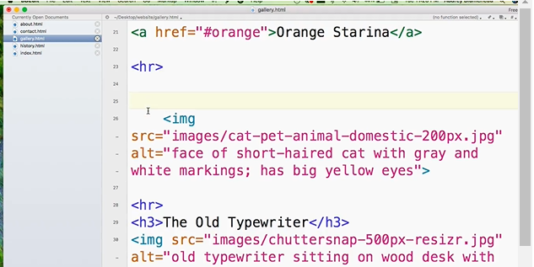
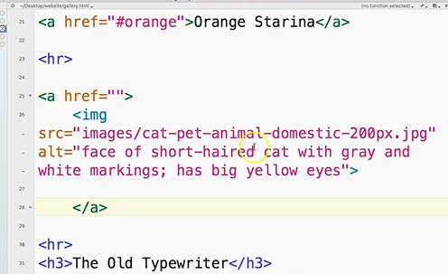
0709.1 Image Link Video
https://ucsc-extension.instructure.com/courses/3825/pages/1-dot-1-welcome?module_item_id=42202
0709.1 Image Link Video: Put the link around the image file.

Slide 6
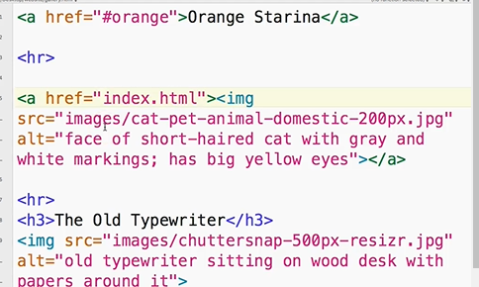
0709.1 Image Link Video
https://ucsc-extension.instructure.com/courses/3825/pages/1-dot-1-welcome?module_item_id=42202
0709.1 Image Link Video: <a href=“index.html”> <img src=“imag.jpg” …></a>

Slide 7
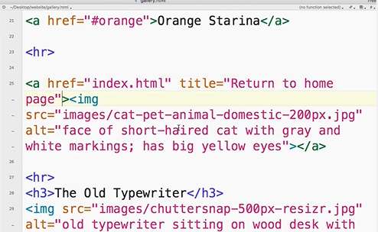
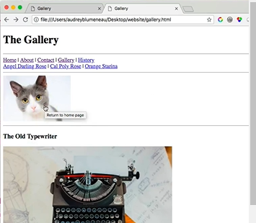
0709.1 Image Link Video
https://ucsc-extension.instructure.com/courses/3825/pages/1-dot-1-welcome?module_item_id=42202
0709.1 Image Link Video: Add Title.

Slide 8
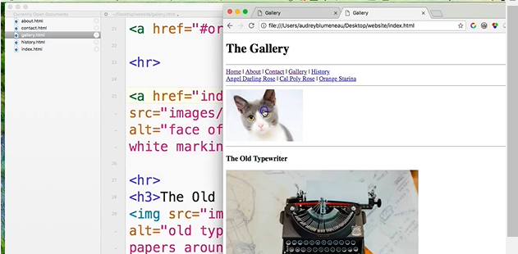
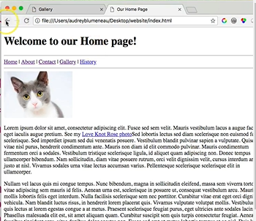
0709.1 Image Link Video
https://ucsc-extension.instructure.com/courses/3825/pages/1-dot-1-welcome?module_item_id=42202
0709.1 Image Link Video: Click the image and will go to Home Page.

Slide 9
End of Chapter

