Slide 1

0710 Thumbnail Link
Peter H. Chen

Slide 2
0710 Thumbnail Link
https://ucsc-extension.instructure.com/courses/3825/pages/1-dot-1-welcome?module_item_id=42202
0710 Thumbnail Link:
Linking thumbnail images to larger images
Thumbnail means “Very small” or “concise”.
A lot of times you will see portfolio sites, e-commerce sites or even a family photo gallery in which you will have thumbnail sized images that you can click on and it will open another page with a larger sized image.
In this class we will do a very simplified version of this but eventually you may want to add a bit of JavaScript.
Add an image (small image) to your page.
Add a link surrounding that <img> element with a link to the larger image.
<a href="images/Large_Rose_Images/Love-Knot-Large.jpg" title="See Larger image of my rose"><img src="images/Thumbnail_Rose_Images/Love-Knot-T.jpg" alt="Love Knot" width="90" height="68"></a>
That's it!

Slide 3
0710 Thumbnail Link
https://ucsc-extension.instructure.com/courses/3825/pages/1-dot-1-welcome?module_item_id=42202
0710 Thumbnail Link:
The href is simply looking for the path of the image and in this example I have the main images folder with another folder called "Large_Rose_Images".
Depending on the browser, this link (when you click on the thumbnail image in the browser) will open a browser window with just that image (Firefox will center the image within the browser window whereas the others will display in upper-left corner).

Slide 4
0710.1 Thumbnail Link Video

Slide 5
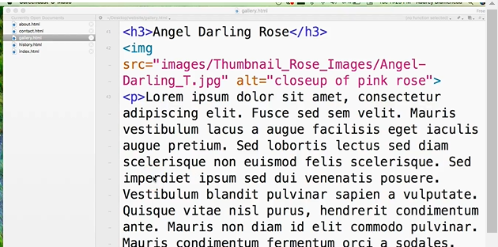
0710.1 Thumbnail Link Video
https://ucsc-extension.instructure.com/courses/3825/pages/1-dot-1-welcome?module_item_id=42202
0710.1 Thumbnail Link Video:

Slide 6
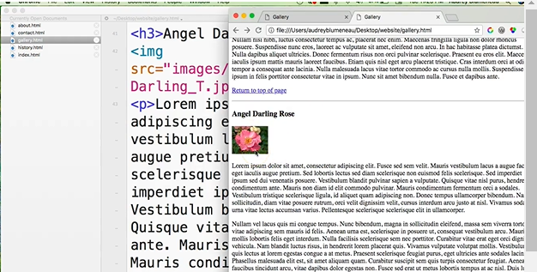
0710.1 Thumbnail Link Video
https://ucsc-extension.instructure.com/courses/3825/pages/1-dot-1-welcome?module_item_id=42202
0710.1 Thumbnail Link Video: Small Thumbnail image.

Slide 7
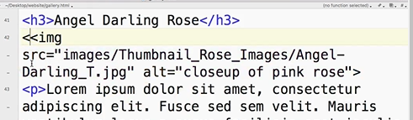
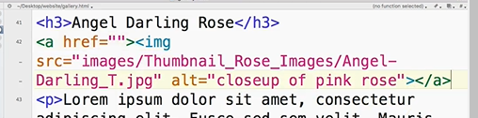
0710.1 Thumbnail Link Video
https://ucsc-extension.instructure.com/courses/3825/pages/1-dot-1-welcome?module_item_id=42202
0710.1 Thumbnail Link Video: Small image.

Slide 8
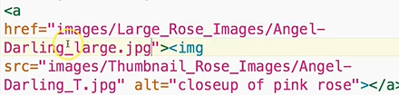
0710.1 Thumbnail Link Video
https://ucsc-extension.instructure.com/courses/3825/pages/1-dot-1-welcome?module_item_id=42202
0710.1 Thumbnail Link Video: href large image to wrap the “click of Small image”.

Slide 9
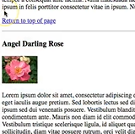
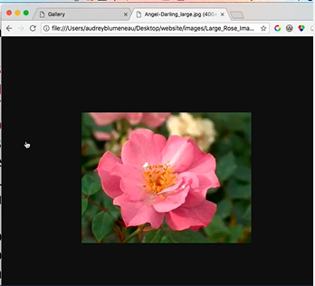
0710.1 Thumbnail Link Video
https://ucsc-extension.instructure.com/courses/3825/pages/1-dot-1-welcome?module_item_id=42202
0710.1 Thumbnail Link Video: Click Small image and then display with href to large image.

Slide 10
End of Chapter

