Slide 1

0711 Iframe
Peter H. Chen

Slide 2
0711 Iframe
https://ucsc-extension.instructure.com/courses/3825/pages/1-dot-1-welcome?module_item_id=42202
0711 Iframe:
Iframes
What are iframes?
An iframe is a small “window” that has been “cut” into your web page through which you can see another web page.
Iframe is an abbreviation of “inline frame”.
It is commonly used these days for embedding a Google map into your page.
The content of an iframe is typically another html document.
You can create links to several html documents to be displayed within this <iframe>
The <iframe> element (which was introduced by Internet Explorer 3.0 and later added to the HTML 4.0 specifications) creates an inline frame (also referred to as a floating frame or internal frame) that contains another document.
The iframe has been given a continued life in HTML5.
This is important to note because Strict HTML and XHTML will not validate the <iframe> tag!

Slide 3
0711 Iframe
https://ucsc-extension.instructure.com/courses/3825/pages/1-dot-1-welcome?module_item_id=42202
0711 Iframe:
The iframe code:
If you have multiple pages you wish to display in this iframe you can use the target attribute to open the page into that specific iframe.
You will designate the name of the iframe using the name attribute—in this example I called it: “myIframe”.
Then create the links and using the target attribute, target the name of that iframe.
This will validate in HTML5, however, please be aware that some browsers do not allow for external web pages to be loaded into an iframe.
Generally, setting up iframes, like the one shown below, is not good for accessibility either. That being said, it's good to see how this works because the next example (after the one below) is ubiquitous to most company websites.

Slide 4
0711 Iframe
https://ucsc-extension.instructure.com/courses/3825/pages/1-dot-1-welcome?module_item_id=42202
0711 Iframe:
Give this a try:
<a href="http://www.ucsc-extension.edu" target="myIframe">UCSC Ext.</a> | <a href="about.html" target="myIframe">Images</a>
<br>
<iframe src="about.html" name="myIframe" width="300" height="300"></iframe>
Here is what it looks like (note that I scrolled down on the About Us page but Safari hides the scroll bar as soon as your cursor leaves! Also, the link to UCSC Ext. did not work when using Safari in this example).

Slide 5
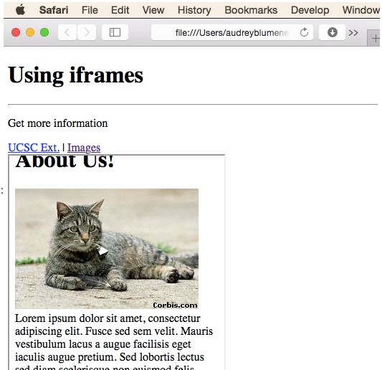
0711 Iframe
https://ucsc-extension.instructure.com/courses/3825/pages/1-dot-1-welcome?module_item_id=42202
0711 Iframe:

Slide 6
0711 Iframe
https://ucsc-extension.instructure.com/courses/3825/pages/1-dot-1-welcome?module_item_id=42202
0711 Iframe:
Embedding a Google Map using iframes:
This is particularly important if you have a physical business address and you want/need your users to be able to find you! Google Maps recently updated their Maps API so it’s really quite a nice addition to a business or organizations’ website.
If one goes to Google maps (https://www.google.com/maps) you can get the code directly.

Slide 7
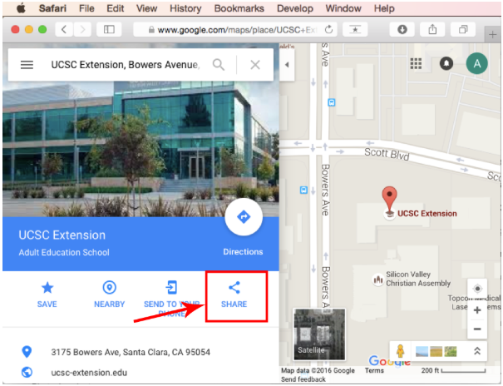
0711 Iframe
https://ucsc-extension.instructure.com/courses/3825/pages/1-dot-1-welcome?module_item_id=42202
0711 Iframe:
Type in a location, say of your business or organization, and then click on the “Share” icon located in the middle of the info panel.

Slide 8
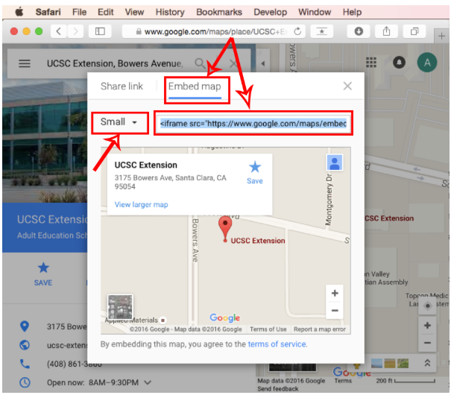
0711 Iframe
https://ucsc-extension.instructure.com/courses/3825/pages/1-dot-1-welcome?module_item_id=42202
0711 Iframe:
This opens a window from which you will choose the “Embed” tab, which will give you the HTML code to copy and use for your web page.
You can also choose the “size” of the iframe/map by selecting from the dropdown menu, which is show below as “Small” (the default is “Medium”).

Slide 9
0711 Iframe
https://ucsc-extension.instructure.com/courses/3825/pages/1-dot-1-welcome?module_item_id=42202
0711 Iframe:
Notes:
Please note that if you are using the HTML5 doctype you will find that the attribute frameborder is not supported by HTML5 and therefore will generate a validation error! The frameborder value can only be “1” or ” 0” which means that the browsers will display a border if “1” or no border if “0”.
What is interesting about their code is that if you change the current “0” to “1” you still won’t get a border to display because they also added in an inline style which states that the border should be “0”.
This inline style will override any change you make to the frame border. I am not sure why frameborder has been left in this code but since it is Google’s code we can/will simply ignore that validation error!

Slide 10
0711 Iframe
https://ucsc-extension.instructure.com/courses/3825/pages/1-dot-1-welcome?module_item_id=42202
0711 Iframe:
How it Displays on the Browser Window:
Google Map displays as shown in the screen shot below, on your web page using iframes.
Technically, all the iframe is doing is pointing to a Google Map web page and loading it into your webpage.

Slide 11
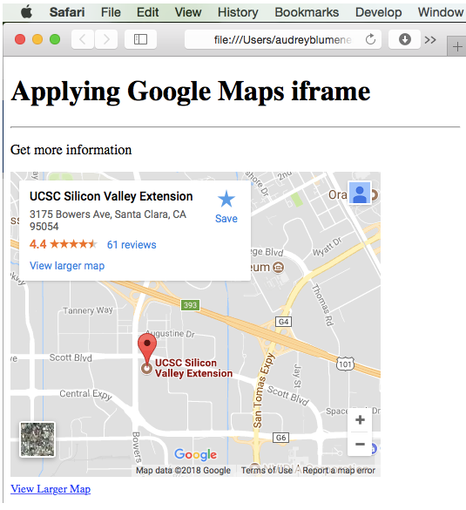
0711 Iframe
https://ucsc-extension.instructure.com/courses/3825/pages/1-dot-1-welcome?module_item_id=42202
0711 Iframe:
The screen-shot below is using a “small” map.

Slide 12
0711 Iframe
https://ucsc-extension.instructure.com/courses/3825/pages/1-dot-1-welcome?module_item_id=42202
0711 Iframe:
That's it!
It's super easy to incorporate a Google Map to your business on your web page!

Slide 13
0711.1 Iframe Video

Slide 14
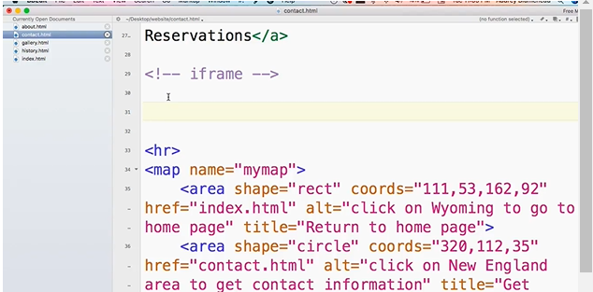
0711.1 Iframe Video
https://ucsc-extension.instructure.com/courses/3825/pages/1-dot-1-welcome?module_item_id=42202
0711.1 Iframe Video:

Slide 15
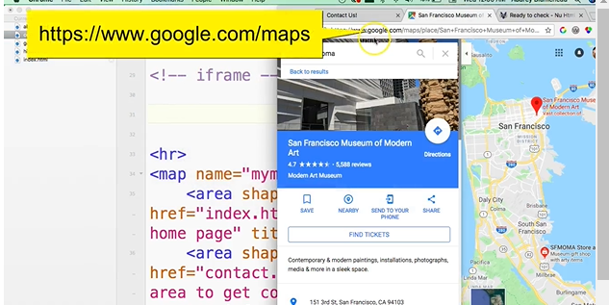
0711.1 Iframe Video
https://ucsc-extension.instructure.com/courses/3825/pages/1-dot-1-welcome?module_item_id=42202
0711.1 Iframe Video: https://www.google.com/maps

Slide 16
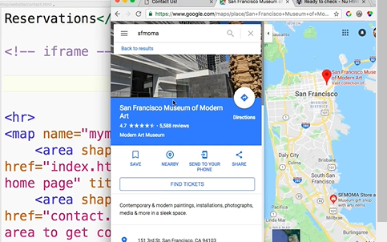
0711.1 Iframe Video
https://ucsc-extension.instructure.com/courses/3825/pages/1-dot-1-welcome?module_item_id=42202
0711.1 Iframe Video: Click “Share” button.

Slide 17
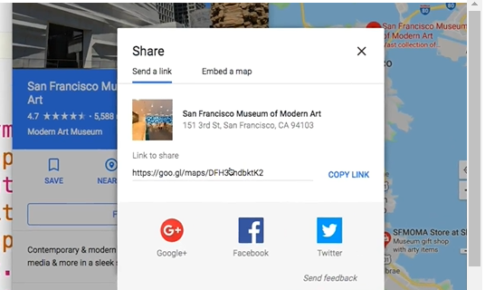
0711.1 Iframe Video
https://ucsc-extension.instructure.com/courses/3825/pages/1-dot-1-welcome?module_item_id=42202
0711.1 Iframe Video: Click “Embed a map”.

Slide 18
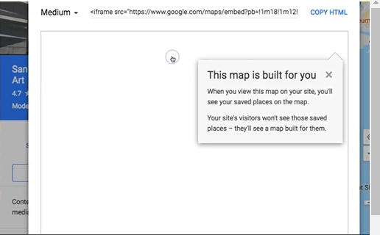
0711.1 Iframe Video
https://ucsc-extension.instructure.com/courses/3825/pages/1-dot-1-welcome?module_item_id=42202
0711.1 Iframe Video: This map is built for you.

Slide 19
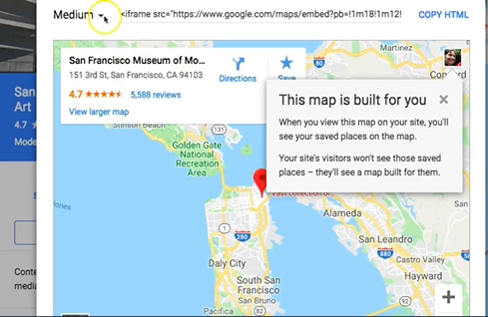
0711.1 Iframe Video
https://ucsc-extension.instructure.com/courses/3825/pages/1-dot-1-welcome?module_item_id=42202
0711.1 Iframe Video: This map is built for you.

Slide 20
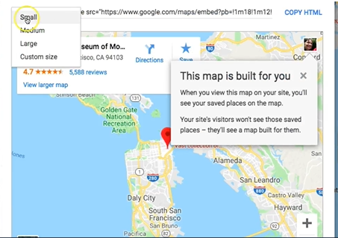
0711.1 Iframe Video
https://ucsc-extension.instructure.com/courses/3825/pages/1-dot-1-welcome?module_item_id=42202
0711.1 Iframe Video: Click “Custom size”

Slide 21
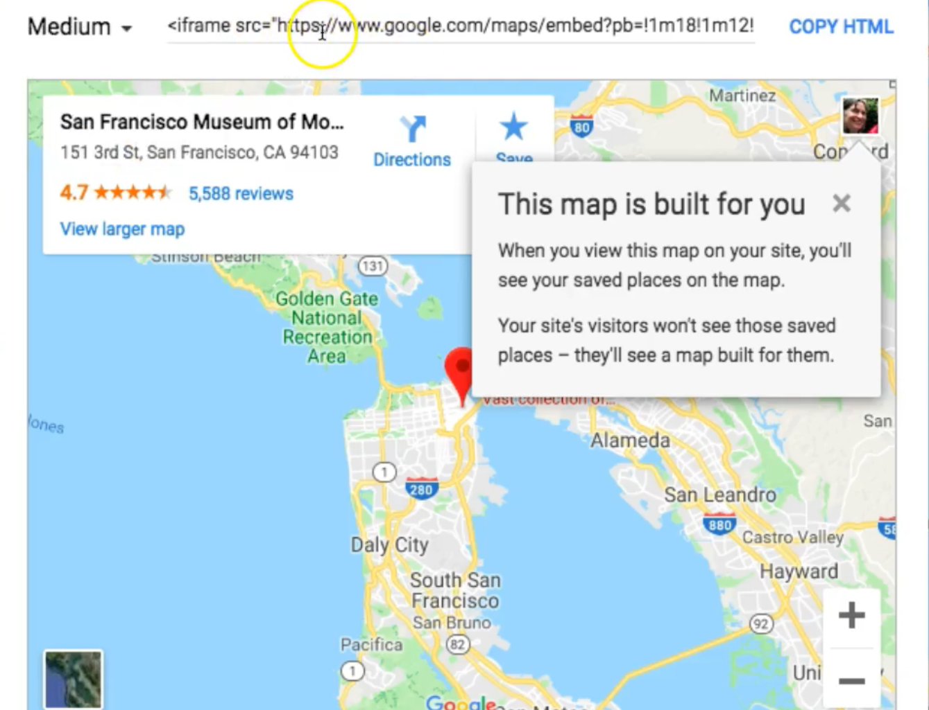
0711.1 Iframe Video
https://ucsc-extension.instructure.com/courses/3825/pages/1-dot-1-welcome?module_item_id=42202
0711.1 Iframe Video: Create the iframe code.

Slide 22
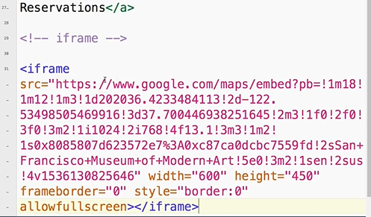
0711.1 Iframe Video
https://ucsc-extension.instructure.com/courses/3825/pages/1-dot-1-welcome?module_item_id=42202
0711.1 Iframe Video: Copy and Paste the iFrame code.

Slide 23
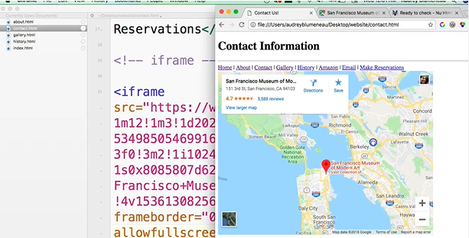
0711.1 Iframe Video
https://ucsc-extension.instructure.com/courses/3825/pages/1-dot-1-welcome?module_item_id=42202
0711.1 Iframe Video: Go back to browser and refresh it.

Slide 24
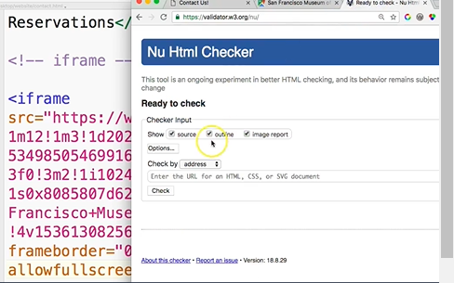
0711.1 Iframe Video
https://ucsc-extension.instructure.com/courses/3825/pages/1-dot-1-welcome?module_item_id=42202
0711.1 Iframe Video: Validate the HTML Code.

Slide 25
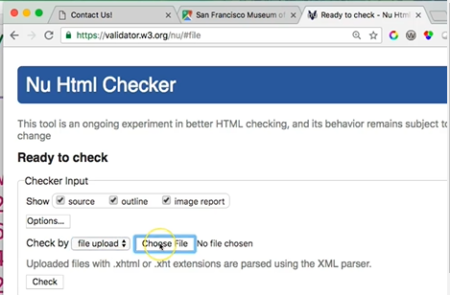
0711.1 Iframe Video
https://ucsc-extension.instructure.com/courses/3825/pages/1-dot-1-welcome?module_item_id=42202
0711.1 Iframe Video: Choose File.

Slide 26
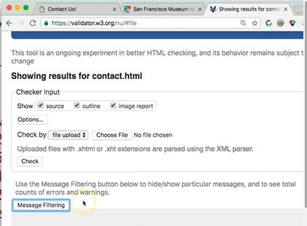
0711.1 Iframe Video
https://ucsc-extension.instructure.com/courses/3825/pages/1-dot-1-welcome?module_item_id=42202
0711.1 Iframe Video: Check.

Slide 27
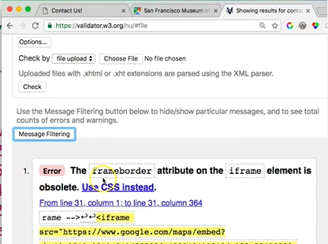
0711.1 Iframe Video
https://ucsc-extension.instructure.com/courses/3825/pages/1-dot-1-welcome?module_item_id=42202
0711.1 Iframe Video: Frameborder of iFrame element is obsolete.

Slide 28
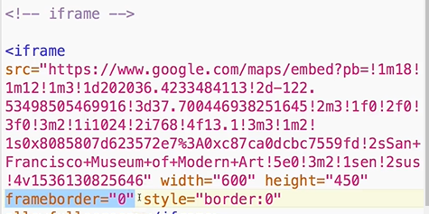
0711.1 Iframe Video
https://ucsc-extension.instructure.com/courses/3825/pages/1-dot-1-welcome?module_item_id=42202
0711.1 Iframe Video: frameorder=“0”

Slide 29
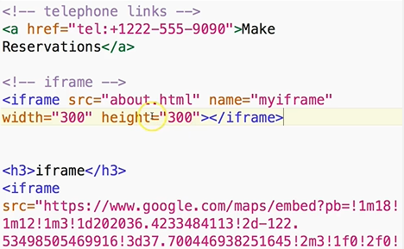
0711.1 Iframe Video
https://ucsc-extension.instructure.com/courses/3825/pages/1-dot-1-welcome?module_item_id=42202
0711.1 Iframe Video: <iframe width=“300” height=“300” ></iframe>

Slide 30
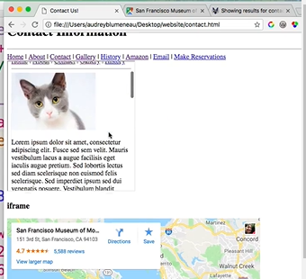
0711.1 Iframe Video
https://ucsc-extension.instructure.com/courses/3825/pages/1-dot-1-welcome?module_item_id=42202
0711.1 Iframe Video: <iframe width=“300” height=“300” ></iframe>
300 x300 pixel iframe

Slide 31
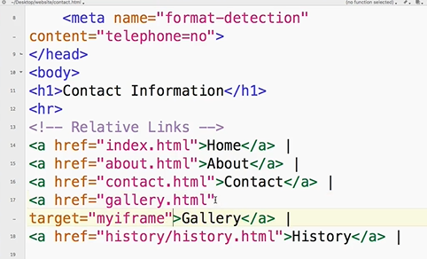
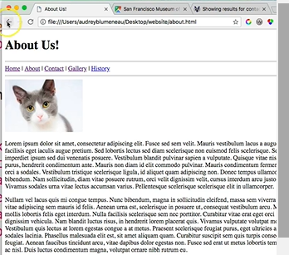
0711.1 Iframe Video
https://ucsc-extension.instructure.com/courses/3825/pages/1-dot-1-welcome?module_item_id=42202
0711.1 Iframe Video: target=“myiframe”

Slide 32
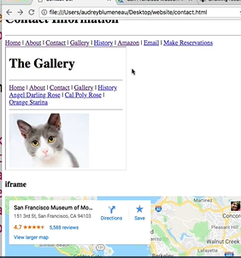
0711.1 Iframe Video
https://ucsc-extension.instructure.com/courses/3825/pages/1-dot-1-welcome?module_item_id=42202
0711.1 Iframe Video: target=“myiframe”

Slide 33
End of Chapter

