Slide 1

0712 Link Assignment
Peter H. Chen

Slide 2
0712 Link Assignment
https://ucsc-extension.instructure.com/courses/3825/pages/1-dot-1-welcome?module_item_id=42202
0712 Link Assignment
Module 07 - Links Assignment
Due Dec 17 by 11:59pm Points 10 Submitting a file upload
Available Sep 17 at 12am - Dec 17 at 11:59pm 3 months
Assignment - Links!

Slide 3
0712 Link Assignment
https://ucsc-extension.instructure.com/courses/3825/pages/1-dot-1-welcome?module_item_id=42202
0712 Link Assignment
Objective:
By the end of this module you will be able to identify and hand-code a web page that contains
Relative Links
Absolute Links
Email Links
Telephone Links
Named Anchor Links,
Image Maps
Iframes
You will be able to identify and incorporate proper HTML attributes to ensure usability, accessibility and functionality.

Slide 4
0712 Link Assignment
https://ucsc-extension.instructure.com/courses/3825/pages/1-dot-1-welcome?module_item_id=42202
0712 Link Assignment
How you will do this:
Create a new folder called YourLastName-module07.
Create a new HTML file and save this file as: "YourLastName-07-links.html". Remember: No spaces! (Your last name, homework assignment: i.e. blumeneau-module07.html). Save to your new folder from step 1.
Put any files (copy and paste previous assignment files into this folder, including the images folder).

Slide 5
0712 Link Assignment
https://ucsc-extension.instructure.com/courses/3825/pages/1-dot-1-welcome?module_item_id=42202
0712 Link Assignment
Include in your HTML files these different types of links:
Relative Link (this is your global navigation and should be on all your files).
Absolute Link.
Email Link.
Telephone Link.
Named Anchor Links (use id attributes in nearest element).
Image Map with one at least on hotspot.
Iframe from Google Maps.

Slide 6
0712 Link Assignment
https://ucsc-extension.instructure.com/courses/3825/pages/1-dot-1-welcome?module_item_id=42202
0712 Link Assignment
Validate your code per the W3C standards:
Use this validator for the HTML5 doctype:
https://validator.w3.org/nu/ (Links to an external site.) (check all the boxes for source, outline and image report).

Slide 7
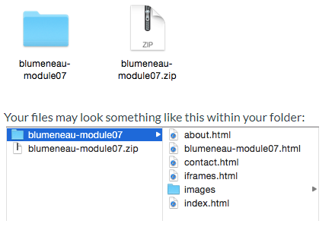
0712 Link Assignment
https://ucsc-extension.instructure.com/courses/3825/pages/1-dot-1-welcome?module_item_id=42202
0712 Link Assignment
zip your folder so you an submit all files as a "package"!
Windows: Right-click the folder, go to Send To > Compressed (zipped) folder").
Mac: Right-click on the folder and choose ">Compress".
This will create a .zip file and this is the file you will submit to me

Slide 8
0712 Link Assignment
https://ucsc-extension.instructure.com/courses/3825/pages/1-dot-1-welcome?module_item_id=42202
0712 Link Assignment
NOTE
Use the HTML5 doctype and meta tag for this exercise. Do not use any deprecated attributes (there is only one deprecated attribute in this module). I only showcase these so you are aware of what they are and what they did, so you can recognize old code from what is currently acceptable. In other words, you shouldn't use these attributes!
The HTML code here is exactly the same whether we use HTML 4.01 Transitional/Strict, XHTML 1.0 Transitional/Strict or HTML5 minus those deprecated attributes!

Slide 9
0712 Link Assignment
https://ucsc-extension.instructure.com/courses/3825/pages/1-dot-1-welcome?module_item_id=42202
0712 Link Assignment
What to Submit:
Check Rubric (below) to ensure that all criteria have been met.
Submit your .zip file here!

Slide 10
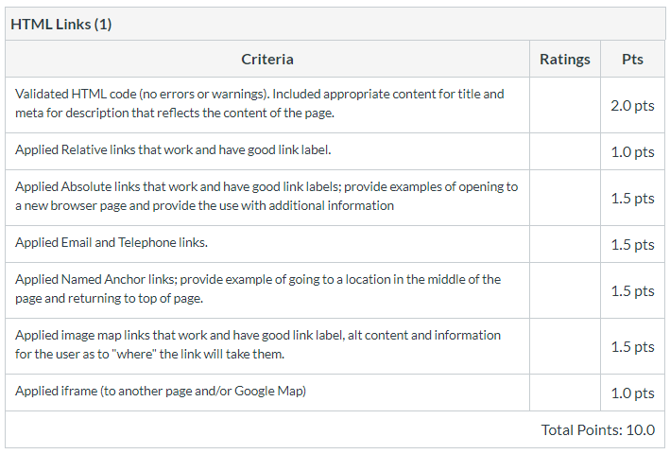
0712 Link Assignment
https://ucsc-extension.instructure.com/courses/3825/pages/1-dot-1-welcome?module_item_id=42202
0712 Link Assignment

Slide 11
End of Chapter

