Slide 1

0713 Link Quiz
Peter H. Chen

Slide 2
0713 Link Quiz
https://ucsc-extension.instructure.com/courses/3825/pages/1-dot-1-welcome?module_item_id=42202
0713 Links Quiz
Due Dec 17 at 11:59pm Points 10 Questions 10
Available Sep 17 at 12am - Dec 17 at 11:59pm 3 months
Time Limit 30 Minutes Allowed Attempts 3
Instructions
Review of Concepts covered in Module 7 – Links
Objectives:
Students should be able to:
Define basic HTML terminology regarding links used on web pages
Identify correct HTML usage of different types of links

Slide 3
0713 Link Quiz
https://ucsc-extension.instructure.com/courses/3825/pages/1-dot-1-welcome?module_item_id=42202
0713 Links Quiz
About the Quiz:
This is a graded quiz
There are 10 questions for a total of 10 points.
You can take the quiz three times
Highest score is applied.
You will have 30 minutes to complete for each attempt.

Slide 4
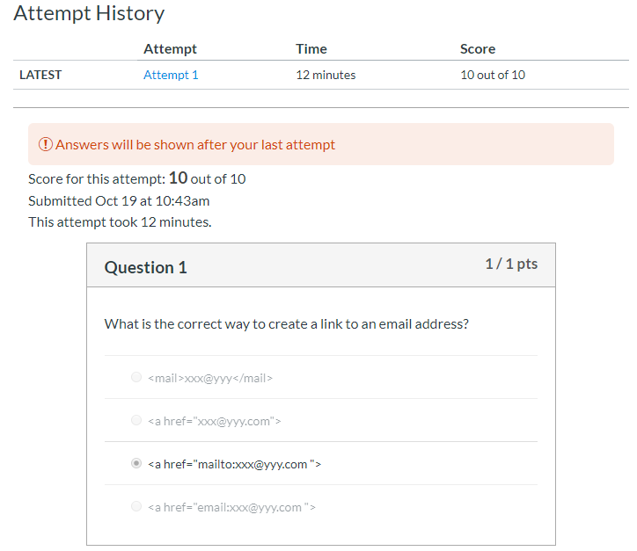
0713 Link Quiz
https://ucsc-extension.instructure.com/courses/3825/pages/1-dot-1-welcome?module_item_id=42202
0713 Links Quiz

Slide 5
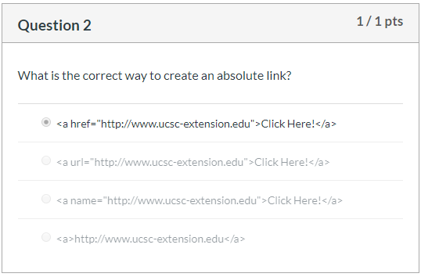
0713 Link Quiz
https://ucsc-extension.instructure.com/courses/3825/pages/1-dot-1-welcome?module_item_id=42202
0713 Links Quiz

Slide 6
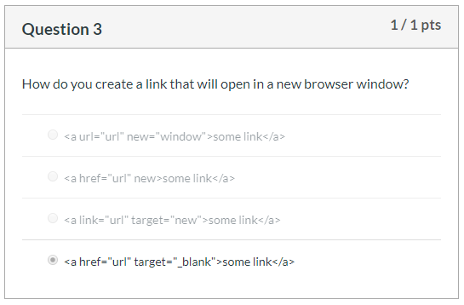
0713 Link Quiz
https://ucsc-extension.instructure.com/courses/3825/pages/1-dot-1-welcome?module_item_id=42202
0713 Links Quiz

Slide 7
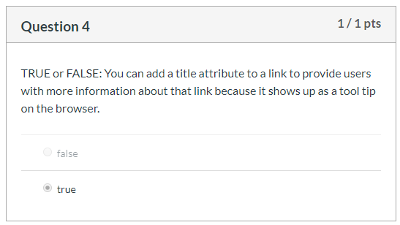
0713 Link Quiz
https://ucsc-extension.instructure.com/courses/3825/pages/1-dot-1-welcome?module_item_id=42202
0713 Links Quiz

Slide 8
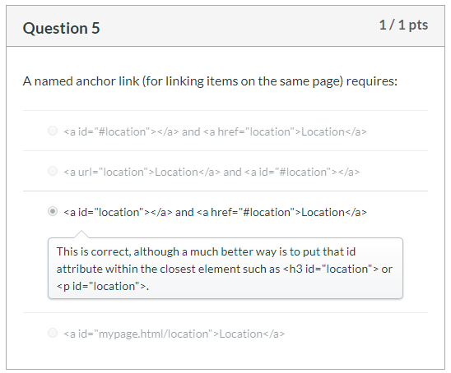
0713 Link Quiz
https://ucsc-extension.instructure.com/courses/3825/pages/1-dot-1-welcome?module_item_id=42202
0713 Links Quiz

Slide 9
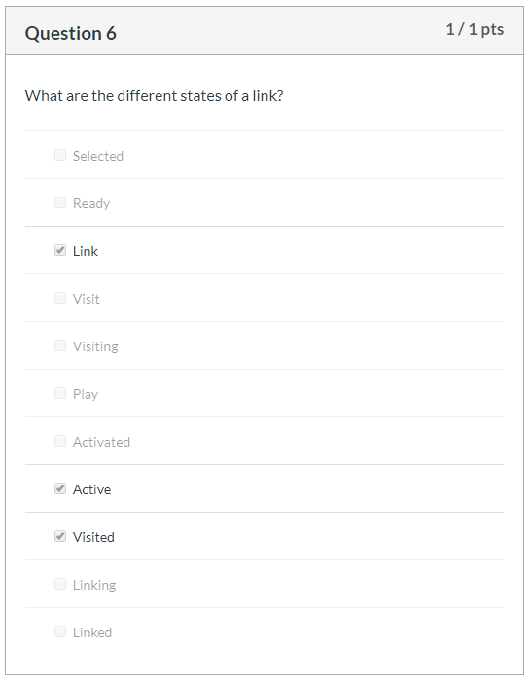
0713 Link Quiz
https://ucsc-extension.instructure.com/courses/3825/pages/1-dot-1-welcome?module_item_id=42202
0713 Links Quiz

Slide 10
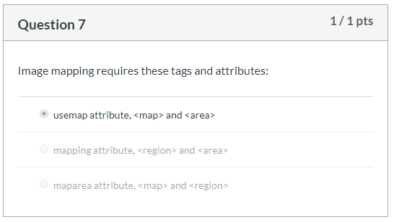
0713 Link Quiz
https://ucsc-extension.instructure.com/courses/3825/pages/1-dot-1-welcome?module_item_id=42202
0713 Links Quiz

Slide 11
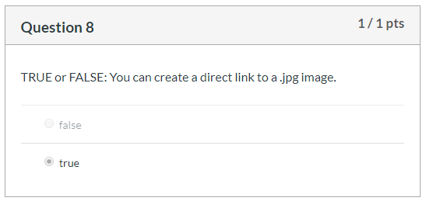
0713 Link Quiz
https://ucsc-extension.instructure.com/courses/3825/pages/1-dot-1-welcome?module_item_id=42202
0713 Links Quiz

Slide 12
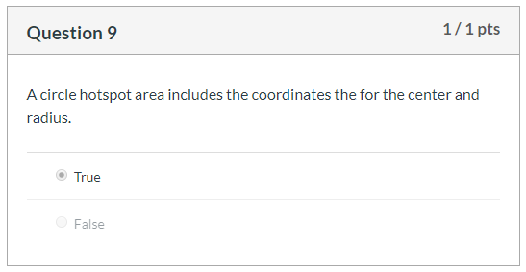
0713 Link Quiz
https://ucsc-extension.instructure.com/courses/3825/pages/1-dot-1-welcome?module_item_id=42202
0713 Links Quiz

Slide 13
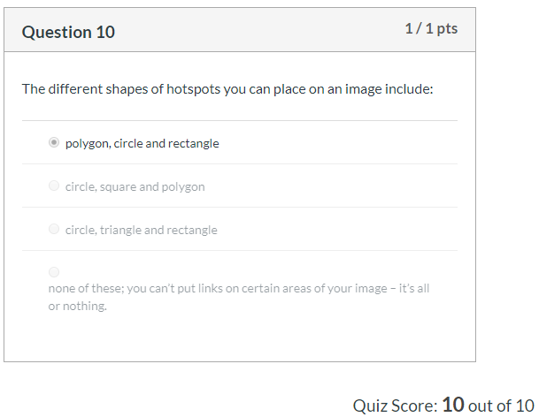
0713 Link Quiz
https://ucsc-extension.instructure.com/courses/3825/pages/1-dot-1-welcome?module_item_id=42202
0713 Links Quiz

Slide 14
End of Chapter

