Slide 1

0901 Coding Form
Peter H. Chen

Slide 2
0901 Coding Form
https://ucsc-extension.instructure.com/courses/3825/pages/1-dot-1-welcome?module_item_id=42202
0901 Introduction to Coding Form
Forms:
Forms allow visitors to communicate with you or to look for things (search).
There are two parts to a form:
The Structure or Shell - consists of fields, labels, and buttons for the user to use.
A Processing Script – Sits on the server; takes the information and converts it into a format that you can read or tally.

Slide 3
0901 Coding Form
https://ucsc-extension.instructure.com/courses/3825/pages/1-dot-1-welcome?module_item_id=42202
0901 Introduction to Coding Form
Processing the Form (backend-development)
Web forms may be processed using one of the following technologies:
PHP (.php) is an open source scripting language most commonly used with the Apache web server.
Microsoft’s ASP.NET (Active Server Pages) (.asp) is a programming environment for the Microsoft Internet Information Server (IIS).
Ruby on Rails. Ruby is the programming language that is used with the Rails platform. Many popular web applications are built with it.
Java Server Pages (.jsp) is a Java-based technology similar to ASP.
Python is a popular scripting language for web and server applications.

Slide 4
0901 Coding Form
https://ucsc-extension.instructure.com/courses/3825/pages/1-dot-1-welcome?module_item_id=42202
0901 Introduction to Coding Form
There are other forms processing options that may have their own suffixes or none at all (as is the case for the Ruby on Rails platform).
Check with your programmer, server administrator, or script documentation for the proper name and location of the program to be provided by the action attribute.
Sometimes there is form-processing code such as PHP embedded right in the HTML file.
In that case, leave the action empty and the form will post to the page itself.

Slide 5
0901 Coding Form
https://ucsc-extension.instructure.com/courses/3825/pages/1-dot-1-welcome?module_item_id=42202
0901 Introduction to Coding Form
What does a processing script do?
Every element (text field, comment field, checkboxes etc.) of your form will have a name and a value associated with it.
The name identifies the data being sent and the value is the data.
When a user clicks on the “Submit Button”, the name-value pair of each form element is then sent to the server.

Slide 6
0901 Coding Form
https://ucsc-extension.instructure.com/courses/3825/pages/1-dot-1-welcome?module_item_id=42202
0901 Introduction to Coding Form
The script will do two things.
First it takes all those name-value pairs and separates them into intelligible pieces.
Second, it sends the data to you via email.
So when you, as the web owner, receive the form from a user that is being processed via a script, this is how it will return the results to you:
First_Name=Audrey
Last_Name=Blumeneau
Email=ablumene@ucsc.edu

Slide 7
0901 Coding Form
https://ucsc-extension.instructure.com/courses/3825/pages/1-dot-1-welcome?module_item_id=42202
0901 Introduction to Coding Form
If I didn’t use a script to process the form, the response I would in my email would look something like this:
First_Name=Audrey&use=Last_Name=Blumeneau&use=Email=ablumene%40ucsc.edu
It's one long sentence with all sorts of additional characters such as ampersands and %40 to represent certain types of characters.
Not very easy to read in other words. Having a processing script is certainly the way to go... but is out of the scope of this class.
We will focus on the front-end development, creating the form and the form fields.

Slide 8
0901.1 Coding Form Video

Slide 9

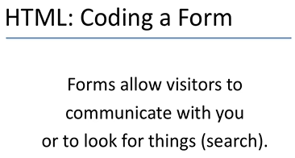
0901.1 Coding Form Video
https://ucsc-extension.instructure.com/courses/3825/pages/1-dot-1-welcome?module_item_id=42202
0901.1 Introduction to Coding Form Video

Slide 10
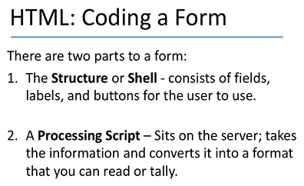
0901.1 Coding Form Video
https://ucsc-extension.instructure.com/courses/3825/pages/1-dot-1-welcome?module_item_id=42202
0901.1 Introduction to Coding Form Video

Slide 11
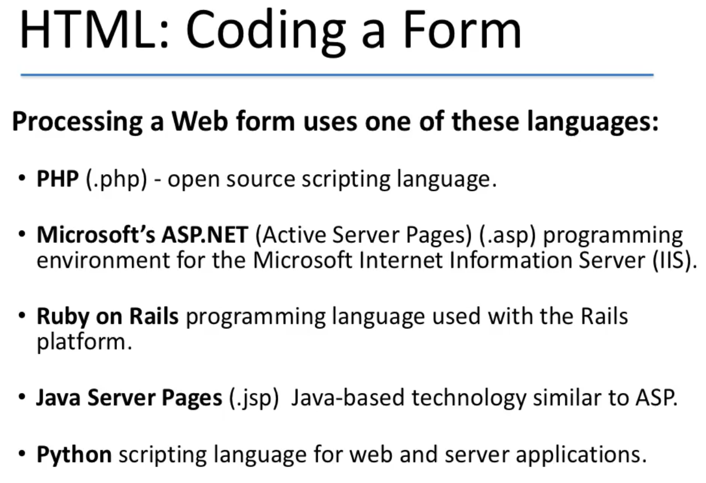
0901.1 Coding Form Video
https://ucsc-extension.instructure.com/courses/3825/pages/1-dot-1-welcome?module_item_id=42202
0901.1 Introduction to Coding Form Video

Slide 12
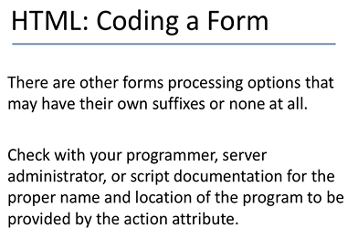
0901.1 Coding Form Video
https://ucsc-extension.instructure.com/courses/3825/pages/1-dot-1-welcome?module_item_id=42202
0901.1 Introduction to Coding Form Video

Slide 13
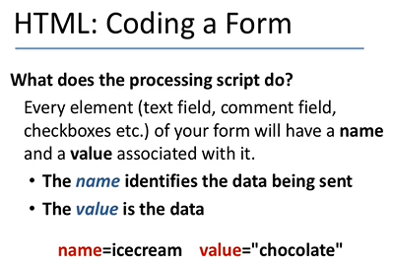
0901.1 Coding Form Video
https://ucsc-extension.instructure.com/courses/3825/pages/1-dot-1-welcome?module_item_id=42202
0901.1 Introduction to Coding Form Video

Slide 14
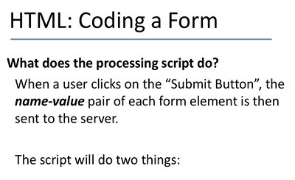
0901.1 Coding Form Video
https://ucsc-extension.instructure.com/courses/3825/pages/1-dot-1-welcome?module_item_id=42202
0901.1 Introduction to Coding Form Video

Slide 15
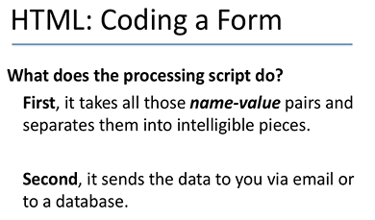
0901.1 Coding Form Video
https://ucsc-extension.instructure.com/courses/3825/pages/1-dot-1-welcome?module_item_id=42202
0901.1 Introduction to Coding Form Video

Slide 16
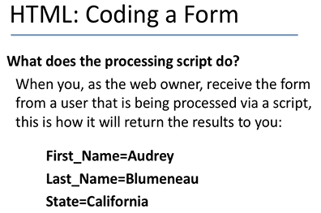
0901.1 Coding Form Video
https://ucsc-extension.instructure.com/courses/3825/pages/1-dot-1-welcome?module_item_id=42202
0901.1 Introduction to Coding Form Video

Slide 17
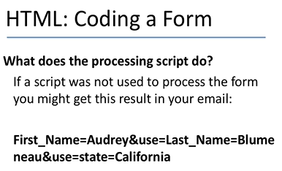
0901.1 Coding Form Video
https://ucsc-extension.instructure.com/courses/3825/pages/1-dot-1-welcome?module_item_id=42202
0901.1 Introduction to Coding Form Video

Slide 18
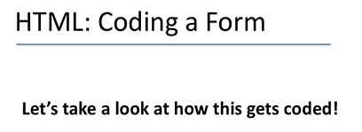
0901.1 Coding Form Video
https://ucsc-extension.instructure.com/courses/3825/pages/1-dot-1-welcome?module_item_id=42202
0901.1 Introduction to Coding Form Video

Slide 19
End of Chapter

