Slide 1

0902 Form Tag
Peter H. Chen

Slide 2
0902 Form Tag
https://ucsc-extension.instructure.com/courses/3825/pages/1-dot-1-welcome?module_item_id=42202
0902 Form Tag
The Form Tag - <form> … </form>
The <form> tag contains all the form elements and the submit button which sends the data to the script on the server.
Mandatory Attributes used in the <Form> Tag:
There are two attributes that are considered mandatory not only for validation but also for proper functioning of the form itself!
<form action="http://www.domain.com/form.php" method="post">
action=" "
The action attribute gives the URL of the application that is to receive and process the forms data. Therefore the action could be also written like this
action="http://www.domain.com/form.php"
OR
action="mailto:forms@mydomain.com" (not recommended!!)

Slide 3
0902 Form Tag
https://ucsc-extension.instructure.com/courses/3825/pages/1-dot-1-welcome?module_item_id=42202
0902 Form Tag
When using email like this, the data will not be parsed (data will not be divided into fields) as there is no processing script so the message will become a data string and look something like this (depending on what your form includes) (as mentioned in the previous content page):
name=Audrey+Blumeneau&use=email=blumeneau%40yahoo.com
A couple of other things to remember if using email as your action value:
data is not encrypted which means that the information is not protected;
user is not sent to a confirmation page and is left looking at the form page after they click on the submit button (although this can be dealt with using a JavaScript).

Slide 4
0902.1 Form Tag Video

Slide 5
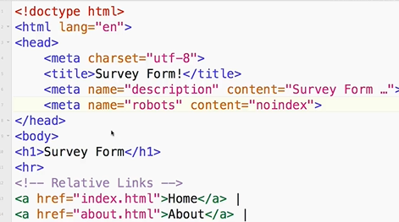
0902.1 Form Tag Video
https://ucsc-extension.instructure.com/courses/3825/pages/1-dot-1-welcome?module_item_id=42202
0902.1 Form Tag Video

Slide 6
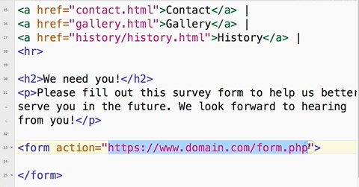
0902.1 Form Tag Video
https://ucsc-extension.instructure.com/courses/3825/pages/1-dot-1-welcome?module_item_id=42202
0902.1 Form Tag Video

Slide 7
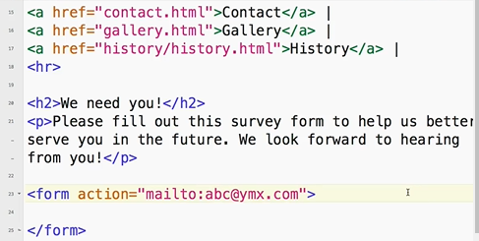
0902.1 Form Tag Video
https://ucsc-extension.instructure.com/courses/3825/pages/1-dot-1-welcome?module_item_id=42202
0902.1 Form Tag Video

Slide 8
0902.2 Method

Slide 9
0902.2 Method
https://ucsc-extension.instructure.com/courses/3825/pages/1-dot-1-welcome?module_item_id=42202
0902.2 Method
method=" “
You have choice of values for the method attribute: “post” or “get”.
post - best method if you are sending secure information (credit card, SS#).
get - used if the user wants to bookmark a submission form (such as a list of search results). This method is not appropriate for forms asking for sensitive information like financial data. Also there is a 256-character limit on what gets sent.
For these reasons we will use post.
Now that the <form> </form> elements are set up, we can now add in some form fields for our user to fill out!

Slide 10
0902.3 Method Video

Slide 11
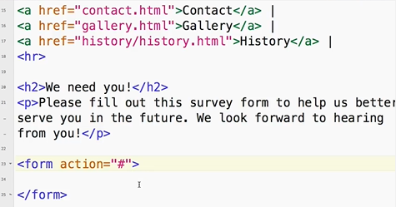
0902.3 Method Video
https://ucsc-extension.instructure.com/courses/3825/pages/1-dot-1-welcome?module_item_id=42202
0902.3 Method Video

Slide 12
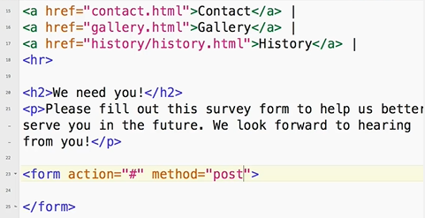
0902.3 Method Video
https://ucsc-extension.instructure.com/courses/3825/pages/1-dot-1-welcome?module_item_id=42202
0902.3 Method Video: Post is for secure information, such as credit card.

Slide 13
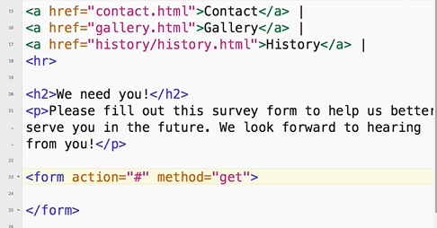
0902.3 Method Video
https://ucsc-extension.instructure.com/courses/3825/pages/1-dot-1-welcome?module_item_id=42202
0902.3 Method Video: Get is used for non-secured information.

Slide 14
End of Chapter

