Slide 1

0903 Fieldset, Legend, and Label
Peter H. Chen

Slide 2
0903 Fieldset, Legend, and Label
https://ucsc-extension.instructure.com/courses/3825/pages/1-dot-1-welcome?module_item_id=42202
0903 Fieldset, Legend, and Label
Accessibility and Forms – Fieldsets, Legends and Labels:
Okay, before we actually create the form fields to have people fill out, let's talk about fieldsets, legends and labels as these are essential for providing a user who uses assistive technology a user-friendly environment in which to fill out your form!
Every form input field (when you input your name, address, phone number, email address – these are all “input fields”) will have a corresponding “label” and “legend” for screen readers and other assistive technology.
A person with no vision problems can “see” that a form field that is next to or underneath some text that reads Name or Email Address connected to a particular input field.
However, this is not the case for someone who can’t see the form and depends on a screen reader to read the form out loud.
There is no way for a sight disabled person to see the connection between a form element and its text label without the visual cues.

Slide 3
0903 Fieldset, Legend, and Label
https://ucsc-extension.instructure.com/courses/3825/pages/1-dot-1-welcome?module_item_id=42202
0903 Fieldset, Legend, and Label
Throughout this module we will be using the “label” element. When using an “explicit association” we will use the “for” attribute.
The “for” attribute simply connects the label to the input field (that way the label and the form element don’t even have to sit right next to each other.
There are other times where we simply wrap the <label> </label> around the form control which is a method called “implicit association”.
The fieldset element goes hand in hand with the legend element.
Suppose you were creating a form in which you had both a Postal address and also a Shipping address.
When creating a legend and fieldset, you can indicate which is which for a screen reader so that it makes sense why it asks for an address twice.
Eventually we will want to use CSS to create a visually appealing form.

Slide 4
0903 Fieldset, Legend, and Label
https://ucsc-extension.instructure.com/courses/3825/pages/1-dot-1-welcome?module_item_id=42202
0903 Fieldset, Legend, and Label
Eventually we will want to use CSS to create a visually appealing form.
So to start our form we will begin immediately after the opening <form> element and add in a <fieldset> and <legend>.
<form id="form1" name="Address Information" method="post" action="">
<fieldset>
<legend>Personal Information</legend>
…various questions…
</fieldset>
<fieldset>
<legend>Choices</legend>
…various questions…
</fieldset>
</form>

Slide 5
0903 Fieldset, Legend, and Label
https://ucsc-extension.instructure.com/courses/3825/pages/1-dot-1-welcome?module_item_id=42202
0903 Fieldset, Legend, and Label
This form has two sets of questions, one set of questions deals with personal information and the second set of questions will deal with questions about choices.
You can have as many field sets as you require.
It's a good idea to fully plan out any form questionnaire to ensure that the questions are easy to follow for both the visual and the visually impaired user.
Okay, now we can begin to add our form elements for our user to fill out!

Slide 6
0903.1 Fieldset, Legend, and Label Video

Slide 7

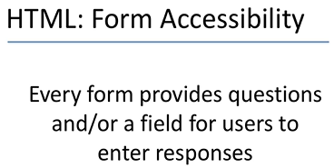
0903.1 Fieldset, Legend, and Label Video
https://ucsc-extension.instructure.com/courses/3825/pages/1-dot-1-welcome?module_item_id=42202
0903.1 Fieldset, Legend, and Label Video

Slide 8
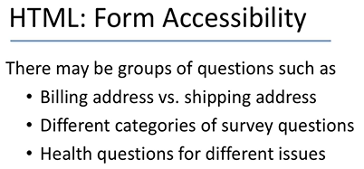
0903.1 Fieldset, Legend, and Label Video
https://ucsc-extension.instructure.com/courses/3825/pages/1-dot-1-welcome?module_item_id=42202
0903.1 Fieldset, Legend, and Label Video

Slide 9
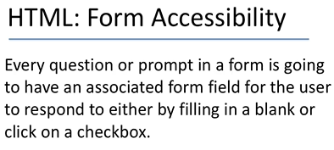
0903.1 Fieldset, Legend, and Label Video
https://ucsc-extension.instructure.com/courses/3825/pages/1-dot-1-welcome?module_item_id=42202
0903.1 Fieldset, Legend, and Label Video

Slide 10
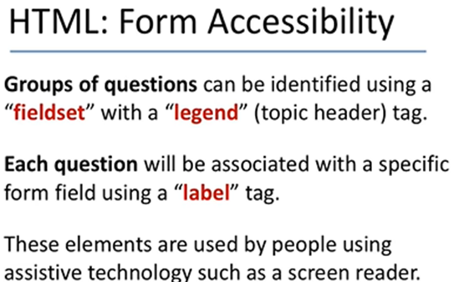
0903.1 Fieldset, Legend, and Label Video
https://ucsc-extension.instructure.com/courses/3825/pages/1-dot-1-welcome?module_item_id=42202
0903.1 Fieldset, Legend, and Label Video

Slide 11
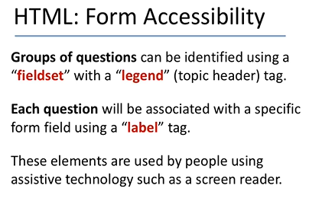
0903.1 Fieldset, Legend, and Label Video
https://ucsc-extension.instructure.com/courses/3825/pages/1-dot-1-welcome?module_item_id=42202
0903.1 Fieldset, Legend, and Label Video

Slide 12
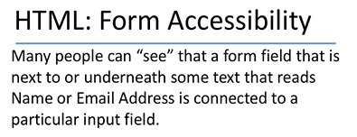
0903.1 Fieldset, Legend, and Label Video
https://ucsc-extension.instructure.com/courses/3825/pages/1-dot-1-welcome?module_item_id=42202
0903.1 Fieldset, Legend, and Label Video

Slide 13
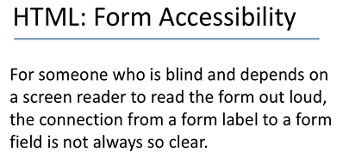
0903.1 Fieldset, Legend, and Label Video
https://ucsc-extension.instructure.com/courses/3825/pages/1-dot-1-welcome?module_item_id=42202
0903.1 Fieldset, Legend, and Label Video

Slide 14
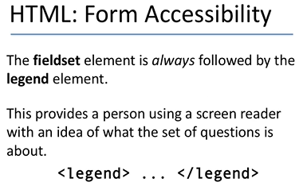
0903.1 Fieldset, Legend, and Label Video
https://ucsc-extension.instructure.com/courses/3825/pages/1-dot-1-welcome?module_item_id=42202
0903.1 Fieldset, Legend, and Label Video

Slide 15
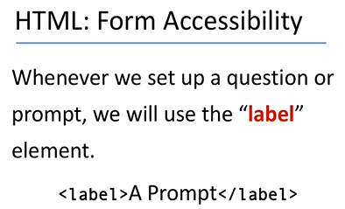
0903.1 Fieldset, Legend, and Label Video
https://ucsc-extension.instructure.com/courses/3825/pages/1-dot-1-welcome?module_item_id=42202
0903.1 Fieldset, Legend, and Label Video

Slide 16
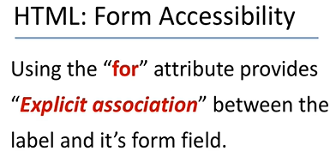
0903.1 Fieldset, Legend, and Label Video
https://ucsc-extension.instructure.com/courses/3825/pages/1-dot-1-welcome?module_item_id=42202
0903.1 Fieldset, Legend, and Label Video

Slide 17
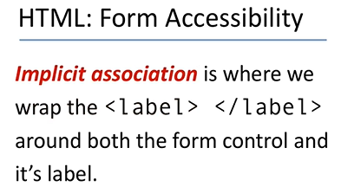
0903.1 Fieldset, Legend, and Label Video
https://ucsc-extension.instructure.com/courses/3825/pages/1-dot-1-welcome?module_item_id=42202
0903.1 Fieldset, Legend, and Label Video

Slide 18
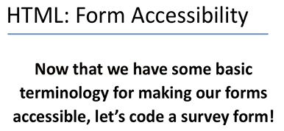
0903.1 Fieldset, Legend, and Label Video
https://ucsc-extension.instructure.com/courses/3825/pages/1-dot-1-welcome?module_item_id=42202
0903.1 Fieldset, Legend, and Label Video

Slide 19
End of Chapter

