Slide 1

0904 Label and Input
Peter H. Chen

Slide 2
0904 Label and Input
https://ucsc-extension.instructure.com/courses/3825/pages/1-dot-1-welcome?module_item_id=42202
0904 Label and Input Type: Text , Password
Elements of a Form:
Text Boxes: type="text“
A text box can contain one line or more of free form text such as names, addresses etc. It looks like this:
<label for="firstName">First Name</label>
<input type="text" name="firstName" id="firstName">

Slide 3
0904 Label and Input
https://ucsc-extension.instructure.com/courses/3825/pages/1-dot-1-welcome?module_item_id=42202
0904 Label and Input Type: Text , Password
What's going on?
Notice that the “input” element does not have a closing tag.
The id attribute connects the input field to the labels “for” attribute. The values for these two are case-sensitive and no spaces are allowed!
The name attribute's value will be used by the form processing script to enter into a database or to return to you which form field was answered.
To control the number of characters entered (e.g. zip code or credit card number) you can add the attributes “size” and “maxlength”.
size will define the width of the text field measured in characters.
You can put a maxlength="n" where “n” is the maximum number of characters that can be entered in the box.
For example:
<label for="zip">Zip Code: </label>
<input type="text" name="zip" id="zip" size="5" maxlength="5">

Slide 4
0904.1 Label and Input Video

Slide 5
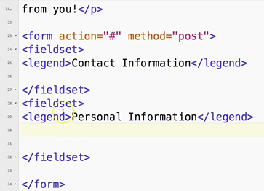
0904.1 Label and Input Video
https://ucsc-extension.instructure.com/courses/3825/pages/1-dot-1-welcome?module_item_id=42202
0904.1 Label and Input Video

Slide 6
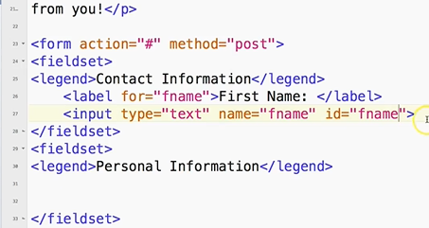
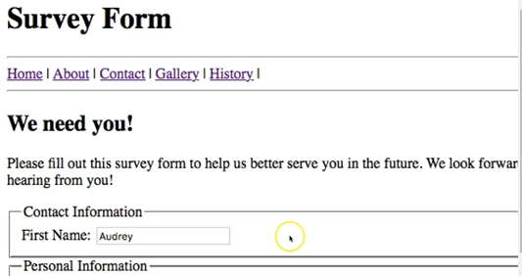
0904.1 Label and Input Video
https://ucsc-extension.instructure.com/courses/3825/pages/1-dot-1-welcome?module_item_id=42202
0904.1 Label and Input Video

Slide 7
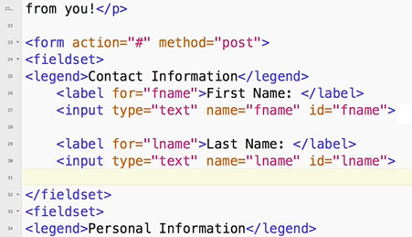
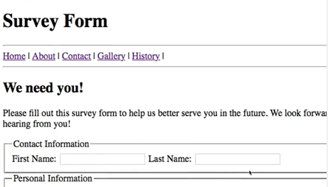
0904.1 Label and Input Video
https://ucsc-extension.instructure.com/courses/3825/pages/1-dot-1-welcome?module_item_id=42202
0904.1 Label and Input Video

Slide 8
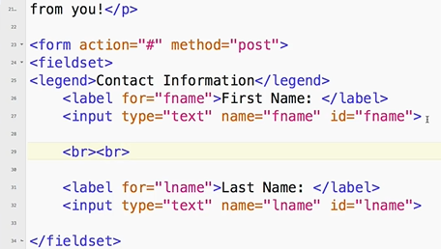
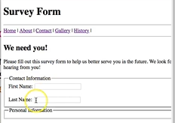
0904.1 Label and Input Video
https://ucsc-extension.instructure.com/courses/3825/pages/1-dot-1-welcome?module_item_id=42202
0904.1 Label and Input Video: In Real world, we do not use <br><br>, we use CSS to separate the field.

Slide 9
0904.2 Password Box

Slide 10
0904.2 Password Box
https://ucsc-extension.instructure.com/courses/3825/pages/1-dot-1-welcome?module_item_id=42202
0904.2 Password Box:
Password Boxes: type="password“
Password boxes are simple text boxes that when you type in them they come with bullets or asterisks.
The only protection this box gives you is that someone looking over your shoulder can’t read your password…you would need use a CGI script and place the password on a secure server to really behave as a password.
<label for="password">Customer ID</label>
<input type="password" name="password" id="password">

Slide 11
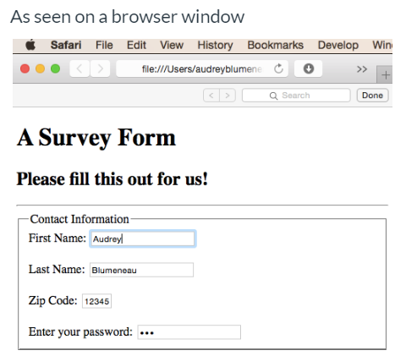
0904.2 Password Box
https://ucsc-extension.instructure.com/courses/3825/pages/1-dot-1-welcome?module_item_id=42202
0904.2 Password Box:

Slide 12
0904.3 Password Box Video

Slide 13
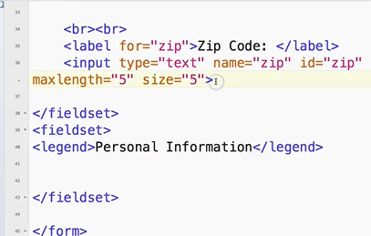
0904.3 Password Box Video
https://ucsc-extension.instructure.com/courses/3825/pages/1-dot-1-welcome?module_item_id=42202
0904.3 Password Box Video

Slide 14
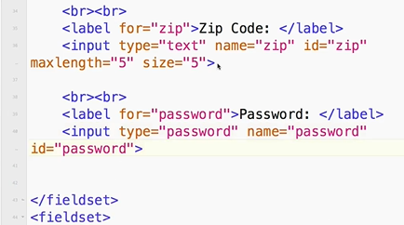
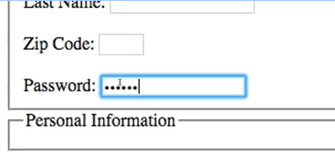
0904.3 Password Box Video
https://ucsc-extension.instructure.com/courses/3825/pages/1-dot-1-welcome?module_item_id=42202
0904.3 Password Box Video: Prevent someone look over your shoulder

Slide 15
End of Chapter

