Slide 1

0905 Select Option
Peter H. Chen

Slide 2
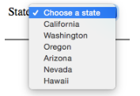
0905 Select Option
https://ucsc-extension.instructure.com/courses/3825/pages/1-dot-1-welcome?module_item_id=42202
0905 Select Option
Creating Menus: <select> and <option>
Menus are great for offering a list of choices from a given set of options. Both the “select” tag and the “option” tags have closing tags
<label for="state">State</label>
<select name="state" id="state">
<option value="CA">California</option>
<option value="OR">Oregon</option>
<option value="WA">Washington</option>
</select>

Slide 3
0905.1 Select Option Video

Slide 4
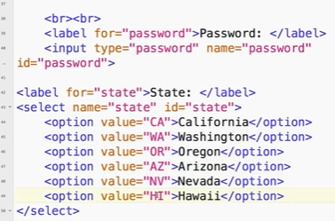
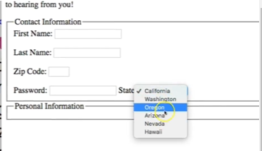
0905.1 Select Option Video
https://ucsc-extension.instructure.com/courses/3825/pages/1-dot-1-welcome?module_item_id=42202
0905.1 Select Option Video

Slide 5
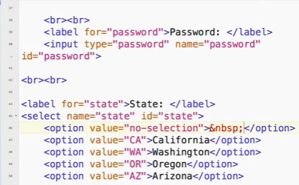
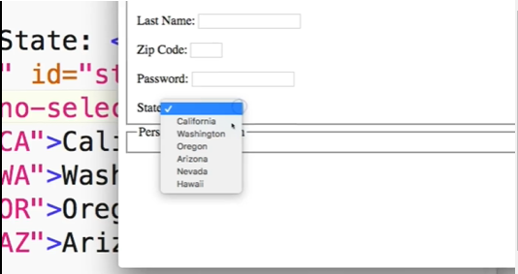
0905.1 Select Option Video
https://ucsc-extension.instructure.com/courses/3825/pages/1-dot-1-welcome?module_item_id=42202
0905.1 Select Option Video

Slide 6
0905.2 Group Option Categories

Slide 7
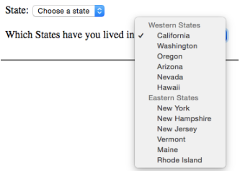
0905.2 Group Options Categories
https://ucsc-extension.instructure.com/courses/3825/pages/1-dot-1-welcome?module_item_id=42202
0905.2 Group Options Categories
Group options into categories:
Use the opt group element to group together different options (be sure to close this element after the last option of that group):
<label for="state">State</label>
<select name="state" id="state">
<optgroup label="Western States">
<option value="CA">California</option>
<option value="OR">Oregon</option>
<option value="WA">Washington</option>
</optgroup>
<optgroup label="North Eastern States">
<option value="VT">Vermont</option>
<option value="MN">Maine</option>
<option value="NH">New Hampshire</option>
</optgroup>
</select>

Slide 8
0905.3 Group Option Categories Video

Slide 9
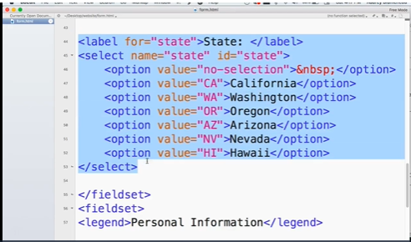
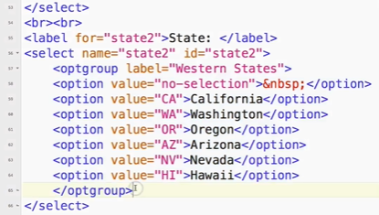
0905.3 Group Options Categories Video
https://ucsc-extension.instructure.com/courses/3825/pages/1-dot-1-welcome?module_item_id=42202
0905.3 Group Options Categories Video

Slide 10
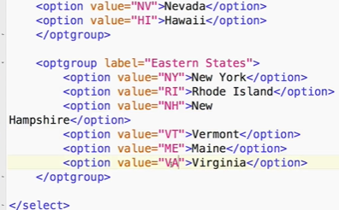
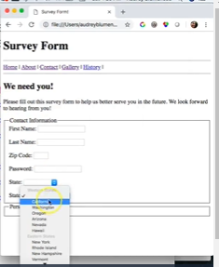
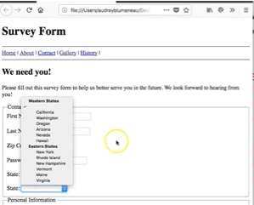
0905.3 Group Options Categories Video
https://ucsc-extension.instructure.com/courses/3825/pages/1-dot-1-welcome?module_item_id=42202
0905.3 Group Options Categories Video

Slide 11
0905.4 <select> List Tag

Slide 12

0905.4 <select> List Tag
https://ucsc-extension.instructure.com/courses/3825/pages/1-dot-1-welcome?module_item_id=42202
0905.4 <select> List Tag
To create a list you simply add a couple of attributes to your “menu” and now you have a scrollable list. Both the “select” tag and the “option” tags have closing tags
<p>
<label for="choiceState">Which state do want to visit?</label>
<select name="choiceState" size="3" multiple id="choiceState">
<option value="CA">California</option>
<option value="NV">Nevada</option>
<option value="OR">Oregon</option>
<option value="WA">Washington</option>
<option value="AZ">Arizona</option>
</select>
</p>
size - identifies the height in lines of the menu (you can leave this out if you don’t want to.
multiple - allows your visitor to select more than one menu option. This attribute can be written (and must be written when using XHTML 1.0) as multiple="multiple" but it's so much easier to simply write multiple as it works and validates!

Slide 13
0905.5 <select> List Video

Slide 14
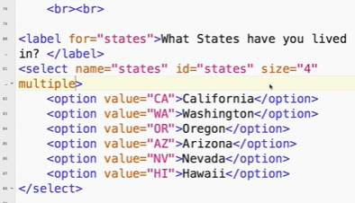
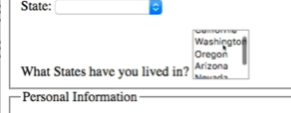
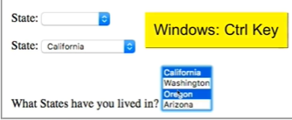
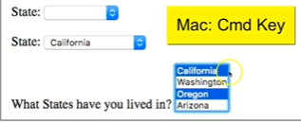
0905.5 <select> List Video
https://ucsc-extension.instructure.com/courses/3825/pages/1-dot-1-welcome?module_item_id=42202
0905.5 <select> List Video

Slide 15
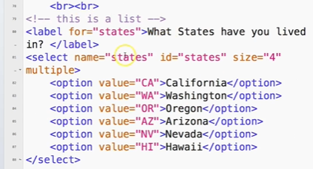
0905.5 <select> List Video
https://ucsc-extension.instructure.com/courses/3825/pages/1-dot-1-welcome?module_item_id=42202
0905.5 <select> List Video

Slide 16
End of Chapter

