Slide 1

0906 Radio Button
Peter H. Chen

Slide 2
0906 Radio Button
https://ucsc-extension.instructure.com/courses/3825/pages/1-dot-1-welcome?module_item_id=42202
0906 Radio Button
Radio Buttons
You can never push two buttons at once.
So when using Radio Buttons the idea is that you can have only one answer.
It is either a true or false, yes or no, male or female, or something that has to do with age groups – you can only select one.
Notice that the <label> tag is wrapped around the <input> a method called “implicit association” meaning that the control and description are nested within the label.

Slide 3
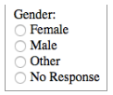
0906 Radio Button
https://ucsc-extension.instructure.com/courses/3825/pages/1-dot-1-welcome?module_item_id=42202
0906 Radio Button
This is how you assign a label to radio and checkboxes.
Gender: <br>
<label>
<input type="radio" name="gender" value="female">Female
</label>
<br>
<label>
<input type="radio" name="gender" value="Male">Male
</label>
<br>
<label>
<input type="radio" name="gender" value="no-response">No Response
</label>

Slide 4
0906 Radio Button
https://ucsc-extension.instructure.com/courses/3825/pages/1-dot-1-welcome?module_item_id=42202
0906 Radio Button
Attributes for Radio Buttons:
name="radioset" identifies both the data sent to the script and also links the radio buttons together thus ensuring that only one button gets selected. So this name attribute must be the same for the entire set of buttons.
value="data" is the text that will be sent to the server if the radio button is checked by the visitor.
checked If you add this attribute it will make that particular radio button active by default when the page is opened.

Slide 5

0906 Radio Button
https://ucsc-extension.instructure.com/courses/3825/pages/1-dot-1-welcome?module_item_id=42202
0906 Radio Button
Do you want to attend our upcoming event?<br>
<label>
<input type="radio" name="event" value="event" checked>Yes I want to attend the event!
</label>
<br>
<label>
<input type="radio" name="event" value="event">No thank you!
</label>

Slide 6
0906.1 Radio Button Video

Slide 7
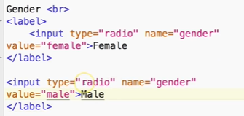


0906.1 Radio Button Video
https://ucsc-extension.instructure.com/courses/3825/pages/1-dot-1-welcome?module_item_id=42202
0906.1 Radio Button Video

Slide 8
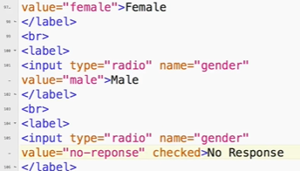

0906.1 Radio Button Video
https://ucsc-extension.instructure.com/courses/3825/pages/1-dot-1-welcome?module_item_id=42202
0906.1 Radio Button Video

Slide 9
End of Chapter

