Slide 1

0907 Checkbox
Peter H. Chen

Slide 2
0907 Checkbox
https://ucsc-extension.instructure.com/courses/3825/pages/1-dot-1-welcome?module_item_id=42202
0907 Checkbox
Check Boxes
Check boxes allow the visitor to check more than one box – they can select as many as they want or just one. Like radio buttons, check boxes are linked by the value of the name attribute.
What kind of Ice Cream do you like? <br>
<label>
<input type="checkbox" name="icecream“ value= "chocolate“ >Chocolate
</label>
<label>
<input type="checkbox" name="icecream" value="vanilla">Vanilla
</label>

Slide 3
0907 Checkbox
https://ucsc-extension.instructure.com/courses/3825/pages/1-dot-1-welcome?module_item_id=42202
0907 Checkbox
Attributes for Checkboxes:
name identifies the data sent to the script and also links the checkboxes together.
value defines a value for each checkbox. The value is sent to the server if the checkbox is checked
checked - If you add this attribute it will make that particular checkbox active by default when the page is opened.

Slide 4
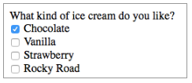
0907 Checkbox
https://ucsc-extension.instructure.com/courses/3825/pages/1-dot-1-welcome?module_item_id=42202
0907 Checkbox
How it looks
The difference between this pre-checked checkbox and the pre-checked radio button is that the checkbox is a toggle box to which I can check or uncheck whereas the radio button I must have another radio button to deselect the pre-checked option.

Slide 5
0907.1 Checkbox Video

Slide 6
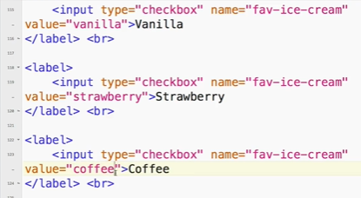
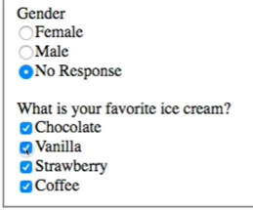
0907.1 Checkbox Video
https://ucsc-extension.instructure.com/courses/3825/pages/1-dot-1-welcome?module_item_id=42202
0907.1 Checkbox Video

Slide 7
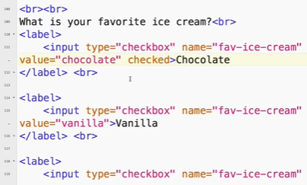

0907.1 Checkbox Video
https://ucsc-extension.instructure.com/courses/3825/pages/1-dot-1-welcome?module_item_id=42202
0907.1 Checkbox Video

Slide 8
End of Chapter

