Slide 1

0908 Textarea
Peter H. Chen

Slide 2
0908 Textarea
https://ucsc-extension.instructure.com/courses/3825/pages/1-dot-1-welcome?module_item_id=42202
0908 Textarea
Multi-Lined Text Field – aka: Comment Boxes
Comment boxes are text areas and may be as large as you wish.
They will expand as needed if the person enters more text then can fit in the display area.
This tag has a closing tag, unlike the others.
<label for="comments">Send us your Comments: </label><br>
<textarea name="comments" id="comments" cols="45"rows="5">Please write your comments here: </textarea>
Pay attention to the “space” you leave between the opening and closing <textarea> tags as this will display within the comment box – shown here, I have written some text between these tags however, this is not the best way to do this.

Slide 3
0908.1 Textarea Video

Slide 4
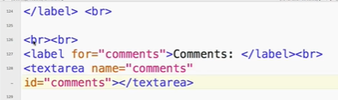
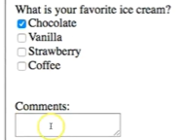
0908.1 Textarea Video
https://ucsc-extension.instructure.com/courses/3825/pages/1-dot-1-welcome?module_item_id=42202
0908.1 Textarea Video

Slide 5
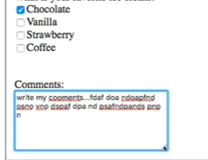
0908.1 Textarea Video
https://ucsc-extension.instructure.com/courses/3825/pages/1-dot-1-welcome?module_item_id=42202
0908.1 Textarea Video: Enlarge text area

Slide 6
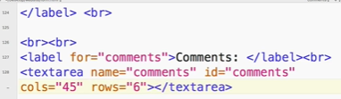

0908.1 Textarea Video
https://ucsc-extension.instructure.com/courses/3825/pages/1-dot-1-welcome?module_item_id=42202
0908.1 Textarea Video: Enlarge text area cols = “45 rows=“6”

Slide 7


0908.1 Textarea Video
https://ucsc-extension.instructure.com/courses/3825/pages/1-dot-1-welcome?module_item_id=42202
0908.1 Textarea Video: Enlarge text area cols = “45 rows=“6”

Slide 8
End of Chapter

