Slide 1

0909 Input Type: File
Peter H. Chen

Slide 2
0909 Input Type: File
https://ucsc-extension.instructure.com/courses/3825/pages/1-dot-1-welcome?module_item_id=42202
0909 Input Type: File
File Selection: <input type="file">:
This allows users to upload a file stored on their computer and send it to the server when they submit the form.
When using the file input type, you should specify the enctype="multipart/form-data" in the form tag. You should confirm this setting with your server administrator.
It will look like this:
<form action="#" method="post" enctype="multipart/form-data">…other form elements…
<label for="upload">Up Load your File: </label>
<input type="file" name="upload" id="upload">
</form>

Slide 3
0909 Input Type: File
https://ucsc-extension.instructure.com/courses/3825/pages/1-dot-1-welcome?module_item_id=42202
0909 Input Type: File
Note:
You are NOT creating a new form element.
You are simply adding in this enctype attribute to the form element IF you are using this input type="file"

Slide 4


0909 Input Type: File
https://ucsc-extension.instructure.com/courses/3825/pages/1-dot-1-welcome?module_item_id=42202
0909 Input Type: File
(please do not create a new form for this... just add to your existing form and add the enctype to you opening form element).
Figure 1: As seen on Safari
Figure 2: As seen on Firefox

Slide 5
0909.1 Input Type: File Video

Slide 6


0909.1 Input Type: File Video
https://ucsc-extension.instructure.com/courses/3825/pages/1-dot-1-welcome?module_item_id=42202
0909.1 Input Type: File Video

Slide 7
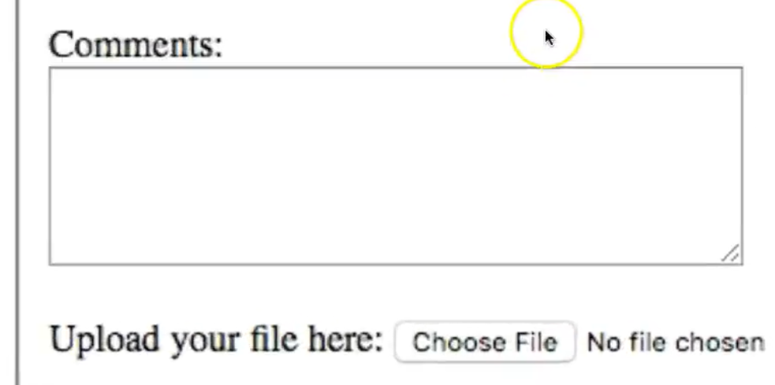
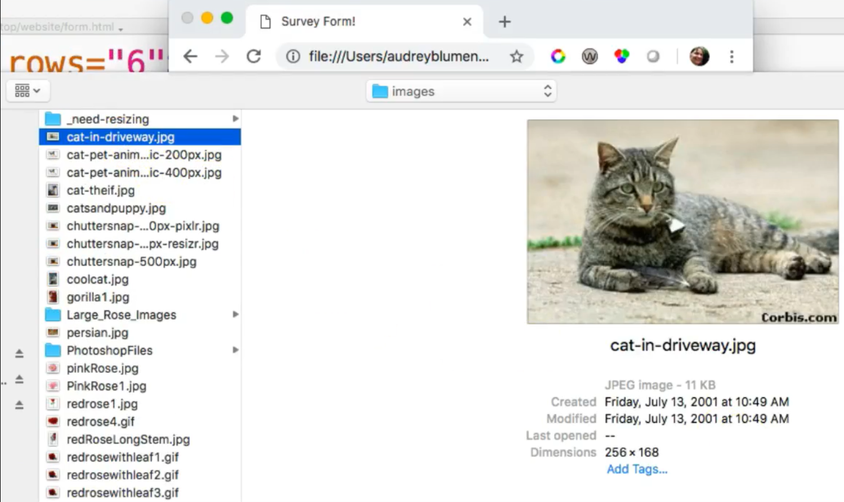
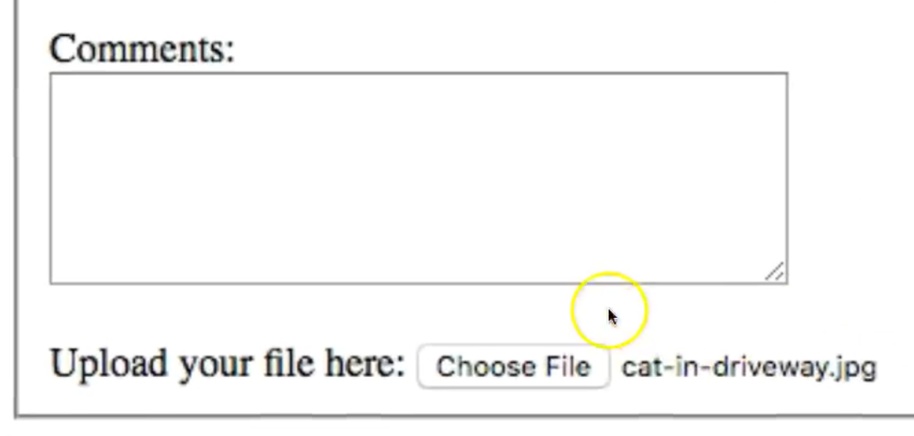
0909.1 Input Type: File Video
https://ucsc-extension.instructure.com/courses/3825/pages/1-dot-1-welcome?module_item_id=42202
0909.1 Input Type: File Video

Slide 8
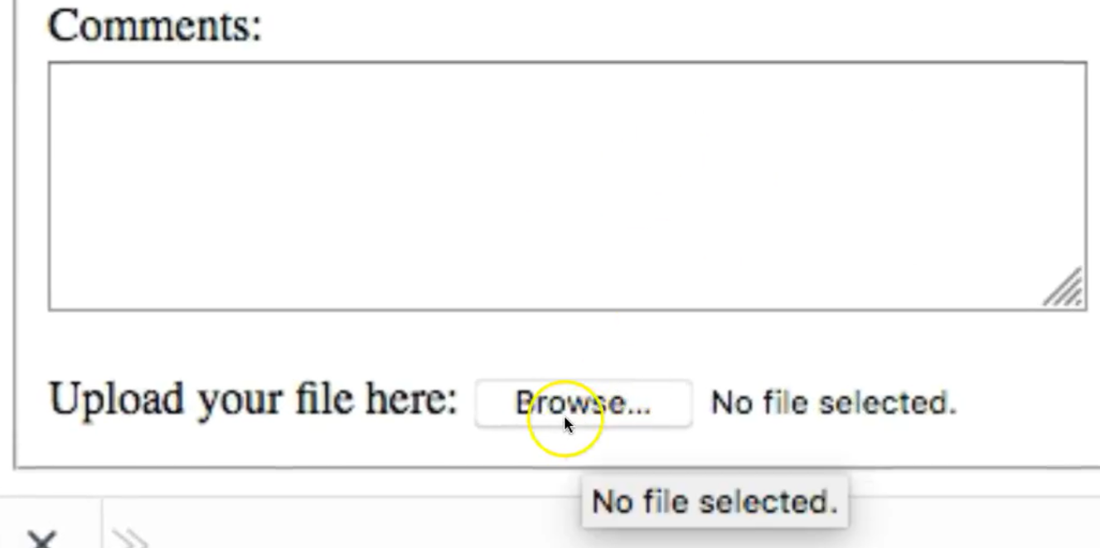
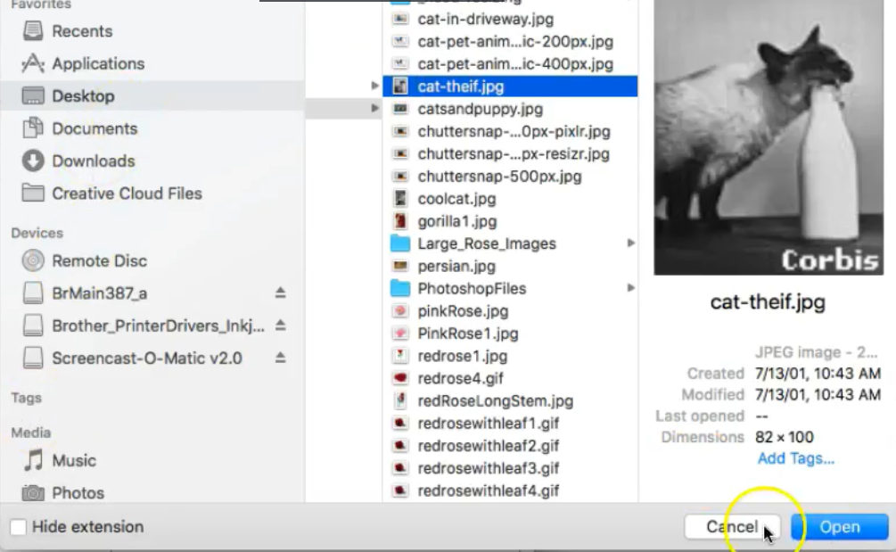
0909.1 Input Type: File Video
https://ucsc-extension.instructure.com/courses/3825/pages/1-dot-1-welcome?module_item_id=42202
0909.1 Input Type: File Video: Check Firefox browser

Slide 9
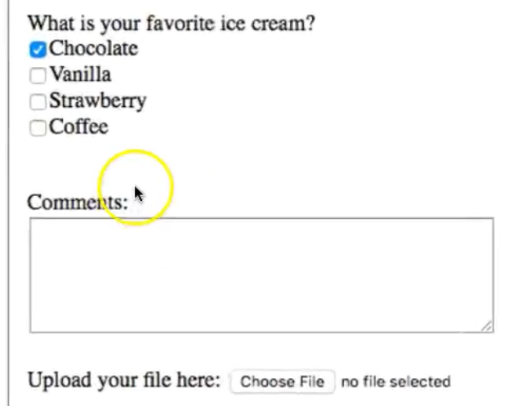
0909.1 Input Type: File Video
https://ucsc-extension.instructure.com/courses/3825/pages/1-dot-1-welcome?module_item_id=42202
0909.1 Input Type: File Video: Check Safari browser. Safari is similar to Chrome.

Slide 10
End of Chapter

