Slide 1

0910 Input Type: Submit and Reset
Peter H. Chen

Slide 2

0910 Input Type: Submit and Reset
https://ucsc-extension.instructure.com/courses/3825/pages/1-dot-1-welcome?module_item_id=42202
0910 Input Type: Submit and Reset
Submit Button
What good is a form if you can’t be submit it?!
<input type="submit" value="Submit this form now!">
Whatever you type for the “value” will be what text shows up on the button.
However, if you left the “value” out, the “Submit Button” will be labeled “Submit Query” by default on some browsers.

Slide 3
0910 Input Type: Submit and Reset
https://ucsc-extension.instructure.com/courses/3825/pages/1-dot-1-welcome?module_item_id=42202
0910 Input Type: Submit and Reset
Reset Button
It is always a nice courtesy to provide a way to clear a form as the client may have made an error in filling it out.
Creating a reset button is quite easy and similar to creating the “submit” button.
<input type="reset" value="Clear this form!">
The value is the text that will show up on the button – so you could have the button read: Reset, Start Over, Clear Form, etc.

Slide 4
0910.1 Input Type: Submit/Reset Video

Slide 5


0910.1 Input Type: Submit/Reset Video
https://ucsc-extension.instructure.com/courses/3825/pages/1-dot-1-welcome?module_item_id=42202
0910.1 Input Type: Submit/Reset Video

Slide 6


0910.1 Input Type: Submit/Reset Video
https://ucsc-extension.instructure.com/courses/3825/pages/1-dot-1-welcome?module_item_id=42202
0910.1 Input Type: Submit/Reset Video

Slide 7
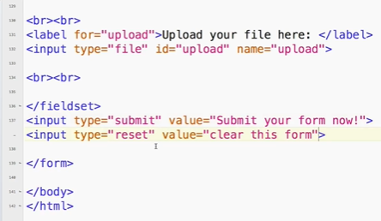
0910.1 Input Type: Submit/Reset Video
https://ucsc-extension.instructure.com/courses/3825/pages/1-dot-1-welcome?module_item_id=42202
0910.1 Input Type: Submit/Reset Video: Reset

Slide 8
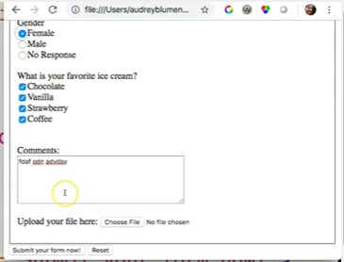
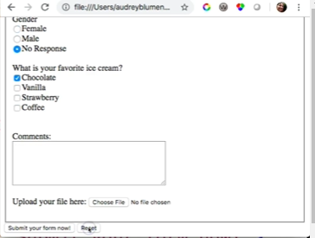
0910.1 Input Type: Submit/Reset Video
https://ucsc-extension.instructure.com/courses/3825/pages/1-dot-1-welcome?module_item_id=42202
0910.1 Input Type: Submit/Reset Video: Reset

Slide 9
0910.2 Create Submit Using Image

Slide 10

0910.2 Create Submit Using Image
https://ucsc-extension.instructure.com/courses/3825/pages/1-dot-1-welcome?module_item_id=42202
0910.2 Create Submit Using Image
Creating a submit button using your own image:
Both HTML and XHTML allow you to add your own prettier button image as a Submit and Reset button by using the button tag – here’s how:
<button type="submit">
<img src="images/button_Submit.gif" alt="Submit Now!" width="" height="">
</button>
<button type="reset">
<img src="images/button_Reset.gif" alt="Reset Now!" width="" height="">
</button>

Slide 11
0910.2 Create Submit Using Image
https://ucsc-extension.instructure.com/courses/3825/pages/1-dot-1-welcome?module_item_id=42202
0910.2 Create Submit Using Image
I should add that using an 'image' for a button is quite unnecessary because we have CSS that can actually style these buttons just like this without the need for images!
But, just so you know you can do this!

Slide 12
End of Chapter

