Slide 1

0911 HTML5 Input Type
Peter H. Chen

Slide 2
0911 HTML5 Input Type
https://ucsc-extension.instructure.com/courses/3825/pages/1-dot-1-welcome?module_item_id=42202
0911 HTML5 Input Type
New HTML5 Input types and attributes:
New Input types:
HTML5 has introduced a bunch of new form controls to standardize the way some information is gathered.
Again, some current and older browsers do not yes support or recognize these new input type and will therefore treat them as a regular text input field.
For this fundamentals class we will look at two: email and tel (again, there are more, but these two work on all browser and mobile devices quite nicely).

Slide 3
0911 HTML5 Input Type
https://ucsc-extension.instructure.com/courses/3825/pages/1-dot-1-welcome?module_item_id=42202
0911 HTML5 Input Type
These all have limited support at this time however, for mobile devices, these input types can affect the keyboard presented the user whether it’s a phone keypad for type="tel" or providing the @ symbol for the type="email".
<label for="email">Email: </label>
<input type="email" name="email" id="email">
And
<label for="tel">Phone Number: </label>
<input type="tel" name="tel" id="tel">
Again, visually you will not “see” a difference but if we had uploaded this to server and viewed this form on our mobile browser, we would see the difference in the keypad that would come up.

Slide 4
0911.1 HTML5 Input Type Video

Slide 5
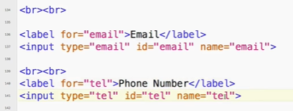
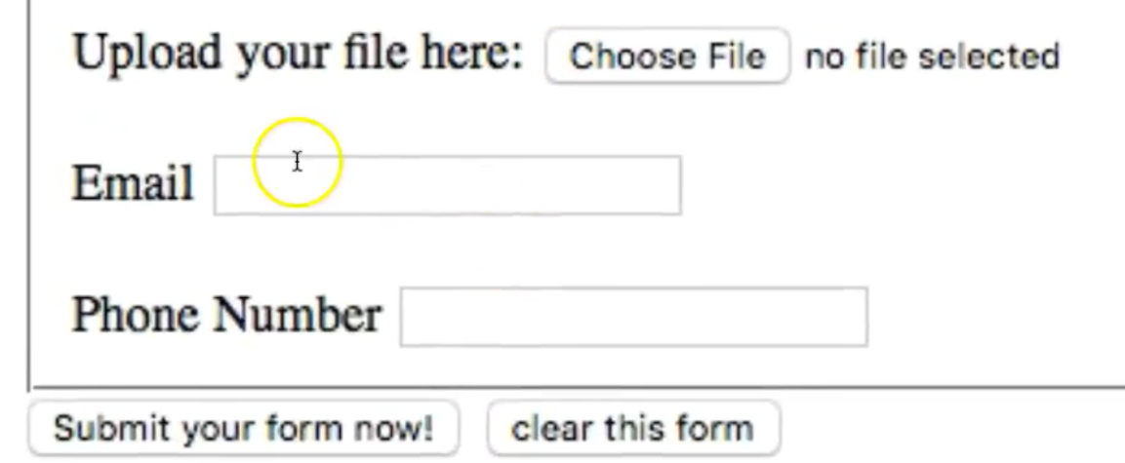
0911.1 HTML5 Input Type Video
https://ucsc-extension.instructure.com/courses/3825/pages/1-dot-1-welcome?module_item_id=42202
0911.1 HTML5 Input Type Video

Slide 6
0911.2 New Attributes

Slide 7
0911.2 New Attributes
https://ucsc-extension.instructure.com/courses/3825/pages/1-dot-1-welcome?module_item_id=42202
0911.2 New Attributes
New Attributes:
As with the input types, there are new attributes that are a part of the new HTML5 specifications.
I will introduce two that are used quite frequently and work on all of today's (2018) browsers!

Slide 8
0911.2 New Attributes
https://ucsc-extension.instructure.com/courses/3825/pages/1-dot-1-welcome?module_item_id=42202
0911.2 New Attributes
The required attribute:
Using HTML5 we can do some very simplistic validation of a form by using an attribute called: required.
It is important to note that not all browsers support this (i.e. Safari!), but the latest versions of Chrome, Opera and Firefox do.
To get the others to support it we need to fix things up with a little JavaScript.
Within your form write:
<input type="text" name="username" required>
You can write just required, as HTML5 does not need a value for this attribute (otherwise it would be required="required" which is redundant).

Slide 9
0911.3 New Attributes Video

Slide 10
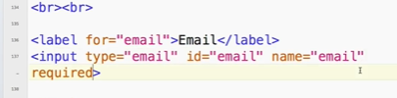
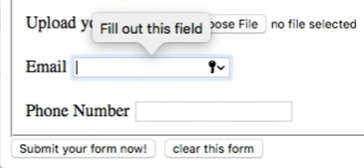
0911.3 New Attributes Video
https://ucsc-extension.instructure.com/courses/3825/pages/1-dot-1-welcome?module_item_id=42202
0911.3 New Attributes Video: Required
Click “Submit” will get prompt “Please fill out this field”

Slide 11
0911.4 Placeholder Attribute

Slide 12
0911.4 Placeholder Attribute
https://ucsc-extension.instructure.com/courses/3825/pages/1-dot-1-welcome?module_item_id=42202
0911.4 Placeholder Attribute
The placeholder attribute:
You can use the placeholder attribute to provide the user an idea of what or how an entry should look. As soon as the user clicks inside the text field, the text will go away.
<input type="tel" name="tel" placeholder="1-222-222-2222">

Slide 13
0911.5 Placeholder Attribute Video

Slide 14
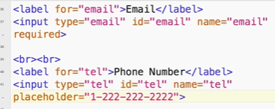
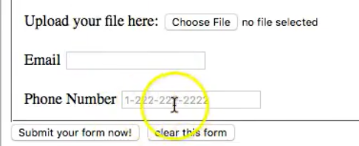
0911.5 Placeholder Attribute Video
https://ucsc-extension.instructure.com/courses/3825/pages/1-dot-1-welcome?module_item_id=42202
0911.5 Placeholder Attribute Video

Slide 15
End of Chapter

