Slide 1

0912 Form Assignment
Peter H. Chen

Slide 2
0912 Form Assignment
  https://ucsc-extension.instructure.com/courses/3825/pages/1-dot-1-welcome?module_item_id=42202
0912 Form Assignment
Due Dec 17 by 11:59pm Points 10 Submitting a file upload
Available Sep 17 at 12am - Dec 17 at 11:59pm 3 months
Assignment - Forms!
Objective:
Be able to hand-code a simple web page that contains a "survey form".
This form will employ the various types of form elements covered in the lecture notes and video demonstrations.
Demonstrate ability to write code that meets and passes W3C Validation standards

Slide 3
0912 Form Assignment
  https://ucsc-extension.instructure.com/courses/3825/pages/1-dot-1-welcome?module_item_id=42202
0912 Form Assignment
How you will do this:
Create a new HTML file and save this file as: "YourLastName-09-forms.html".
Remember: No spaces.
Your 'survey form' can be about any topic from favorite ice cream to items important in your new office space. Include in your HTML file these different types of form elements:
  Fieldset, legend and labels
  Input fields for text
  Menus/Lists
  Checkbox
  Radio Buttons.
  Textarea.
  File upload
  Submit/Reset

Slide 4
0912 Form Assignment
  https://ucsc-extension.instructure.com/courses/3825/pages/1-dot-1-welcome?module_item_id=42202
0912 Form Assignment
Validate your code per the W3C standards:
Use this validator for the HTML5 doctype:
https://validator.w3.org/nu/ (https://validator.w3.org/nu/) (check all the boxes for source, outline and image report).
NOTE:
Use the HTML5 doctype and meta tag for this exercise. Do not use any deprecated attributes. I only showcase these so you are aware of what they are and what they did, so you can recognize old code from what is currently acceptable. In other words, you shouldn't use these attributes!
The HTML code here is exactly the same whether we use HTML 4.01 Transitional/Strict, XHTML 1.0 Transitional/Strict or HTML5 minus those deprecated attributes!

Slide 5
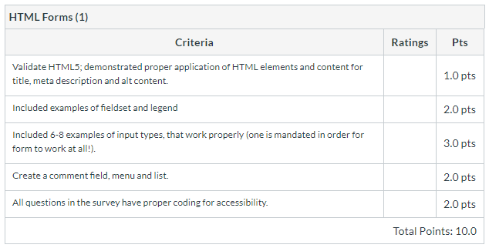
0912 Form Assignment
  https://ucsc-extension.instructure.com/courses/3825/pages/1-dot-1-welcome?module_item_id=42202
0912 Form Assignment
What to Submit:
Be sure to review the Rubric criteria (below)
Submit your .html file here!

Slide 6
End of Chapter

