Slide 1

0401 Introduction to HTML/XHTML
Peter H. Chen

Slide 2
0401 Introduction to HTML/XHTML
https://ucsc-extension.instructure.com/courses/3825/pages/1-dot-1-welcome?module_item_id=42202
0401 Introduction to HTML/XHTML
The Anatomy of HTML:
Tags:
Elements that are written between < and > (known as angle brackets) are HTML tags. For example, <p> is a tag and p is an element.
The tags tell a browser how to display your content such as text or an image. They provide semantic meaning to the content that they contain. This will be essential for search engines and people using assistive technology.
Tags usually come in pairs because they “contain” the content. We would use a <p> tag to indicate the beginning of a paragraph and then put a closing tag to indicate that we are at the end of a paragraph. These pairs contain the text of the paragraph. There are starting/beginning and closing/ending tags for most tags. A closing tag has a / (forward slash) inside the tag: </p>.
Not all tags have a closing (or “end”) tag. Some tags do not “contain” information, but refer to the content. For example an <img> tag will tell the browser where an image is located. XHTML mandates closure of all tags, which is done by adding a forward slash at the end of the opening tag.

Slide 3
0401 Introduction to HTML/XHTML
https://ucsc-extension.instructure.com/courses/3825/pages/1-dot-1-welcome?module_item_id=42202
0401 Introduction to HTML/XHTML
Attributes:
These add options to tags and are placed inside the opening tag. This can be used to provide additional information for the browser or for other languages such as CSS or JavaScript. For example, I will use an attribute called href to tell the browser where a link location exists.

Slide 4
0401 Introduction to HTML/XHTML
https://ucsc-extension.instructure.com/courses/3825/pages/1-dot-1-welcome?module_item_id=42202
0401 Introduction to HTML/XHTML
Values:
Attributes have values.
If I want to use the href attribute to send a user to another page, the value of the attribute will make it be so:
href="my.html“
Note the equal sign (no spaces) and the quotation marks around the value.
Values of attributes should be enclosed in "straight" Quotation Marks (not “curly” ones).
These quotations marks are mandatory in XHTML.
They are not considered mandatory in HTML 4.01 or 5; however, it is considered good coding practices, so consider them mandatory in HTML.

Slide 5
0401.1 Video of HTML/XHTML

Slide 6

0401.1 Video of HTML/XHTML
https://ucsc-extension.instructure.com/courses/3825/pages/1-dot-1-welcome?module_item_id=42202
0401.1 Video of HTML/XHTML

Slide 7
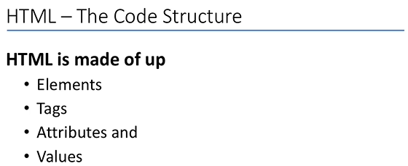
0401.1 Video of HTML/XHTML
https://ucsc-extension.instructure.com/courses/3825/pages/1-dot-1-welcome?module_item_id=42202
0401.1 Video of HTML/XHTML

Slide 8
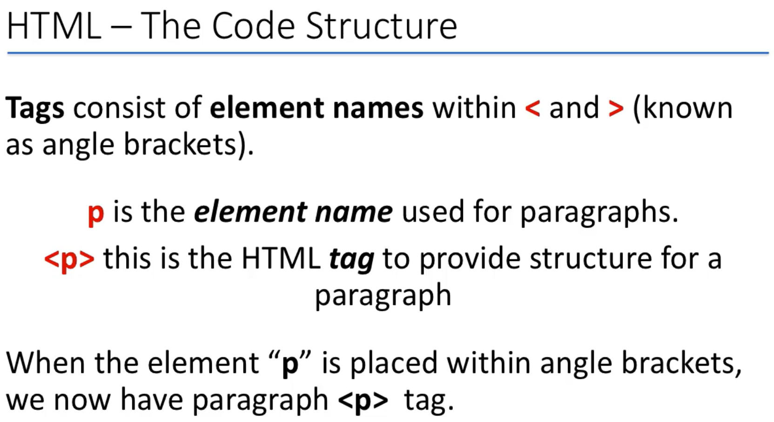
0401.1 Video of HTML/XHTML
https://ucsc-extension.instructure.com/courses/3825/pages/1-dot-1-welcome?module_item_id=42202
0401.1 Video of HTML/XHTML

Slide 9
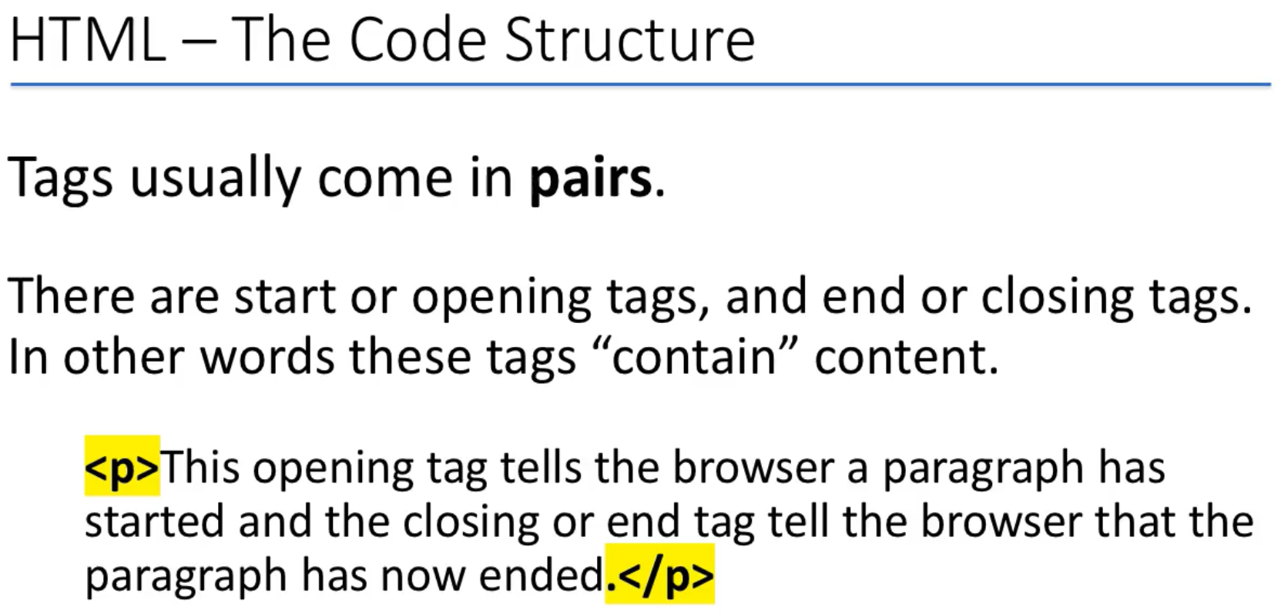
0401.1 Video of HTML/XHTML
https://ucsc-extension.instructure.com/courses/3825/pages/1-dot-1-welcome?module_item_id=42202
0401.1 Video of HTML/XHTML

Slide 10
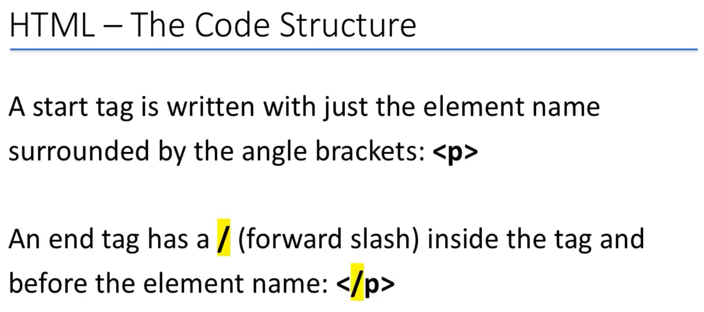
0401.1 Video of HTML/XHTML
https://ucsc-extension.instructure.com/courses/3825/pages/1-dot-1-welcome?module_item_id=42202
0401.1 Video of HTML/XHTML

Slide 11
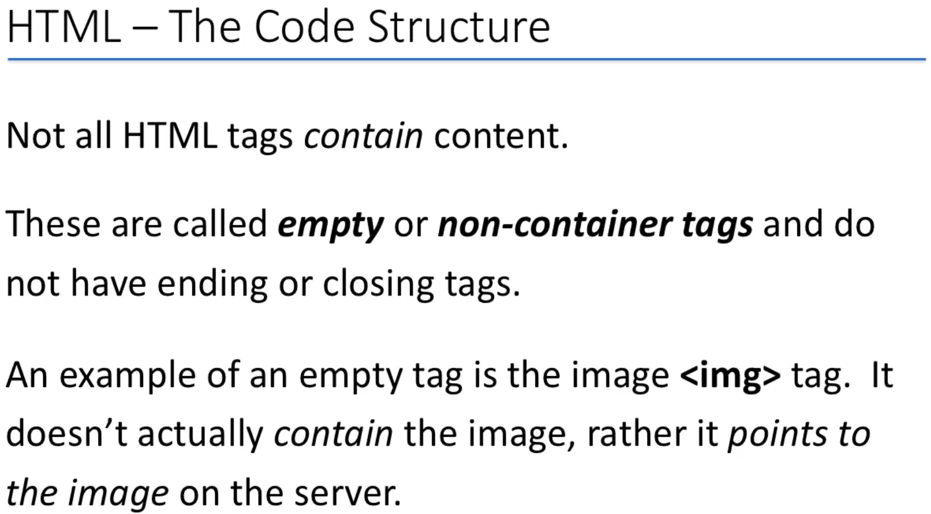
0401.1 Video of HTML/XHTML
https://ucsc-extension.instructure.com/courses/3825/pages/1-dot-1-welcome?module_item_id=42202
0401.1 Video of HTML/XHTML
<img src="smiley.gif" alt="Smiley face" height="42" width="42">

Slide 12
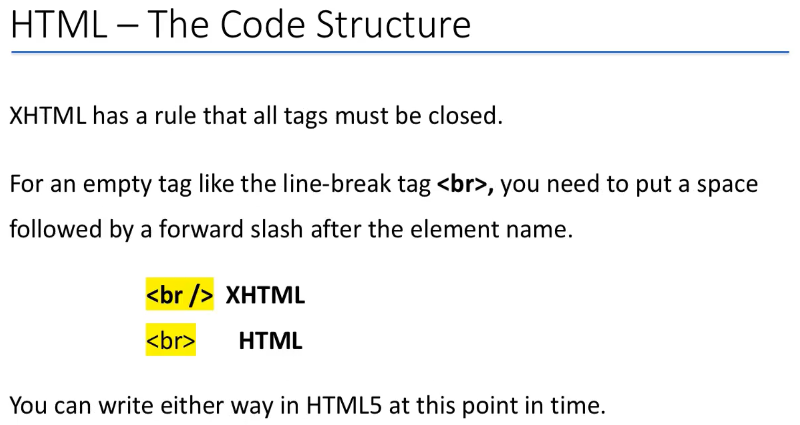
0401.1 Video of HTML/XHTML
https://ucsc-extension.instructure.com/courses/3825/pages/1-dot-1-welcome?module_item_id=42202
0401.1 Video of HTML/XHTML

Slide 13
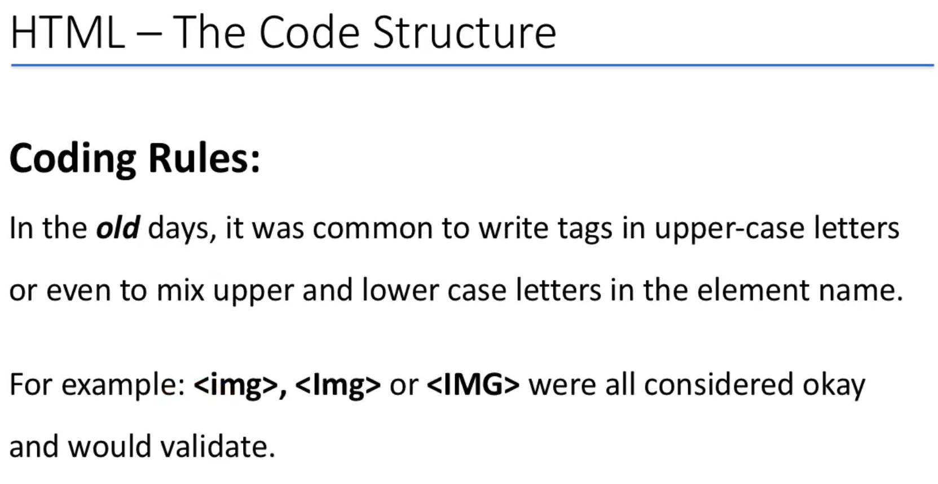
0401.1 Video of HTML/XHTML
https://ucsc-extension.instructure.com/courses/3825/pages/1-dot-1-welcome?module_item_id=42202
0401.1 Video of HTML/XHTML

Slide 14
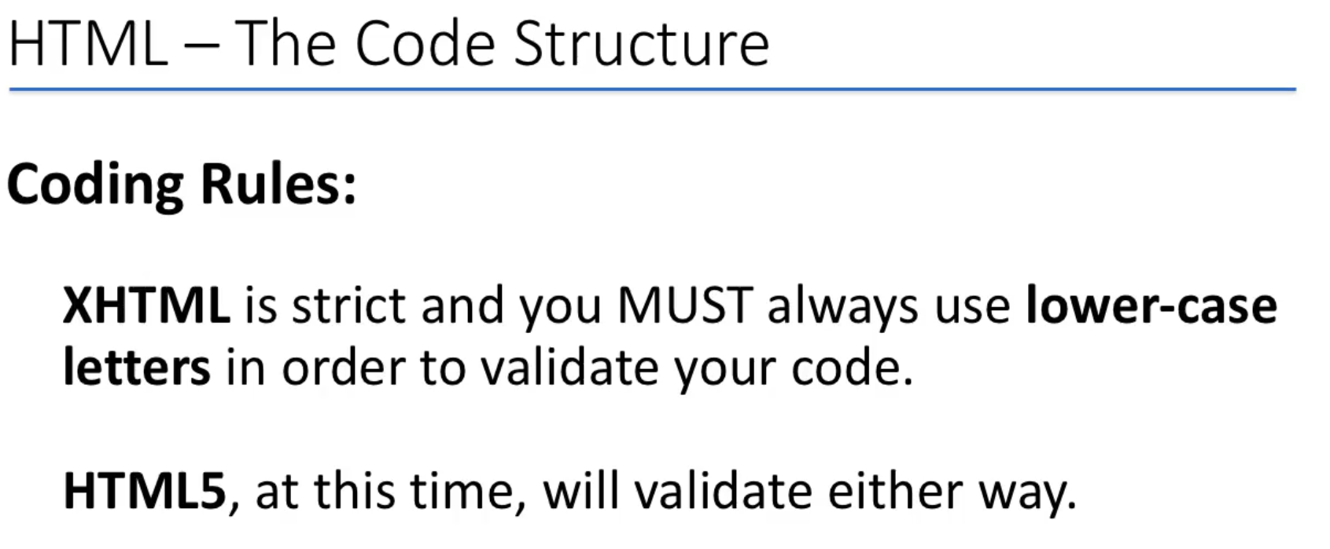
0401.1 Video of HTML/XHTML
https://ucsc-extension.instructure.com/courses/3825/pages/1-dot-1-welcome?module_item_id=42202
0401.1 Video of HTML/XHTML

Slide 15
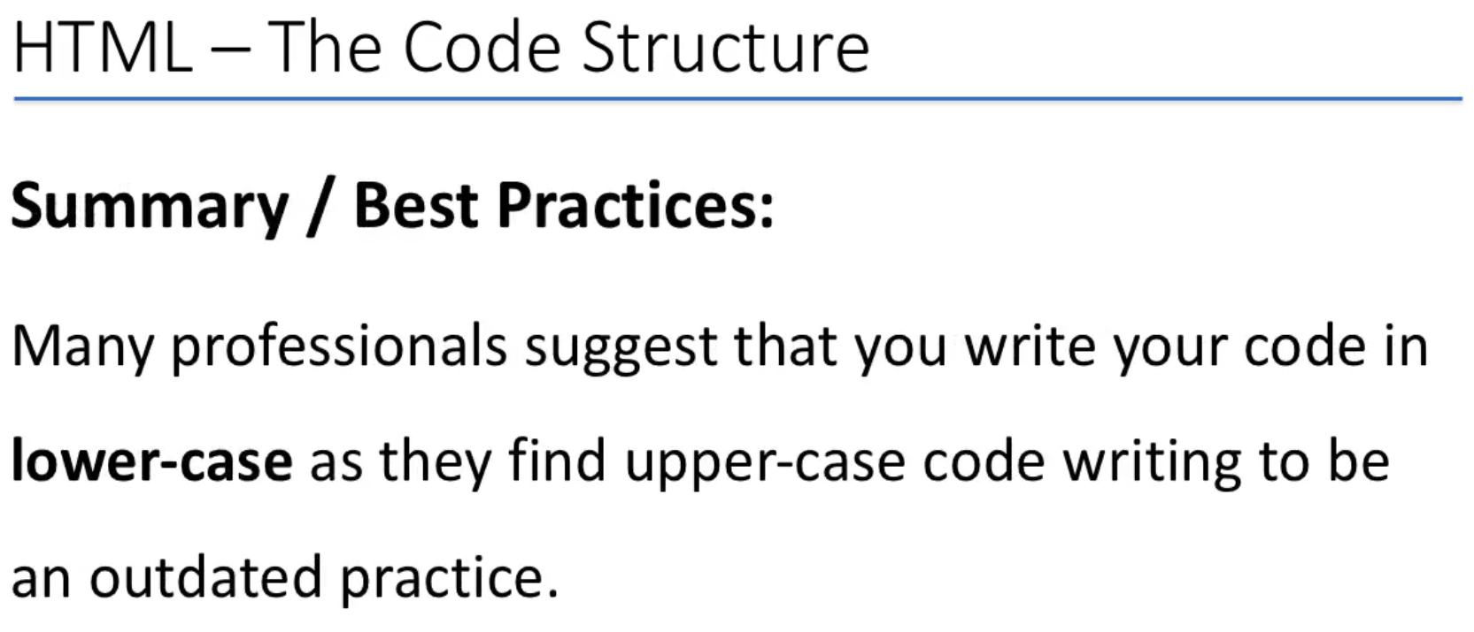
0401.1 Video of HTML/XHTML
https://ucsc-extension.instructure.com/courses/3825/pages/1-dot-1-welcome?module_item_id=42202
0401.1 Video of HTML/XHTML

Slide 16
End of Chapter

