Slide 1

0402 HTML/XHTML Skeleton
Peter H. Chen

Slide 2
0402 HTML/XHTML Skeleton
https://ucsc-extension.instructure.com/courses/3825/pages/1-dot-1-welcome?module_item_id=42202
0402 HTML/XHTML Skeleton
Basic overall Page Structure – these tags give the document structure.
Every web page will use this structure of the HEAD and BODY.
<html> Opens up the html document
<head> Opens content that is not visible to the user such as: scripts
JavaScript, CSS, meta tags and title tags.
</head> Closes the content not visible to the user.
<body> Opens the content which is visible to the user.
All Content (images, text, links) goes between the body tags.
</body> Closes the visible area to the user.
</html> Closes the html document (nothing EVER goes after this tag!!)

Slide 3
0402.1 Video

Slide 4
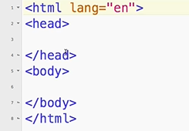
0402.1 Video
https://ucsc-extension.instructure.com/courses/3825/pages/1-dot-1-welcome?module_item_id=42202
0402.1 Video

Slide 5
End of Chapter

