Slide 1

0403 File Name Convention
Peter H. Chen

Slide 2
0403 File Name Convention
https://ucsc-extension.instructure.com/courses/3825/pages/1-dot-1-welcome?module_item_id=42202
0403 File Name Convention
Often our Web files sit on a Unix server; Unix file and directory (folder) naming conventions apply.
This means that file and directory names can contain ONLY the following:
Uppercase letters A-Z.
Lowercase letters a-z.
Numbers 0-9.
A hyphen – or an underscore _ (these days use the hyphen).
An underscore.
A dot (a period) but only between the name and the extension.
File names should not contain spaces!
In other words: no other punctuation, no special characters, and NO SPACES.
Repeat: NO SPACES in ANY file or directory names!

Slide 3
0403 File Name Convention
https://ucsc-extension.instructure.com/courses/3825/pages/1-dot-1-welcome?module_item_id=42202
0403 File Name Convention
Additionally:
File and directory names should not start with a dot.
File and directory names are case-sensitive.
NOTE:
The “no-spaces” rule goes for any document that will go on a web site (this goes for pdf files, music, video, flash or images for jpg’s or .gif files – anything!
File name extensions for both HTML and XHTML web pages
Web pages should always be named with the following extensions:
.html

Slide 4
0403 File Name Convention
https://ucsc-extension.instructure.com/courses/3825/pages/1-dot-1-welcome?module_item_id=42202
0403 File Name Convention
Your Home Page:
The home page of any web site (unless your web host tells you otherwise) MUST be named:
index.html
If you do not name your home page this way, you would have to type in the URL as http://www.mydomain.com/home.html and no one will type in the home.html.
If you file name is simply index.html than all they need to type in is http://www.mydomain.com.
The index.html indicates to the server to serve up this page when the main domain is being called upon.
Otherwise it will generate a 404 Error message!

Slide 5
0403 File Name Convention
https://ucsc-extension.instructure.com/courses/3825/pages/1-dot-1-welcome?module_item_id=42202
0403 File Name Convention
Acceptable Naming Conventions:
A typical file name would look like this (again, Google prefers hyphens!):
aboutus.html
about-us.html
about_us_philosophy.html

Slide 6
0403.1 File Name Convention Video

Slide 7

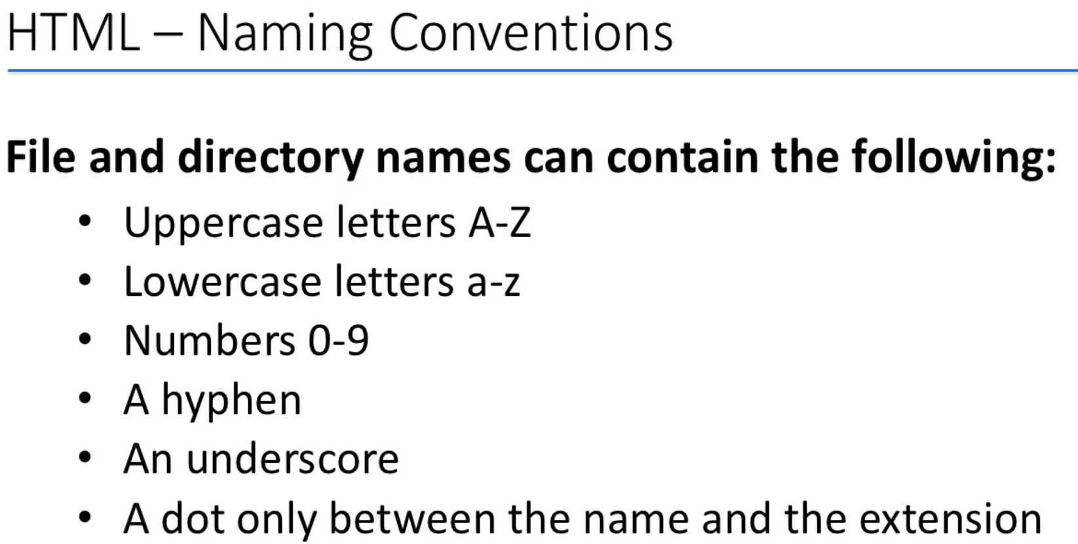
0403.1 File Name Convention Video
https://ucsc-extension.instructure.com/courses/3825/pages/1-dot-1-welcome?module_item_id=42202
0403.1 File Name Convention Video

Slide 8
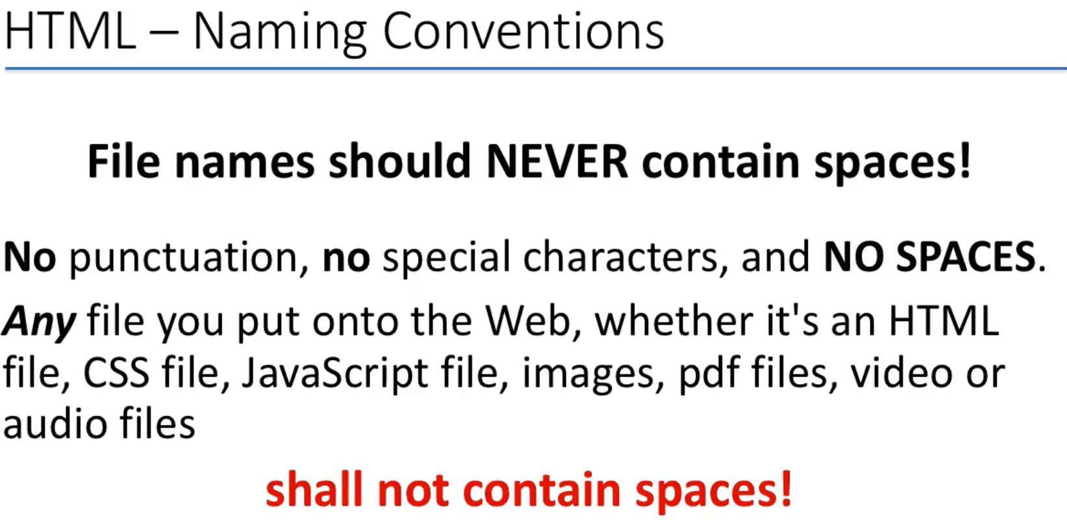
0403.1 File Name Convention Video
https://ucsc-extension.instructure.com/courses/3825/pages/1-dot-1-welcome?module_item_id=42202
0403.1 File Name Convention Video

Slide 9
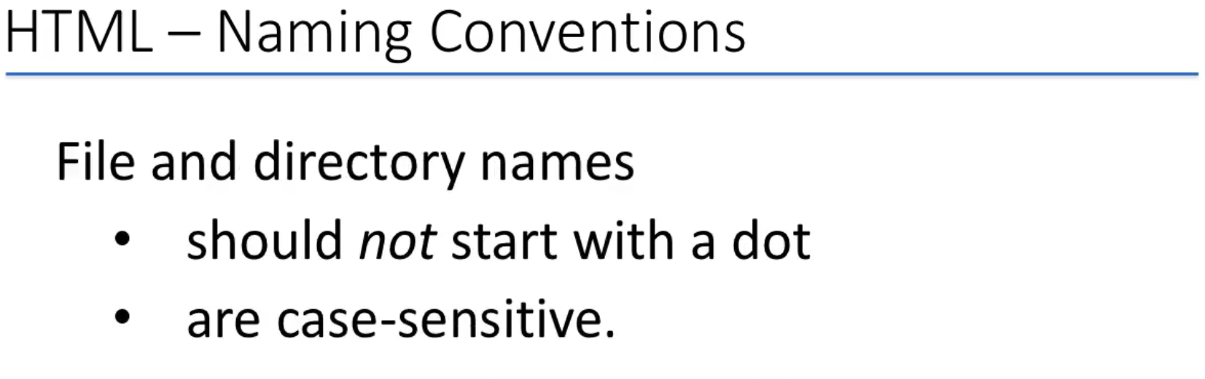
0403.1 File Name Convention Video
https://ucsc-extension.instructure.com/courses/3825/pages/1-dot-1-welcome?module_item_id=42202
0403.1 File Name Convention Video

Slide 10
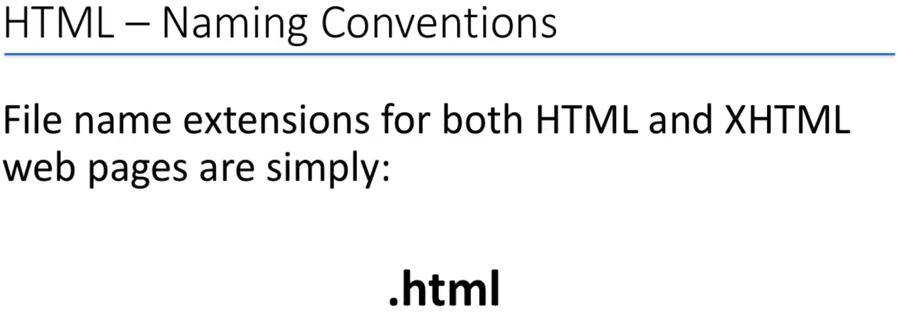
0403.1 File Name Convention Video
https://ucsc-extension.instructure.com/courses/3825/pages/1-dot-1-welcome?module_item_id=42202
0403.1 File Name Convention Video

Slide 11
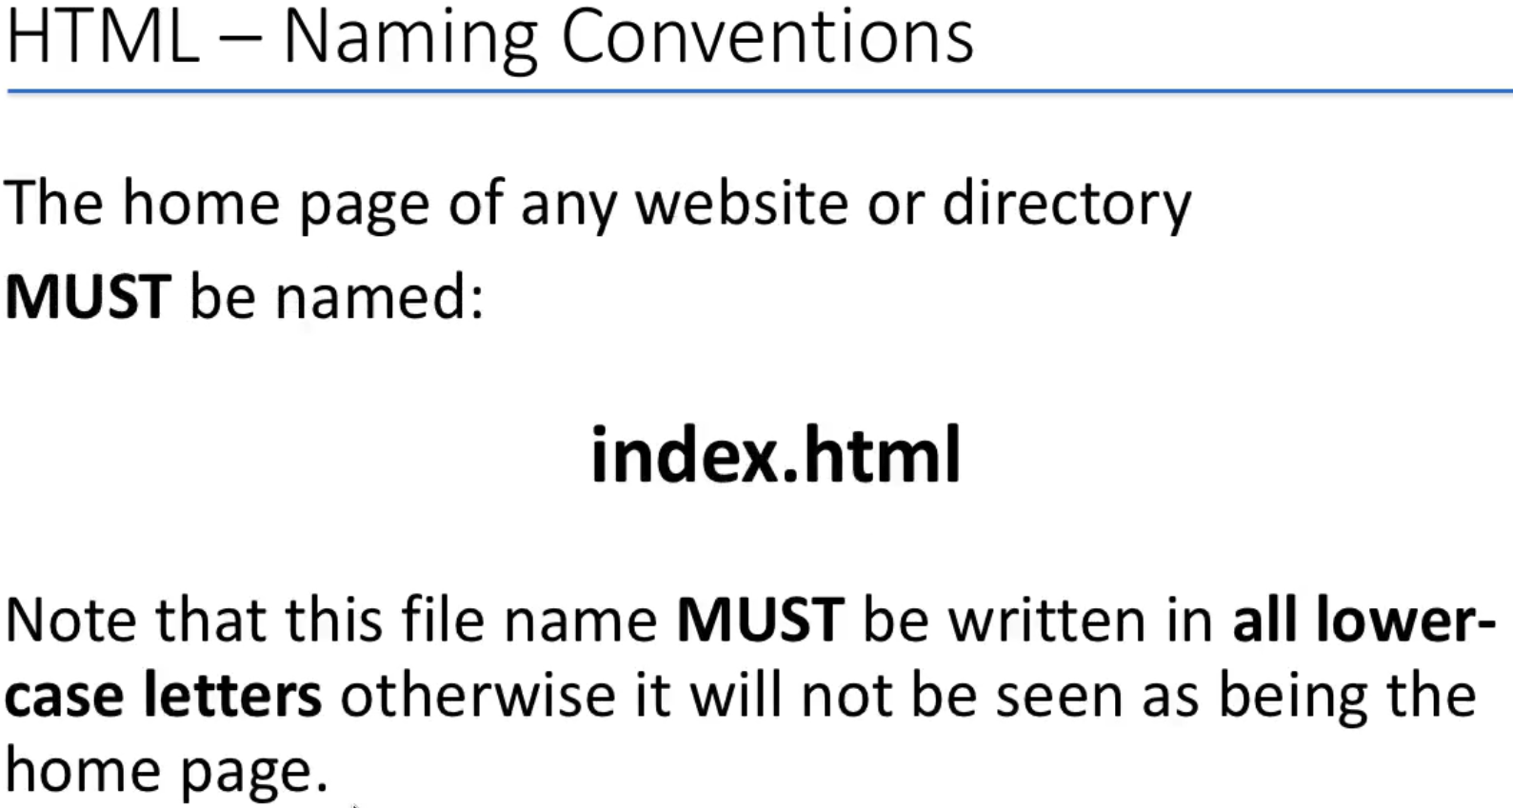
0403.1 File Name Convention Video
https://ucsc-extension.instructure.com/courses/3825/pages/1-dot-1-welcome?module_item_id=42202
0403.1 File Name Convention Video

Slide 12
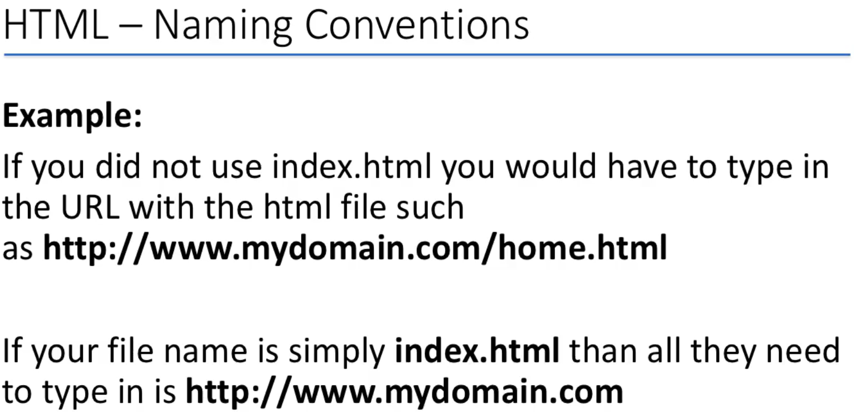
0403.1 File Name Convention Video
https://ucsc-extension.instructure.com/courses/3825/pages/1-dot-1-welcome?module_item_id=42202
0403.1 File Name Convention Video

Slide 13
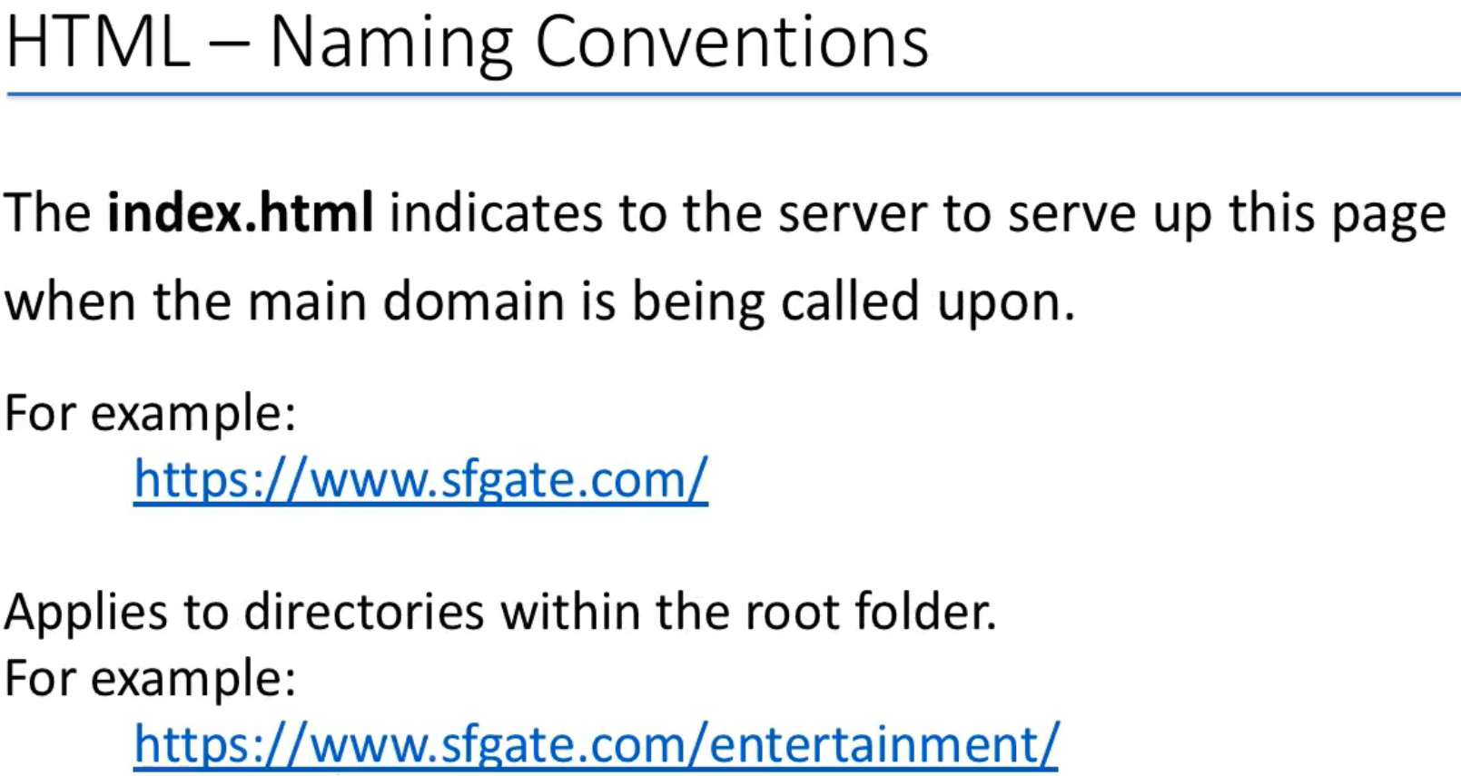
0403.1 File Name Convention Video
https://ucsc-extension.instructure.com/courses/3825/pages/1-dot-1-welcome?module_item_id=42202
0403.1 File Name Convention Video

Slide 14
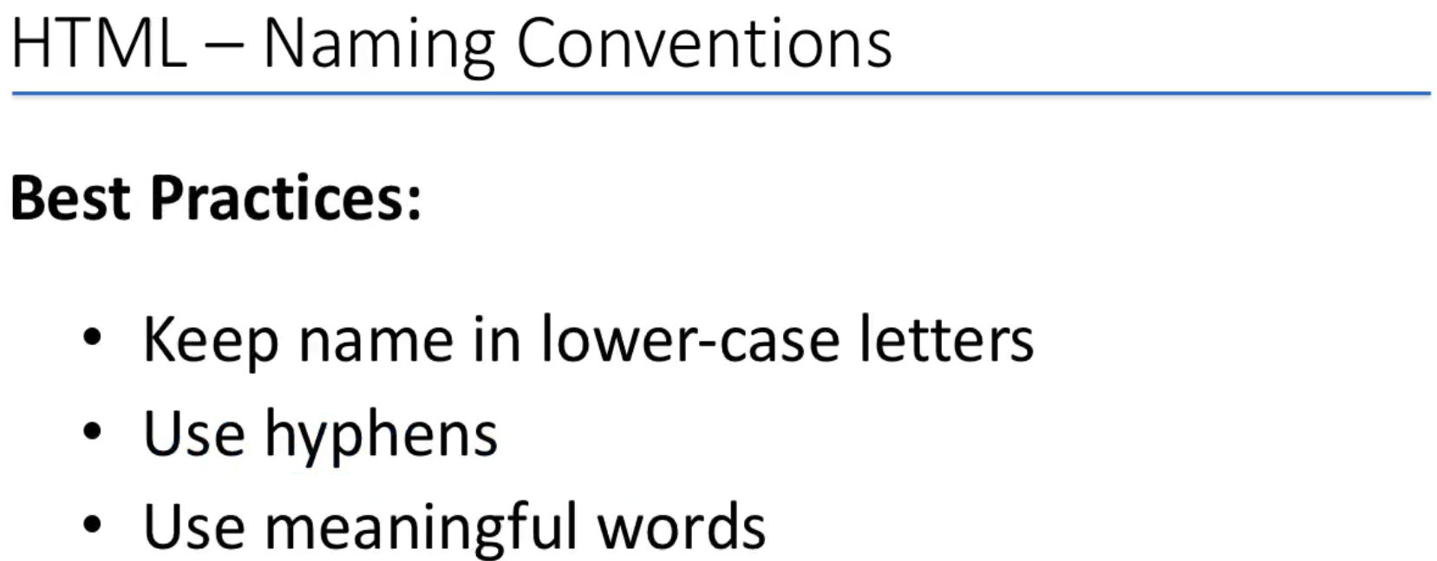
0403.1 File Name Convention Video
https://ucsc-extension.instructure.com/courses/3825/pages/1-dot-1-welcome?module_item_id=42202
0403.1 File Name Convention Video

Slide 15
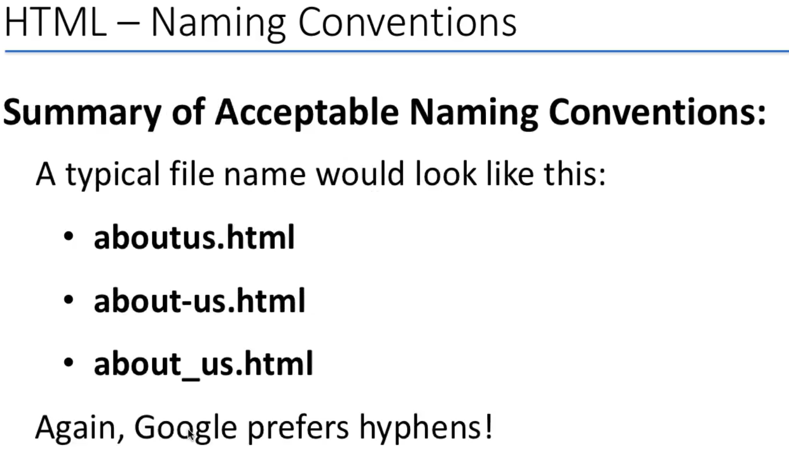
0403.1 File Name Convention Video
https://ucsc-extension.instructure.com/courses/3825/pages/1-dot-1-welcome?module_item_id=42202
0403.1 File Name Convention Video

Slide 16
End of Chapter

